Slide 1

Bang for the Buck?
Following the Money from Transportation Decisions to Outcomes
Rob Zako, Ph.D.
Notes:
Thank you Lisa and thank you to the National Institute for Transportation and Communities for making this research possible.
------
Links:
http://pppm.uoregon.edu/
http://sci.uoregon.edu/
http://nitc.trec.pdx.edu/research/project/875/

Slide 2

Pair of PIs
Rebecca Lewis, Ph.D. + Rob Zako, Ph.D.
Notes:
Today’s presentation isn’t a one-man show.
In some TV series, the woman does most the work and the man takes the bows. [Joke: This was the premise of Remington Steele]
My fellow principal investigator, Rebecca Lewis, is an assistant professor of planning, public policy & management at the University of Oregon, and is the research director for the Sustainable Cities Initiative, where I am based. [Joke: PIs = private investigators vs. principal investigators]
I, on the other hand, have no formal training in planning or transportation, but picked up what I know on the streets. [Joke: Self-deprecating reference to being street-smart / politically-savvy]
------
Footnotes:
Remington Steele (1982–1987), http://en.wikipedia.org/wiki/Remington_Steele
Laura Holt (Stephanie Zimbalist) intro voiceover: “Try this for a deep dark secret: The great detective Remington Steele... He doesn’t exist. I invented him. Follow: I’d always loved excitement, So I studied and apprenticed, and put my name on an office. But absolutely no one knocked on my door. A female private investigator seemed so… feminine. So I invented a superior. A decidedly masculine superior. Suddenly there were cases around the block. It was working like a charm. Until the day he walked in, with his blue eyes and mysterious past. And before I knew it, he assumed Remington Steele’s identity. Now I do the work, and he takes the bows. It’s a dangerous way to live, But as long as people buy it, I can get the job done. We never mix business with pleasure. Well… almost never. I don’t even know his real name!”
Image Source: https://seniorcitylocal.com/boomer-tv-trivia-remington-steele/

Slide 3
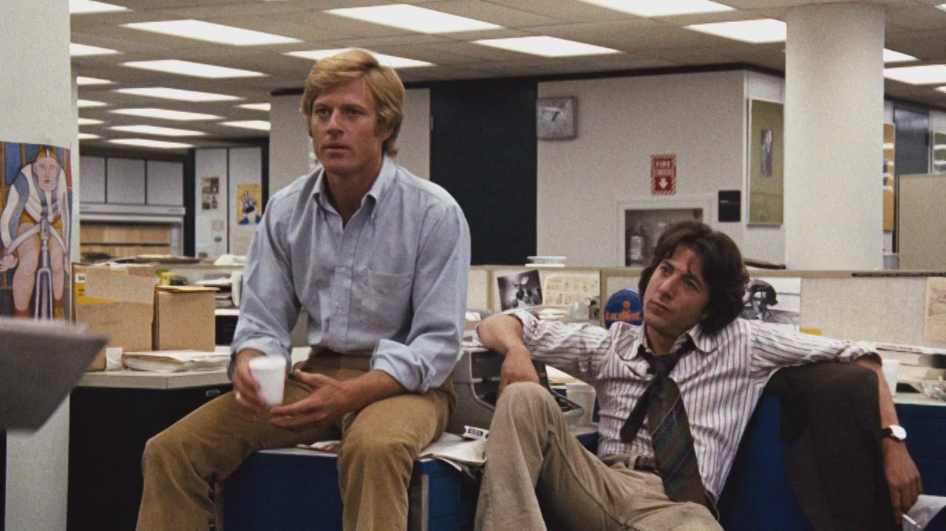
Grad Students: “Follow the Money”
Alexis Biddle, J.D., M.C.R.P. + Rory Isbell, J.D., M.C.R.P.
Notes:
Rebecca & I hired a couple hot shot investigators: graduate students Alexis Biddle & Rory Isbell, both of whom were pursuing and recently completed dual degrees in law & planning.
We asked them to help us “follow the money” from transportation decisions to outcomes. [Joke: Reference to “Deep Throat” in Watergate]
------
Footnotes:
Watergate: Bob Woodward & Carl Bernstein (1972–1974), http://en.wikipedia.org/wiki/Watergate_scandal
All the President’s Men: Robert Redford & Dustin Hoffman (1976), https://en.wikipedia.org/wiki/All_the_President's_Men_(film)
Image source: http://www.twincities.com/2016/09/30/robert-redford-walker-art-institute/

Slide 4
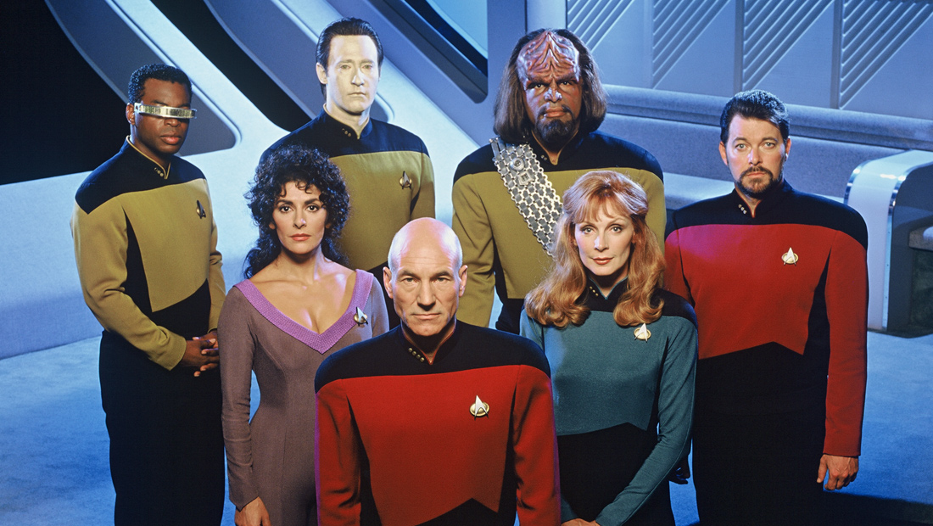


Advisors: T4A & NRDC
Notes:
We are also grateful for the advice of our partners at Transportation for America (James Corliss, Adrea Turner, Beth Osborne, Joe McAndrew, Alex Depompolo, Chris Rall) and the Natural Resources Defense Council (Deron Lovaas).
These rocket scientists have been exploring the frontiers of transportation for years, boldly going where no man—or woman—has gone before. [Joke: Rocket science & Star Trek reference]
But the ideas presented today—and any errors—are the responsibility of Rebecca and me.
------
Links:
http://t4america.org/
http://www.nrdc.org/
Footnotes:
Deron: I agree to the Star Trek slide but only if I get to be Geordi.
Beth: I claim 1/2 Data and 1/2 Riker on slide 4. Seems only appropriate considering this message is half geeky and half emotional.
Star Trek: The Next Generation (1987–1994), https://en.wikipedia.org/wiki/Star_Trek:_The_Next_Generation
Image Source: http://www.startrek.com/videos

Slide 5
Research Questions
Effectiveness (“Bang for the Buck”): How effectively are states and metropolitan planning organization (MPOs) advancing their own economic development, public health, and other livability goals with transportation investments?
Accountability & Transparency: How are states and MPOs making transportation investment decisions? How could (performance-based) decision-making processes be improved to provide better outcomes?
Notes:
Our research looked at two related sets of questions, one about outcomes and the other about process:
Our research is about effectiveness, or “bang for the buck”: How effectively are states and metropolitan planning organizations advancing their own economic development, public health, and other livability goals with transportation investments?
Our research is also about transparency, i.e., about the public seeing what decisions are made on their behalf and how these decisions are made. Ultimately, our research is about accountability, i.e., about how to make decisions better in order to deliver more value to the public.
>>> Reference to SAFETEA-LU?
------
Footnotes:
Research Title: “Effectiveness of Transportation Funding Mechanisms for Achieving National, State, and Metropolitan Economic, Health, and Other Livability Goals”
The central research question is: How effectively are economic development, public health, and other livability goals integrated into transportation funding decisions?
Framework: Which states and MPOs adopt economic development, public health, or other livability goals into transportation plans? What is the process for selecting and funding transportation projects and programs? What are the available transportation funding sources, and how is the use of these sources constrained?
Objective: To understand how national, state, and metropolitan livability goals and performance measures are incorporated into state and metropolitan transportation plans.
Objective: To understand how transportation funding decisions are made by states and MPOs.
Objective: To describe the transportation funding sources available to states and MPOs and the constraints on these sources.
Assessment: How well do states and metropolitan areas incorporate economic development, public health, and other livability goals into transportation funding decisions? What are the opportunities and constraints for integrating these goals into transportation funding decisions? What are the legal, technical, and political challenges?
Objective: To assess the linkages between economic development, public health, and other livability goals and funding decisions.
Objective: To understand how effectively, in theory and in practice, transportation funding is advancing livability goals.
Knowledge Transfer: What are the best approaches for integrating economic development, public health, and other livability goals and performance measures into the transportation funding process? How should other states and MPOs adapt the funding process to better achieve such goals?
Objective: To offer best practices for incorporating economic development, public health, and other livability goals and performance measures into funding decisions.

Slide 6

Best & Worst Practices
Notes:
Actually, we didn’t think answering our research question would be rocket science. [Joke: rocket science again]
We planned to just gather and analyze existing data on transportation investments.
----
Image Source: http://www.thedetroitbureau.com/2016/02/audi-subaru-top-annual-consumer-reports-auto-issue/

Slide 7
Methodology
Case Studies
  Considered 10 states/MPOs; studied 6 states/MPOs in detail
Document Analysis
  Organizational structures
  Constitutions & statutes
  Long-range plans & goals
  State & metropolitan transportation improvement Programs (STIPs & MTIPs); budgets
  Other reports
Stakeholder Interviews
  Contacted 6 states & 6 MPOs with follow up questions
Notes:
In more detail:
We looked at case studies.
We analyzed documents.
And we checked our understanding by interviewing stakeholders.

Slide 8
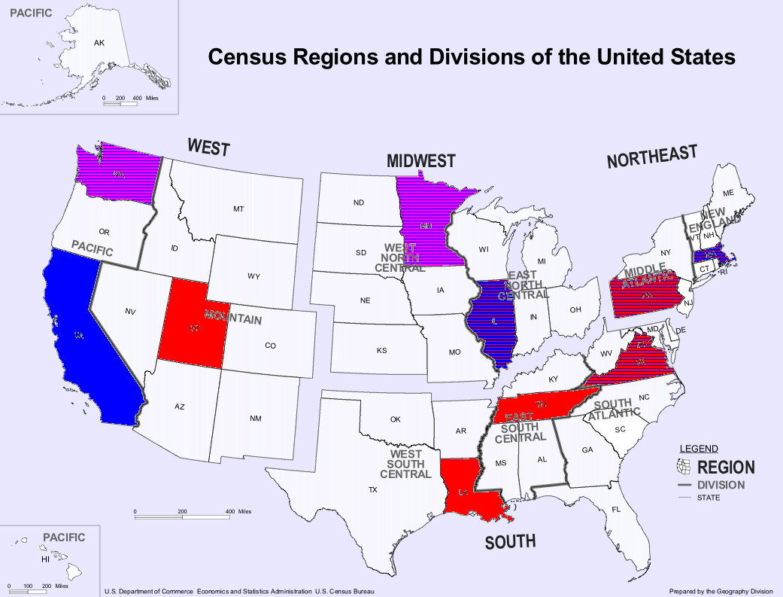
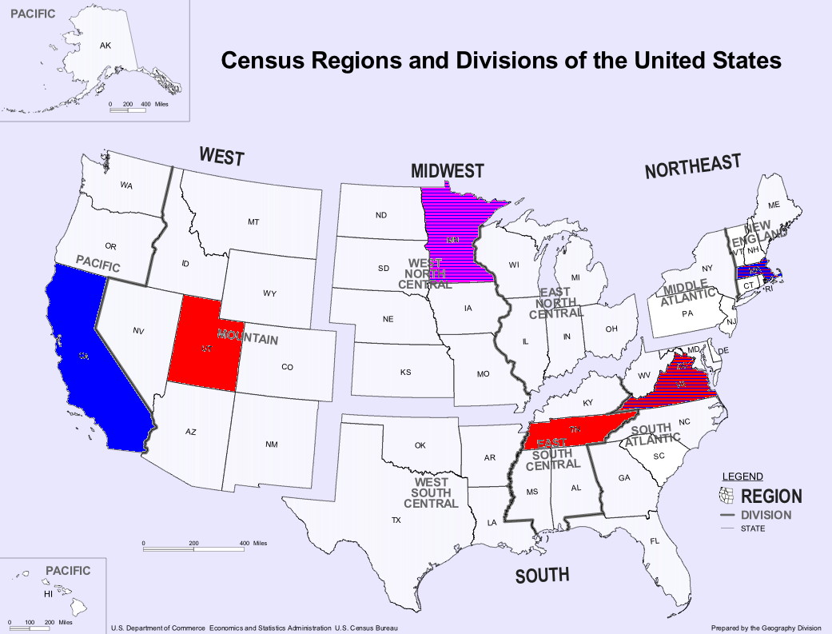
Case Studies
Notes:
Because we didn’t have the resources to look at all 50 states, we reviewed 10 potential case study states, including many that are more innovative. These included a mix of large & small, urban & rural, varying limits on use of gas taxes, red & blue.
From this tentative list of 10, we selected 6 to study in detail. In each of these states, we also selected one metropolitan planning area to study in detail. Our six case studies are:
California … and the Metropolitan Transportation Commission for the San Francisco Bay Area
Massachusetts … and the Pioneer Valley MPO for Springfield
Minnesota …and the Metropolitan Council for the Minneapolis-St. Paul twin cities
Tennessee … and the Nashville Area MPO
Utah … and the Wasatch Front Regional Council for Salt Lake City
Virginia … and the Hampton Roads TPO for the Chesapeake area

Slide 9
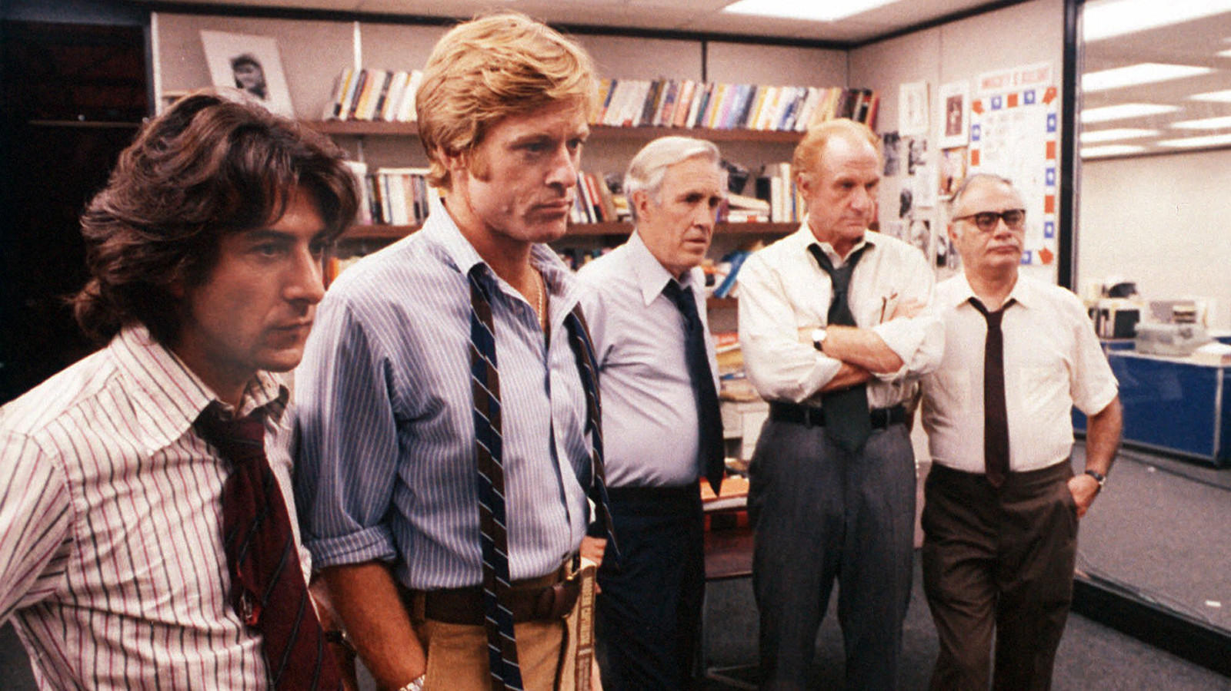

Findings
Notes:
So what did we find?
After a year of intensive research, the findings of our investigative team are contained in a soon-to-be-published 150-page report, documenting the 6 case studies in great detail.
Alas, I regret to say that we couldn’t follow the money, at least not completely. We failed to answer our primary research question about the effectiveness of transportation investments.
------
Footnotes:
Watergate: Bob Woodward & Carl Bernstein (1972–1974), http://en.wikipedia.org/wiki/Watergate_scandal
All the President’s Men: Robert Redford & Dustin Hoffman (1976), https://en.wikipedia.org/wiki/All_the_President's_Men_(film)
Image source: http://www.latimes.com/entertainment/tv/showtracker/la-et-st-0707-tvhighlights-20160707-snap-story.html
Image source: http://eightball.ie/five-reasons-why-events-fail/

Slide 10

Questions
The End.
Actually, just the beginning.
Notes:
That concludes my talk.
Any questions? [false ending]
Not really. In fact, our research hasn’t been a failure. We just had to refocus our inquiry.
So what did we really learn? [reveal]
------
Image Source: http://mlp.wikia.com/wiki/File:%22To_be_continued...%22_S02E25.png

Slide 11
Outline
Problem
Solutions
MAP-21
Conclusion
Notes:
Outline:
For the rest of my talk, after quickly walking through what we were able to learn, I will articulate the major problem we found.
Then I will outline proposed solutions.
Then I will compare and contrast our recommendations with performance management under the 2012 federal transportation reauthorization bill Moving Ahead for Progress in the 21st Century Act. Spoiler: We find that MAP-21 is a good step in the right direction—but doesn’t go far enough.
Finally I will conclude with a summary and possible next steps, and will be happy to answer your questions.
------
Source: FHWA, 2013, Performance Based Planning and Programming Guidebook, https://www.fhwa.dot.gov/planning/performance_based_planning/pbpp_guidebook/

Slide 12
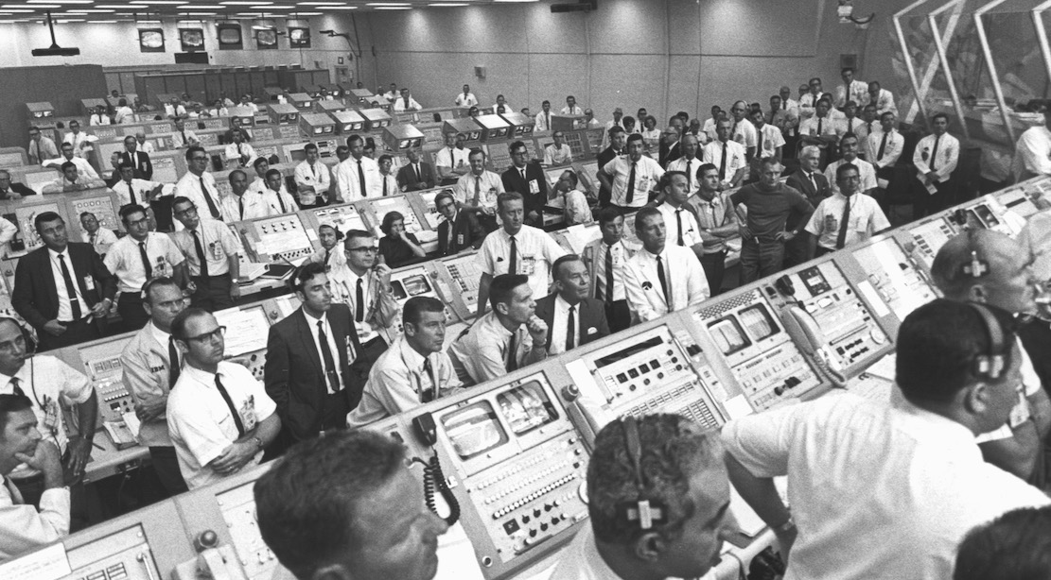
“Houston, we have a problem”
Notes:
Let’s begin with the problem we found.
A major finding is that there is a huge lack of transparency in what outcomes transportation investments deliver.
Think about it. After spending a year, a team of two PhDs and two grad students, with advice from our partners Transportation for America and Natural Resources Defense Council, and with assistance from key staff for 6 states and 6 MPOs, couldn’t determine what outcomes taxpayers were buying nor assess how cost-effectively. If even a team with the “right stuff” couldn’t determine the “bang for the buck,” how could a typical citizen hope to learn what their taxes buy? [Joke: Reference to The Right Stuff]
Note that based on our research, we believe this lack of transparency is widespread, and isn’t limited to just our case study states and MPOs. Nothing in our research is intended as criticism of their efforts, which we believe include some of the better practices around the nation.
------
Footnotes:
The Right Stuff (1983), https://en.wikipedia.org/wiki/The_Right_Stuff_(film)
Image source: https://www.nasa.gov/centers/kennedy/about/history/timeline/60s-decade.html

Slide 13
Government Transportation Expenditures
Mode | Expenditures (millions of $)
Highway | 206,251 | 64.5%
Transit | 55,150 | 17.2%
Rail | 1,752 | 0.5%
Air | 41,794 | 13.1%
Water | 13,261 | 4.1%
Pipeline | 86 | 0.0%
General Support | 1,523 | 0.5%
Total | 319,817 | 100.0%
Notes:
So let me back up to tell you in a little detail what we have learned.
We actually can follow the money—up to a point. We can tell how much taxpayer money goes to projects for different modes.
In particular, in 2012 (the last year for which good data is available from the Bureau of Transportation Statistics), federal, state and local governments spent a total of $320 billion on transportation. Almost two thirds of this total was spent on highways and other roads, bridges and tunnels. Another 17% goes to transit.
------
Caption: Federal, State and Local Government Transportation Expenditures in 2012
Source: Bureau of Transportation Statistics, 2016, Transportation Statistics Annual Report 2015, table 5-5. http://www.rita.dot.gov/bts/sites/rita.dot.gov.bts/files/publications/transportation_statistics_annual_report/2015/index.html

Slide 14
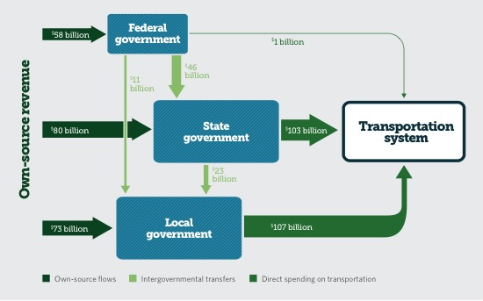
$ Flows Between Levels of Government
Notes:
At a very high level, we can track the flow of money between different levels of government. This figure from the Pew Charitable Trusts shows the flow of just surface transportation funding—highways and transit—in 2011. Note that more than half of all such spending occurs at the local level, but more than half of the funding comes from federal and state sources.
------
Caption: Surface Transportation Funding Flows Among Levels of Government: Spending on highways and transit, 2011
Source: Pew Charitable Trusts, 2014, Intergovernmental Challenges in Surface Transportation Funding, figure 3, http://www.pewtrusts.org/en/research-and-analysis/reports/2014/09/intergovernmental-challenges-in-surface-transportation-funding
Image Source: http://www.pewtrusts.org/~/media/assets/2014/09/intergovernmentalchallengestransportationdvs.pdf

Slide 15
$ Flows in Massachusetts
Notes:
One of our case studies, Massachusetts, has been doing a lot of things well. In 2009 they created MassDOT, for the first time consolidating all state transportation responsibilities under one agency. In 2014, they adopted their first multi-modal statewide transportation plan. They are renewing their focus on customer service and understanding what the public wants. They are establishing a culture of accountability & transparency. And they have adopted a series of sustainability initiatives collectively known as GreenDOT.
This figure shows the flow of just state transportation funds in Massachusetts. A graphic including federal and local funds would include even more boxes and arrows.
I won’t discuss these flows in detail, but will merely note the complexity. The corresponding graphics for other states are similarly complex.
------
Caption: Massachusetts Transportation Funding Flow Chart, FTY 2015
Source: Phineas Baxandall, 2017, “What Does Massachusetts Transportation Funding Support and What Are the Revenue Sources,” http://www.massbudget.org/report_window.php?loc=What-Does-MA-Transportation-Funding-Support.html
Source: MassDOT, 2014, weMove Massachusetts: Planning for Performance, p. 3, https://www.massdot.state.ma.us/wemove/
Source: http://www.massdot.state.ma.us/planning/Main/SustainableTransportation.aspx
Source:

Slide 16
$ Flows in Massachusetts
Mass. Gen. Laws ch. 29, § 2ZZZ
(a) There shall be established and set up on the books of the commonwealth a separate fund to be known as the Commonwealth Transportation Fund, which shall be used exclusively for financing transportation-related purposes. …
(c) In addition to those revenues credited to the fund under subsection (a) there shall be credited to the fund all monies received by the commonwealth from the receipts from sales of motor vehicles under sections 3, 25 and 26 of chapter 64H and all monies received by the commonwealth on the sales price of purchases of motor vehicles under sections 4, 26 and 27 of chapter 64I, from the taxes imposed under said chapters 64H and 64I as excises upon the sale and use at retail of motor vehicles and upon the storage, use or other consumption of motor vehicles, including interest thereon or penalties; provided however, such amount shall not include any portion of the taxes that constitute special receipts within the meaning of subsection (b1/2) of section 10 of chapter 152 of the acts of 1997. The amount credited to the fund under this subsection shall be net of the dedicated sales tax revenue amount transferred to the Massachusetts Bay Transportation Authority State and Local Contribution Fund under section 35T of chapter 10 and to the School Modernization and Reconstruction Trust Fund under section 35BB of said chapter 10.
(d) Not less than the following amounts shall annually be distributed from the fund to the Massachusetts Bay Transportation Authority and regional transit authorities:
(1) $160,000,000 to the Massachusetts Bay Transportation Authority or any fund controlled by the authority in each fiscal year; and
(2) $15,000,000 to regional transit authorities organized under chapter 161B or predecessor statutes in each fiscal year. …
Notes:
Many of the funding flows are the result of state statutes or budget bills, i.e., transportation investment decisions. In many cases, we tracked down the laws directing the flows of funds.
For example, Massachusetts has set up the Commonwealth Transportation Fund to hold transportation revenues from various sources, such as dedicated sales taxes. Here we see that, by statute, at least $160 million per year is transferred to the Massachusetts Bay Transportation Authority and an additional $15 million to other regional transit authorities.
A decision to direct funding to highways, local streets, transit, or some other particular purpose is a decision—even if not one that specifies exactly which projects get funded. To a significant extent, constraints on how funding can be used determine what projects are or are not funded.
We do not question the wisdom of Massachusetts in allocating such funding to MBTA and regional transit authorities.
But to assess the effectiveness of such decisions, we did look to see what outcomes Massachusett’s legislature wanted to see from these investments.
Alas, we could not find documentation of either the specific goals for such funding allocations nor the outcomes achieved.
------
Source: https://malegislature.gov/Laws/GeneralLaws/PartI/TitleIII/Chapter29/Section2ZZZ

Slide 17
$ Flows in California
Notes:
In much more detail, statewide transportation improvement programs (STIPs) and metropolitan transportation improvement programs (MTIPs) list all projects receiving federal or state funding, or that are regionally significant. Such documents are typically hundreds or even thousands of pages long.
California is another innovative state. Their Senate Bill 375, although focused on reducing greenhouse gas emissions linked to climate change, requires all MPOs to undertake scenario planning that integrates transportation and land use decisions at the metropolitan level.
Shown here is a random example from California’s Interregional Transportation Improvement Program (ITIP). It appears to support freight movement, increased safety, sustainability, and the reduction of greenhouse gas emissions.
Again, I want to emphasize that we believe our case study states and MPOs are among the more innovative ones around the nation. Nothing I say is intended as criticism of their efforts. Our interest is in understanding how transportation decisions are made—and what we can learn from these case studies about better processes for making decisions.
But although we could track the flow of money to projects, in general, we did not find comprehensive information tracking the outcomes these projects produced, either individually or in aggregate.
------
Source: Caltrans, 2016, Revised 2016 Interregional Transportation Improvement Program (ITIP), p. 13, http://www.dot.ca.gov/hq/transprog/ocip.htm, http://www.dot.ca.gov/hq/transprog/ocip/final_2016_itip/revised_2016_itip.pdf
Source: https://www.arb.ca.gov/cc/sb375/sb375.htm, http://www.ca-ilg.org/post/basics-sb-375

Slide 18

It’s Complicated
Notes:
We also looked at goals, long-range transportation plans, budgets, statutes, and various reports. Again, details of our case studies will be summarized in our forthcoming 150-page report.
But in brief, we learned that following the flow of money is complicated, in some cases requiring herculean efforts to even get partway. And our research was blocked when we tried to follow the flows all the way to outcomes.
We are reminded of the difficulties Bob Woodward & Carl Bernstein had trying to “follow the money” in the case of Watergate. Perhaps we need to call in some plumbers? [Joke: Watergate, plumbers & blocked plumbing]
------
Image Source: http://www.surrealplaces.com/various/plumber.jpg

Slide 19
What the Public Sees
Government
?????
Gas Tax $
Highways
License Fee $
Transit
Fare $
Bike / Ped
Sales Tax $
Airports
Income Tax $
Marine
Notes:
As the saying goes, the devil is in the details. But the public doesn’t care so much about the details, about the intricacies of the plumbing. [Joke: Watergate, plumbing]
They care less about the internal operations of government, which they see as a “gray box.” Yes, they see their is money being spent, for example, whenever stuck in traffic due to a construction project. But they don’t necessarily understand to what extent that project improves their lives, businesses, or other things of value.

Slide 20
What the Public REALLY Sees
$
?
Notes:
In brief, the public sees money taken from them … but is unclear what they get in return.
The failure to be able to see what outcomes transportation investments produce is the fundamental problem our research hit upon.

Slide 21
Problem: Lack of Transparency
Accountability: Delivering desired results
  “The continuous effort to use public dollars in the most efficient and cost-effective way” —Wisconsin DOT
  “Demonstrating wise stewardship of public funds or generating a positive return on investment” —T4America
Transparency: In an understood manner
  “In a free society, transparency is government’s obligation to share information with citizens. It is at the heart of how citizens hold their public officials accountable.”
  —Sunshine Review
  “Broadly understood and accepted decision-making process” —T4America
Notes:
So that we are all speaking the same language, I want to define “accountability” and “transparency.”
“Accountability” is about outcomes…
“Transparency” is about process…
What we found is a significant lack of transparency, i.e., a significant inability to understand what outcomes taxpayer monies buys.
It is possible that in many cases transportation investments are actually delivering value—that governments are actually accountable and meeting public expectations.
But if transparency is at the heart of how citizens hold governments accountable, it is hard to see how we could have accountability without transparency.
------
Quote Source: http://wisconsindot.gov/Pages/about-wisdot/performance/mapss/goalaccountability.aspx
Quote Source: Transportation for America, 2015, Measuring What We Value: Setting Priorities and Evaluating Success in Transportation, p.9, http://t4america.org/maps-tools/performance-measures-report/
Quote Source: http://www.baynews9.com/content/news/baynews9/news/article.html/content/news/articles/bn9/2012/3/6/_polk_county_public_.html, https://ballotpedia.org/Transparency_checklist
Quote Source: Transportation for America, 2015, Measuring What We Value: Setting Priorities and Evaluating Success in Transportation, p.9, http://t4america.org/maps-tools/performance-measures-report/

Slide 22
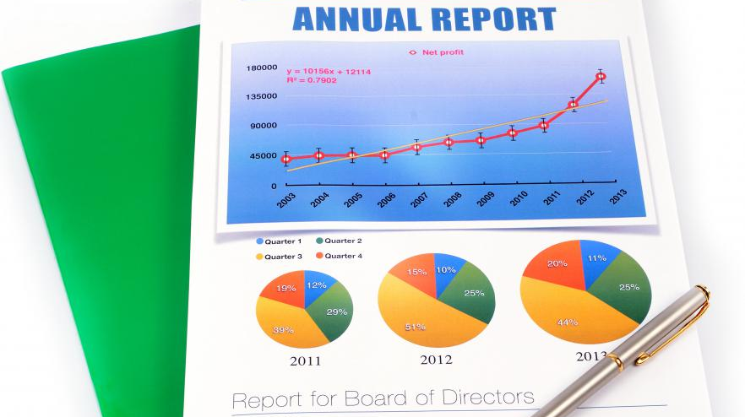
Need: Report Outcomes to Taxpayers
Notes:
What we think is ultimately needed is something akin to an annual report to shareholders on what investments were made with their taxes, how these decisions were made, and most importantly what outcomes these investments produced.
------
Image Source: http://www.wisegeek.com/what-are-the-different-types-of-shareholder-benefits.htm

Slide 23
Solutions: Outcomes-Based Decision-Making
A proposed 4-phase approach
Planning
  Set real-world goals that matter
  Determine actions to achieve outcomes
Funding
  Levy taxes to raise needed revenues
  Empower well-positioned decision-makers
Programming
  Invest in effective projects
Evaluating
  Monitor outcomes on the ground
  Report returns on investments to taxpayers
  Adjust expectations in light of experience
Notes:
So let’s talk move to solutions.
A few spoilers:
First, what follows are preliminary recommendations based on our research. We don’t pretend to have all the answers, and welcome your feedback and suggestions.
Second, much of what follows will sound familiar, even just plain common sense. This isn’t rocket science. [Joke: rocket science]
But we have tried to organize a bunch of familiar ideas into a simple and complete framework for transportation decision-making.
Third, taken together, what we propose would represent a significant reform of transportation decision-making in America, boldly going beyond that established by MAP-21 or practiced by any single state or MPO today. [Joke: another Star Trek reference]
To identify some possible solutions, let’s work backwards from the results we want to see—transparency—to what needs to happen to get there.
0. We propose a simple 4-phase approach to transportation decision-making, with each phase including a few steps:
4. Evaluating: In order to be able to report outcomes and returns on investment, outcomes need to be monitored—on the ground.
3. Programming: Of course, someone needs to decide what investments to make, and these should be effective projects that deliver the most “bang for the buck.”
2. Funding: To make investments, there needs to be funding. And those delegated to invest that funding need to be well-positioned and empowered to select the most effective projects.
1. Planning: Finally, as transportation decision-making involves many factors, there needs to be a plan of what goals are to be achieved and how to achieve them.
Note that we refer to this approach as “outcomes-based” rather than “performance-based” decision-making. As indicated before, our approach isn’t entirely new. It is mostly just common sense. But as we will see shortly, the performance-based approach called for by MAP-21 goes only partway to what is needed.

Slide 24
Benefits of Outcomes-Based Approach
Transparency: Maintaining taxpayer confidence
Accountability: Delivering value to the public
Bang for the Buck: More value on the ground
Resolve Conflicts: Amongst and between transportation and other policies
Additional Funding: Make case to taxpayers
Notes:
An outcomes-based approach provide many benefits:
Transparency: We have already seen that transparency is necessary for accountability.
Accountability: And accountability is about delivering value, i.e., effectiveness.
Bang for the Buck: Indeed, by focusing on outcomes, it is possible to stretch limited taxpayer dollars further, to provide more value.
Resolve Conflicts: As you know and we will discuss, running a transportation agency is decidedly not like running a business. Private companies typical focus on just a single bottom line: profit to shareholders. But a public agency must serve many interests and work to advance different policies, which are sometimes in conflict with each other. Focusing on outcomes doesn’t eliminate such conflicts, but it can help to resolve them by establishing priorities.
Additional Funding: Finally, if taxpayers know their dollars are buying outcomes they care about, they are more likely to support continuing or even increased funding levels.

Slide 25
Four Phases in a Cycle
Planning
Evaluating
Funding
Programming
Notes:
The 4 phases can be viewed as a cycle, with evaluating feeding back to the next cycle of planning, funding and programming.
Also note that the phases and steps within phases are not necessarily performed in the indicated sequence. What we call “outcomes-based decision-making” is a conceptual framework intended to highlight the different key decisions in making investments in transportation.

Slide 26


Physics Analogy: Adiabatic Expansion
Notes:
Again, this isn’t rocket science … or even physics. [Joke: Reference to my background as a mathematician & theoretical physicist]
But speaking of physics, let’s look for a moment at “adiabatic expansion.” Don’t worry: You’ll see my point shortly.
A physicist has a piston containing some air. She slowly expands the piston. You have probably already experienced this phenomenon: If you let the air out of a balloon or a car tire quickly and feel how the escaping air is colder than its surroundings, that is adiabatic expansion.
(As an aside, note that much of the math used in transportation modeling is adapted from thermodynamics, with gas molecules being replaced by vehicles. The gravity model used to estimate trip distribution is taken from what physicists call the Boltzmann equation.)
------
Video Source: Alexander C, 2009, https://www.youtube.com/watch?v=dQeCEqkE9eE
Reference: https://en.wikipedia.org/wiki/Trip_distribution#Gravity_model

Slide 27
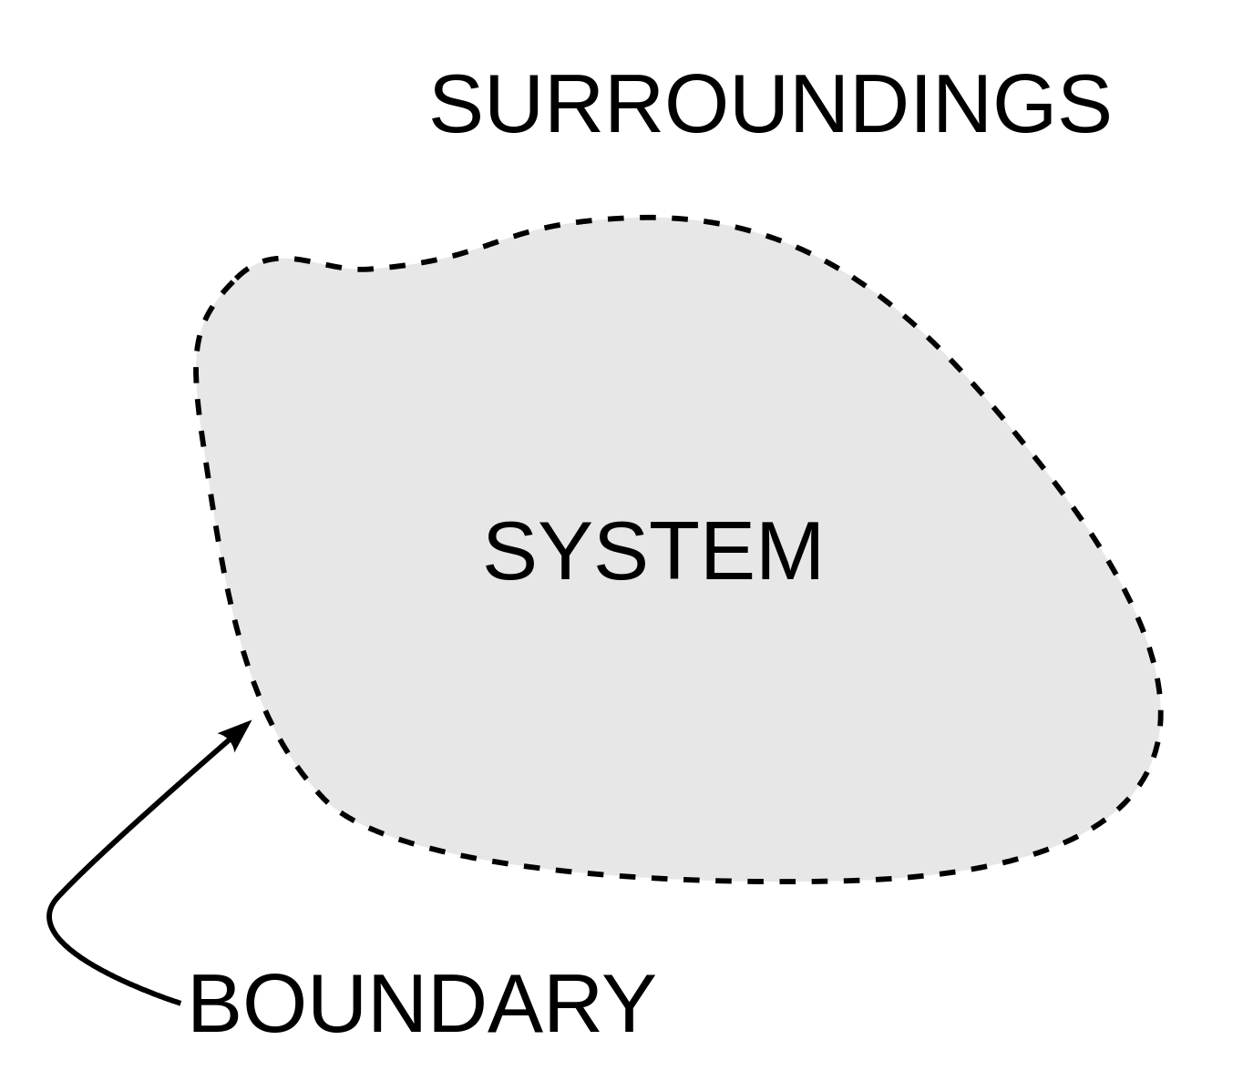
What Counts as “Transportation”?
Health
Air Quality
Water Quality
Communities
Equity
Residences
Businesses
Industries
Schools
Parks
Transportation
Prices
Income
Demographics
Notes:
It is important to understand the lesson from this physics analogy.
The physicist’s goal is to cool the air in the piston. To do so, she decides to expand the piston. [Joke: explicit reference to a woman in a field dominated by male engineers]
But to be effective, i.e., to achieve the desired outcome, it is critical for the piston be well insulated. If it had leaks, then all expanding the piston would do would be to suck in more warm air, frustrating our physicist in her efforts to lower the temperature.
In thermodynamics, an isolated system is one that doesn’t interact with its surroundings. The concept is crucial. To effectively manage a system, you need to control all parts of the system, not just a subset.
As you have surely guessed, the analogy is apt: Expanding a piston to cool it is a lot like expanding a highway to reduce congestion. So let’s return to transportation…
Consider a transportation system, for example, a highway. A highway is not an isolated system: Cars and trucks enter and leave the highway all the time. Indeed, the whole point of a highway is to serve origins and destinations located outside the highway’s right-of-way.
Thus a transportation system interacts with trip generators: residences, businesses, industries, schools and parks. A physicist would understand these are part of the whole system, and would seek to affect these as part of managing the entire system. For example, siting a new community college on the edge of town where land is cheap but there is currently no transit service will generate a lot of new traffic, and hence is a transportation decision.
The transportation system is also is influenced by socio-economic factors. How many people are there? What are their ages and abilities? How much do they earn? What are the prices of different transportation options? People and business make individual choices in response to the economics of their options. For example, some governments have decided to keep gas taxes relatively low. Instead, they tax sales, income, property, and so on to fund transportation. But such decisions keep the marginal costs of driving lower, hence increase demand. So such pricing is also a transportation decision.
And as you know, transportation systems have various kinds of environmental impacts. Indeed, under the National Environmental Policy Act (NEPA), federally funded projects are required to broadly assess environmental impacts.
But the point of the analogy with an air piston is not about the need to assess external impacts. The point is that those so-called external factors are actually part of the system of interest, not only affected by but also affecting. Unless one could isolate, for example, a highway so that vehicles never enter or leave, then for transportation decisions to be effective, they need to account for those factors that interact with the highway. In brief, to be effective you need to look beyond what is traditionally considered to be the transportation system.
------
Image source: https://en.wikipedia.org/wiki/Thermodynamic_system

Slide 28
1. Planning – Set Goals
Set real-world goals that matter
Identify Goals: Learn what the public wants
Consider the “Three P’s / E’s”: Think beyond traditional goals to prosperity, people & planet, i.e., economy, (social) equity & environment
Set Priorities: Especially when goals conflict
  Example: Is mobility or safety more important?
Quantify Performance: Establish objectives, measures & targets
Notes:
Now let’s walk through the 4 phases of outcomes-based decision-making in more detail. We begin with the first phase: planning.
A key step is to set real-world goals that matter.
Identify Goals: These should reflect what the public wants.
Consider the “Three P’s / E’s”: The term “triple bottom line” was first coined in 1994 by John Elkington, who argued that organizations should pursue three different bottom lines: The first is the traditional bottom line of profit (or prosperity). The second is a measure of how socially responsible an organization is to people. The third is a measure of how environmentally responsible an organization is to the planet. The triple bottom line thus consists of the three Ps: prosperity, people and planet, or alternatively the three E’s of economy, (social) equity & environment. Here our recommendation is merely that a reasonable set of goals should include elements from each of these three areas. [Source: http://www.economist.com/node/14301663]
Set Priorities: Although it is necessary for public entities to pursue multiple goals to serve multiple interests, it isn’t always possible to do so. For example, higher speeds might support freight mobility while lower speeds might support safety. It is essential to set priorities in order to know what outcomes are most important and how to best invest limited funding.
Quantify Performance: Broad goals should be quantified as performance measures & targets.

Slide 29
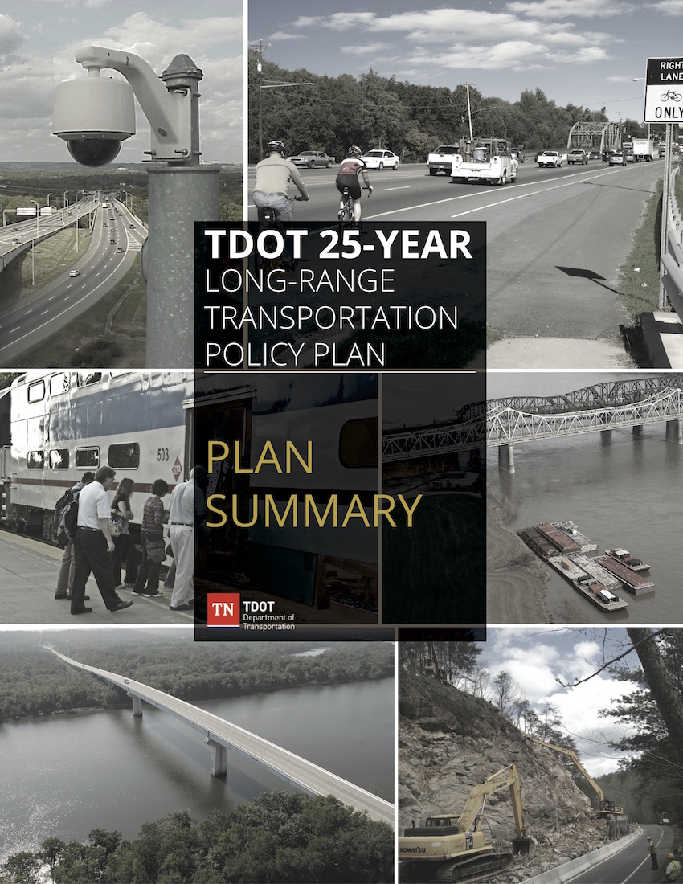
Tennessee: LRTP Guiding Principles
Preserve & manage the existing system
Support the state’s economy
Maximize safety and security
Provide for the efficient movement of people & freight
Build partnerships for sustainable & livable communities
Protect natural, cultural & environmental resources
Emphasize financial responsibility
Notes:
For example, Tennessee’s 25-Year Long Range Transportation Policy Plan sets out these 7 guiding principles.
These principals focus on things that matter: the economy, moving people, moving freight, sustainable & livable communities, the environment, and cost-effectiveness.
Although Tennessee might not use the term, these goals reflect the “Three P’s / E’s.”
------
Footnotes:
The Guiding Principles represent seven interrelated value statements that express the major priorities of TDOT and provide tangible actions as the Department works towards their vision. The 25-Year Long-Range Transportation Policy Plan is formed using a framework of Policy Papers to review and discuss key policy topics relevant to TDOT’s vision and Guiding Principles. Through this process, each Guiding Principle is supported by a number of initiatives and policies spanning important policy paper topics.
Preserve and Manage the Existing System: Protect existing assets and maintain efficiency of the system through cost-effective management and new technologies.
Support the State’s Economy: Make transportation investments that support economic growth, competitiveness and tourism; build partnerships with communities and regions to link employment, commercial/retail areas and other key activity centers.
Maximize Safety and Security: Reduce injuries and fatalities in all modes of transportation; minimize construction-related safety incidents; improve disaster preparedness and incident response.
Provide for the Efficient Movement of People and Freight: Optimize the movement of people and goods by providing greater access to transportation services for all people and by building better connections among different modes of transportation.
Build Partnerships for Sustainable and Livable Communities: Provide early and ongoing opportunities for broad public input on plans and programs; work closely with local public and private planning efforts; coordinate land use and transportation planning.
Protect Natural, Cultural, and Environmental Resources: Maintain the integrity of communities and historical sites; minimize impacts on natural resources and conserve energy.
Emphasize Financial Responsibility: Provide accountability; maximize Tennessee’s share of federal transportation funding; develop alternative funding strategies; select projects based on identified regional needs; allow flexibility in local management of projects where feasible.
Source: TDOT, 2015, TDOT 25-Year Long-Range Transportation Policy Plan: Plan Summary, p. 11, https://www.tn.gov/tdot/section/25-year-transportation-plan, https://tn.gov/assets/entities/tdot/attachments/TDOT_LRTP_Summary_Final.pdf

Slide 30
1. Planning – Determine Actions
Determine actions to achieve outcomes
Identify Actions: Consider a broad range of potential actions that affect the goals of interest
Develop Scenarios: Determine a package of actions to achieve outcomes cost-effectively
Plan for Uncertainty: As not all factors can be controlled and models are imperfect, plan for imperfect predictions
Notes:
The next planning step is to determine actions to achieve desired outcomes—cost-effectively.
Identify Actions: Planning is about identifying actions to achieve desired outcomes.
Develop Scenarios: To explore what is possible—and at what cost—it make sense to develop a variety of scenarios.
Plan for Uncertainty: Alas, transportation here on earth isn’t rocket science. One can land a man on the moon with pinpoint precision, but can’t always predict future traffic. Because key variables are outside of control—for example, whether the economy booms or busts—models predicting the future are necessarily imperfect. The key is to accept such uncertainty, planning for actions that make sense in a variety of scenarios.

Slide 31
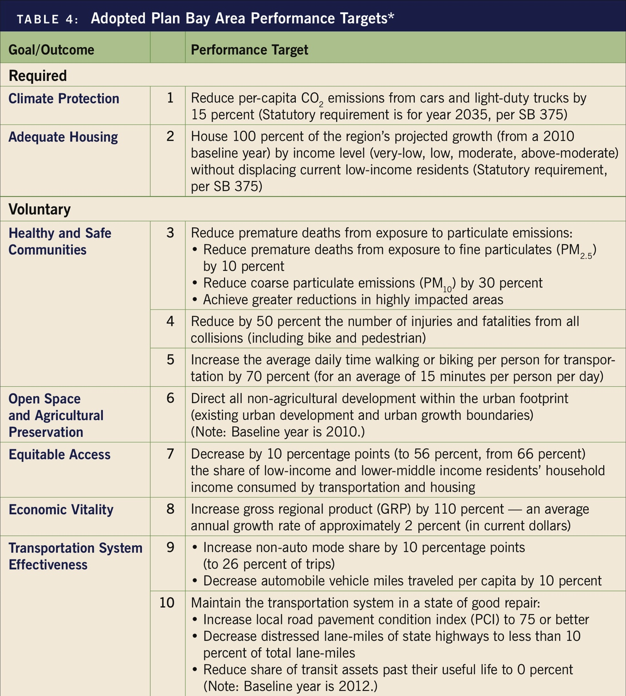
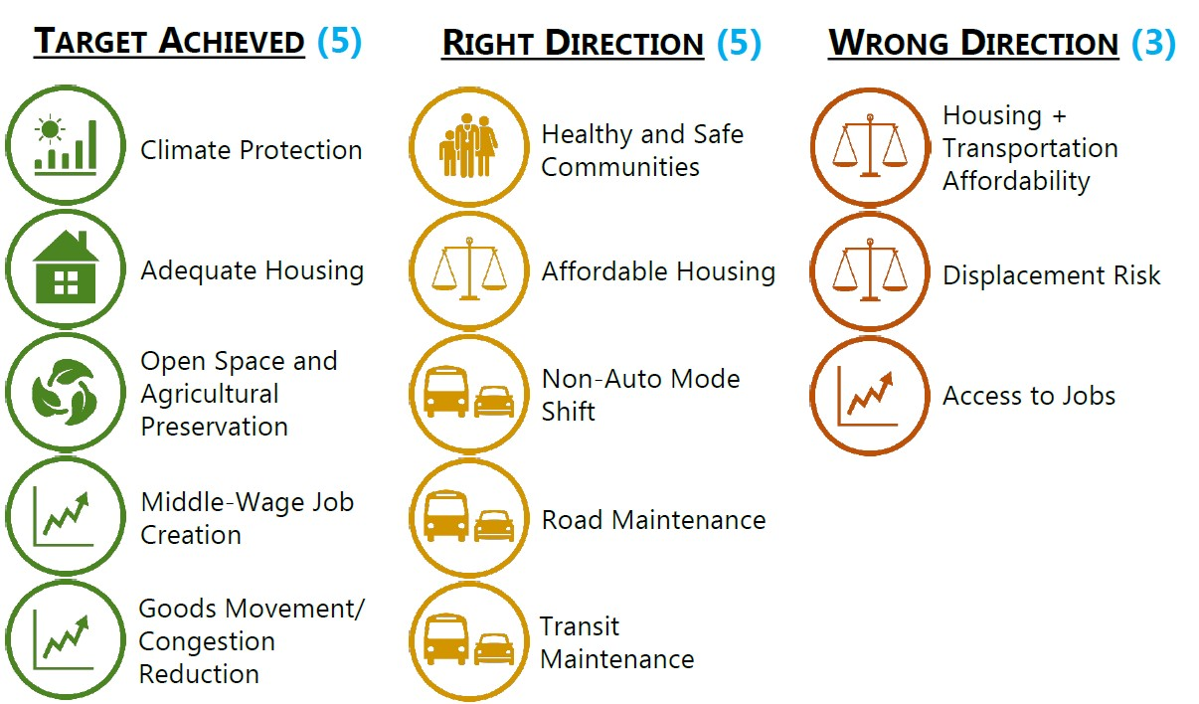
San Francisco: Plan Bay Area
Goals & Targets
Projected Outcomes
Notes:
For example, California’s Senate Bill 375 requires MPOs to do “blueprint planning”—scenario planning—to create a Sustainable Communities Strategy to achieve, among other goals, a reduction in greenhouse gas emissions. Such planning looks at both transportation and land use.
San Francisco’s Plan Bay Area includes 10 goals and 13 performance targets.
The recently adopted final preferred scenario is projected to achieve some performance targets but not others.
------
Source: http://mtc.ca.gov/tools-and-resources/digital-library/plan-bay-area-chapter-1-setting-our-sights
Source: http://mtc.ca.gov/whats-happening/news/special-features/performance

Slide 32
2. Funding – Levy Taxes
Levy taxes to raise needed revenues
Secure Revenues: Levy taxes & fees to fund transportation actions
Be Accountable: Needed to maintain taxpayer support
Price Efficiently: Taxes & fees aren’t merely sources of revenue, but also actions that create incentives & disincentives that impact the transportation system
Notes:
The second phase is funding.
A key step is to levy taxes & fees to raise needed revenues:
Secure Revenues: You can’t invest in transportation without funding.
Be Accountable: But to maintain taxpayer support, it is essential to be accountable to taxpayers.
Price Efficiently: Lastly, as already noted, imposing taxes & fees affects the relative prices of different transportation options, hence affecting the choices of people and businesses. It makes sense to set prices efficiently as a way to manage the transportation system.

Slide 33
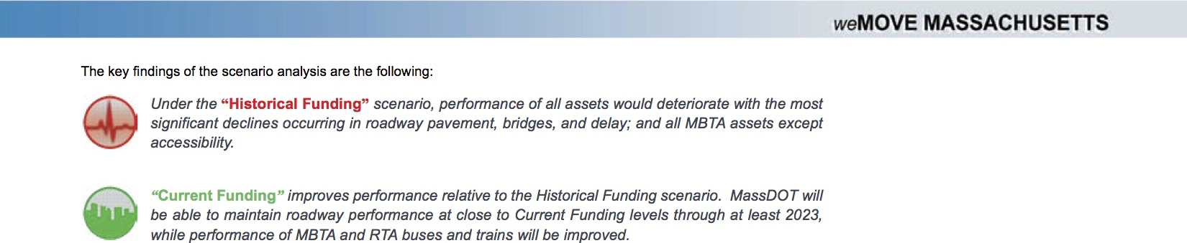
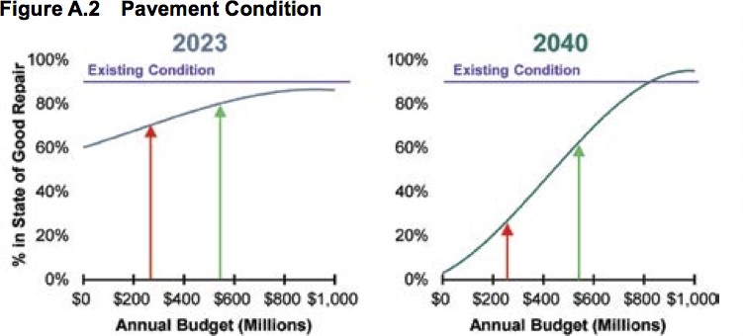
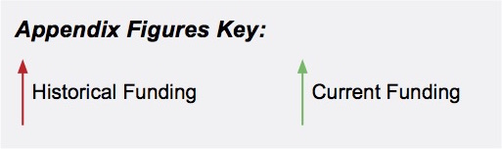
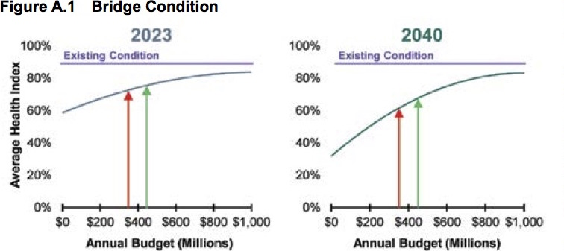
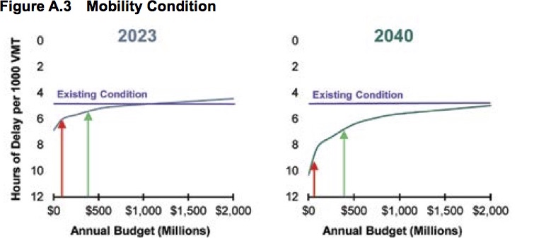
weMove Massachusetts
Notes:
Our four phases are not necessarily distinct.
For example, weMove Massachusetts: Planning for Performance is a long-range transportation plan adopted in 2014.
But the main purpose of the plan was to test different funding levels as part of an effort to increase revenues.
Massachusetts is making a case for which kinds of investments provide what sort of outcomes at what cost.
------
Source: MassDOT, 2014, weMove Massachusetts: Planning for Performance, pp. 29, 34, 35, https://www.massdot.state.ma.us/wemove/

Slide 34
2. Funding – Empower
Empower well-positioned decision-makers
Allocate: Provide funding to decision-makers with sufficient breadth of responsibility and familiarity with issues
Give Flexibility / Eliminate Constraints: Decision-makers need sufficient flexibility—lack of constraints—to fund the most effective actions
Hold Accountable: Hold decision-makers accountable for achieving outcomes
Notes:
The next funding step is to empower well-positioned decision-makers.
Allocate: As noted before, but more than half of all surface transportation funding comes from federal and state sources but more than half is spent at the local level. When allocating funding, it is better to do so to decision-makers at a high enough level that they see and are responsible for a range of interconnected issues, and thus in a position to make the most effective investments. But it is also key that such decision-makers be close enough to issues to be familiar with the impacts.
Give Flexibility / Eliminate Constraints: Constraining the use of funds, whether by jurisdiction or mode, makes it hard to invest in the most cost-effective projects.
Hold Accountable: But if decision-makers are given flexibility in how they invest funding, they also need to be held accountable for delivering outcomes.

Slide 35
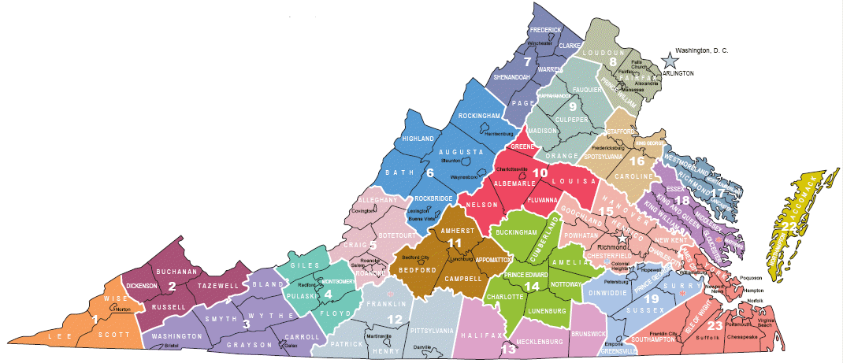
Appropriate Decision-Makers?
“Transportation decision making in Virginia suffers from an inability to marshal the resources and the authority to make transportation funding and investment decisions that both offer the appropriate nexus of decision making and provide an appropriate level of funding to address regional transportation challenges.” —Office of Intermodal Planning and Investment, 2009
Notes:
As we will see in a moment, Virginia is doing great work embracing an outcomes-based approach.
But like many parts of the country, Virginia is constrained by governmental structures not so suited to making effective transportation investments.
Part of the VTrans 2035 long-range planning effort offered this self-assessment: “Transportation decision making in Virginia suffers from an inability to marshal the resources and the authority to make transportation funding and investment decisions that both offer the appropriate nexus of decision making and provide an appropriate level of funding to address regional transportation challenges.”
Virginia is referring, in part, to MPOs having transportation decision-making authority but cities and counties having land use authority, and how it is thus difficult to coordinate the two kinds of decisions.
------
Source: Office of Intermodal Planning and Investment, prepared by Cambridge Systematics, 2009, VTrans 2035: Regional and Local Decision Making, p. 1, http://www.vtrans.org/resources/vtrans2035_regional_and_local_cs_final.pdf
Image Source: https://swvahealthauthority.net/

Slide 36
Constitutional & Statutory Constraints
Notes:
“Nearly every state has laws that restrict the use of state fuel taxes and other revenues to transportation purposes. These laws can take the form of limiting the use of the revenues themselves (for example, by requiring all fuel tax proceeds to be used for certain transportation purposes) or restricting use of the funds and accounts into which the revenues are deposited (for example, by creating a trust fund into which fuel taxes are placed, and prohibiting use of the fund for any purpose other than transportation).”
On the one hand, such restrictions can ensure that revenues go to the intended purposes and reassure taxpayers.
On the other hand, constraints that are too restrictive can prevent making the most cost-effective investments.
------
Source: American Association of State Highway and Transportation Officials, 2016, Transportation Governance & Finance: A 50-State Review of State Legislatures and Departments of Transportation, 2nd ed., http://www.aashtojournal.org/Pages/12091650state.aspx, http://www.financingtransportation.org/pdf/50_state_review_nov16.pdf

Slide 37
3. Programming
Invest in effective projects
Fund What’s Planned: Ideally, the most effective projects are already planned, making programming a lesser exercise in timing
Think Multi-Modal / Jurisdictional: Fund the most effective projects, regardless of mode or jurisdiction
Assess Benefits & Costs: Review not only benefits but also costs—“bang for the buck”
Notes:
The third phase is programming.
The aim is to invest in effective projects:
Fund What’s Planned: If there is already strong plan to invest in the most effective projects that deliver the most value, then programming should be a lesser exercise in timing. Alas, it many cases plans are weak, and programming can become an exercise in setting priorities and making decisions that existing plans failed to do so adequately.
Think Multi-Modal / Jurisdictional: In order to fund the most effective projects, it is necessary to consider those for different modes and jurisdictions to identify those delivering the most value.
Assess Benefits & Costs: Lastly, too often transportation investment decisions focus on benefits without regard to costs. For example, there is a congestion or safety problem. This becomes termed a “need.” Engineers design a solution to the problem, sometimes without much regard to cost. Then politicians try to secure funding to meet this need. But in a world of severely limited resources, it is essential to weigh benefits against costs, aiming to pursue only those delivering the most value.

Slide 38
Virginia: SMART SCALE Measures
Factor Area | Measure
Safety | S.1 Number of Fatal and Injury Crashes (50%)
 | S.2 Rate of Fatal and Injury Crashes (50%)
Congestion Mitigation | C.1 Person Throughput (50%)
 | C.2 Person Hours of Delay (50%)
Accessibility | A.1 Access to Jobs (60%)
 | A.2 Access to Jobs for Disadvantaged Persons (20%)
 | A.3 Access to Multimodal Choices (20%)
Environmental Quality | E.1 Air Quality and Environmental Effect (50%)
 | E.2 Impact to Natural and Cultural Resources (50%)
Economic Development | ED.1 Project Support for Economic Development (60%)
 | ED.2 Intermodal Access and Efficiency (20%)
 | ED.3 Travel Time Reliability (20%)
Land Use* | L.1 Transportation-Efficient Land Use (100%)
* for areas over 200,000 in population
Notes:
For example, Virginia’s implementation of House Bill 2, called SMART SCALE, is about picking the right transportation projects for funding and ensuring the best use of limited tax dollars. It is the method of scoring planned projects included in the long-range transportation plan, VTrans, for funding by House Bill 1887. Transportation projects are scored based on an objective, outcome-based process that is transparent to the public and allows decision-makers to be held accountable to taxpayers.
Projects seeking funding are scored across 6 factor areas and 13 performance measures.
------
Source: VDOT, 2017, SMART SCALE evaluation measures, http://vasmartscale.org/about/default.asp

Slide 39
Virginia: SMART SCALE Scorecard
Notes:
Each project seeking funding receives a scorecard like this one pictured.
------
Source: VDOT, 2015, How to Read a Project Scorecard, http://vasmartscale.org/documents/how_to_read_a_scorecard_3.pdf
See also: VDOT, 2017, How to Read a Project Scorecard, http://vasmartscale.org/projects/, http://vasmartscale.org/documents/howtoreadascorecard.pdf

Slide 40
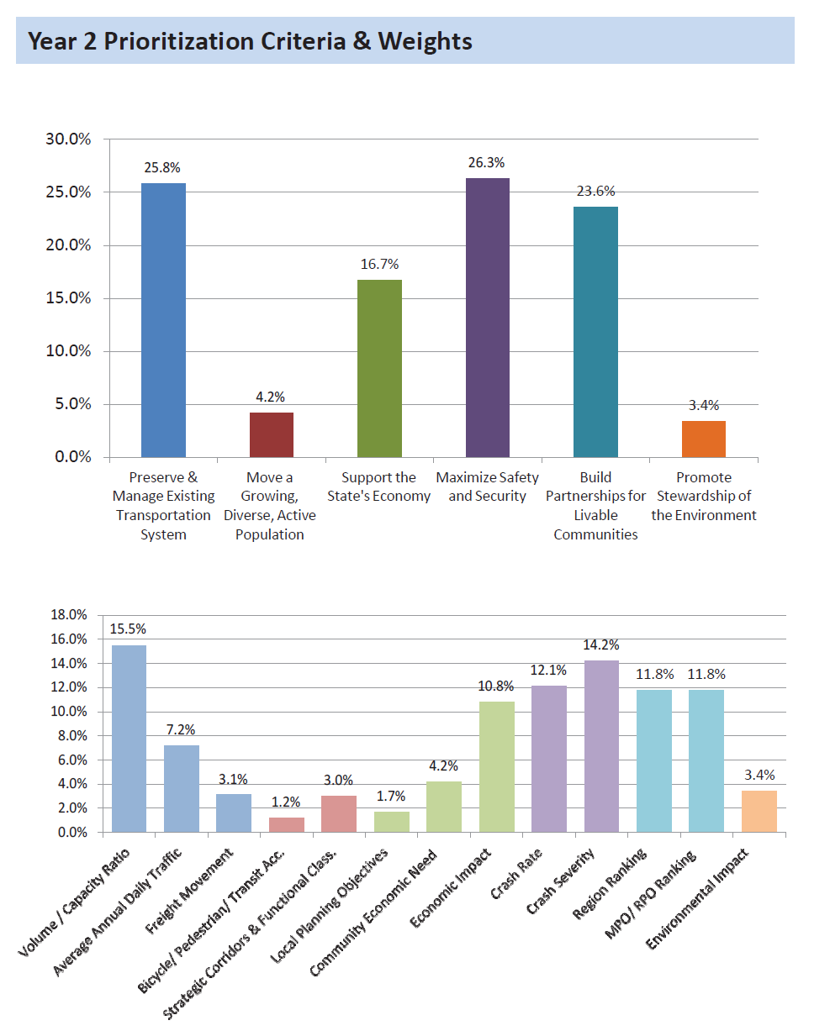
Tennessee: DL3 Criteria Weights
TRAFFIC OPERATIONS 25.8%
Multimodal/Func. Class 4.2 %
Economic Development 26.3%
Roadway Safety
26.3%
Region/MPO/RPO Rank
23.6%
Environmental lmpact
3.4%
Notes:
For example, in 2012, Tennessee shifted to a technology-driven prioritization process using Decision Lens (DL3) software. Under this process, based on input from TDOT staff, criteria are identified related to the guiding principles in the long range transportation plan. Each principle is weighted differently. The software ranks projects based on Benefit Score, Investment Funding Source and Scheduling Constraints while additional consideration is given to Even Distribution of Projects per Region, Phase of construction, and MPO/RPO distribution.
------
Tennessee has been recognized for restructuring project selection to select projects based on data-driven evaluation (Smart Growth America and State Smart Transportation Initiative, 2015). Tennessee shifted to a technology-driven prioritization process using Decision Lens (DL3) software for evaluating and prioritizing projects funded through discretionary sources and setting performance criteria.

Slide 41
4. Evaluating – Monitor Outcomes
Monitor outcomes on the ground
Measure Outcomes: Measure outcomes on the ground over time after projects are implemented (as opposed to just modeling before)
Track Cause & Effect: Link outcomes back to actions (as opposed to those due to external factors)
Notes:
The fourth phase is evaluating.
A key step is to monitor outcomes on the ground:
Measure Outcomes: Although models can be used to estimate the future when planning or programming, it is essential to model actual outcomes on the ground over time.
Track Cause & Effect: It is also critical to link outcomes back to actions to identify cause and effect relationships.

Slide 42
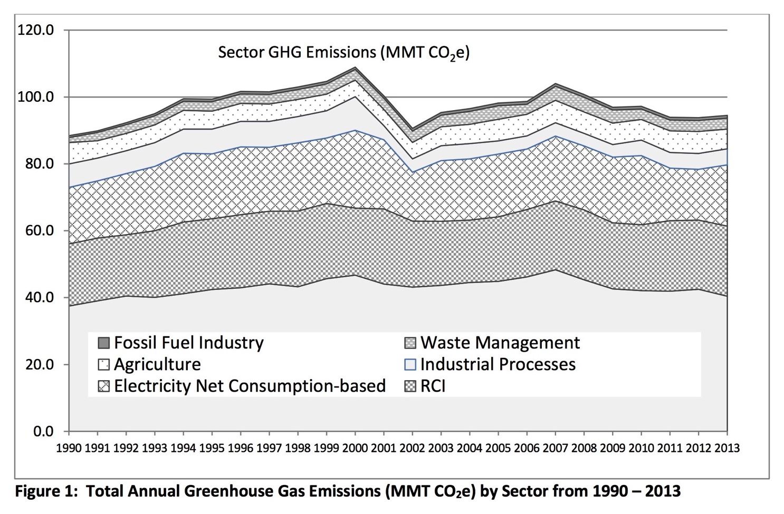
Washington: Greenhouse Gas Emissions
Notes:
For example, the State of Washington with its Results Washington is a leader on reporting how state government is achieving outcomes for the public.
Although not focused solely on transportation, every year Washington inventories it greenhouse gas emissions linked to climate change. Washington is also striving to reduce such emissions.
The good news is that emissions statewide are down somewhat. The bad news is that to a significant extent this outcome is not the result of any state policies, but rather the shrinking of the energy-intensive aluminum industry between 2000 and 2002.
In the transportation sector, we see a similar lack of cause and effect when congestion and fatalities fall not as a result of transportation investments but rather due to gas prices rising or the economy shrinking.
It isn’t sufficient to blindly track performance measures and see how they change. It is also necessary to understand if and how actions have led to those changes.
------
Source: http://www.results.wa.gov/
“There was a significant decrease in emissions between 2000 and 2002, mainly due to changes in the aluminum industry in Washington.”
Source: Washington State Dept. of Ecology, 2016, Report to the Legislature on Washington Greenhouse Gas Emissions Inventory: 2010–2013, p. 8, https://fortress.wa.gov/ecy/publications/SummaryPages/1602025.html

Slide 43
4. Evaluating – Report Returns
Report returns on investments to taxpayers
Be Accountable: Report what outcomes were delivered—at what cost
Be Transparent: Report how were decisions made
Be Accessible: Report succinctly in plain English to the general public
Notes:
The next evaluating step is to report returns on investments to taxpayers, as we have discussed. There are different good ways to do so, but we recommend that governments:
Be Accountable: Be Accountable: Report what outcomes were delivered—at what cost.
Be Transparent: Report how were decisions made.
Be Accessible: Report succinctly in plain English to the general public.

Slide 44
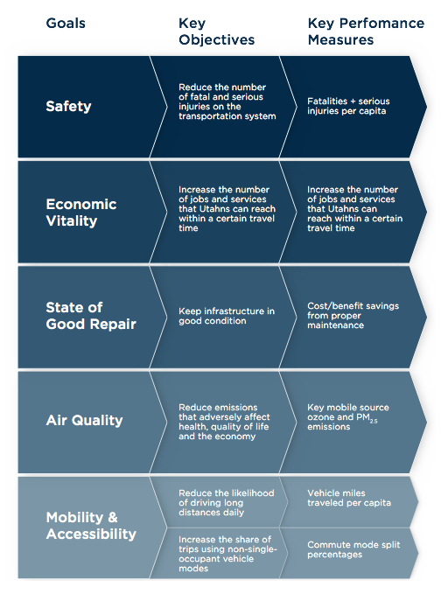
Utah’s Unified Plan
Notes:
For example, although not a report on outcomes achieved, Utah’s Unified Transportation Plan unifies UDOTs plans and all MPO plans into a single document – includes objectives and performance measures. And it estimates not the performance of individual projects but rather the results in the aggregate.
------
Source: UDOT, 2015, Utah Unified Transportation Plan, http://www.utahunifiedplan.org/

Slide 45
Minnesota: Sources & Uses of Funding
Notes:
For example, Minnesota nicely summarizes the sources & uses of funding, helping taxpayers see at a very high level how their money is used.
But this particular document stops short of reporting outcomes.
------
Source: MnDOT, Transportation Funding, Fiscal Year 2014 Where it comes from and where it goes, http://www.dot.state.mn.us/funding/documents/TranspFunding%20Pie%20Chart%202014.pdf

Slide 46
4. Evaluating– Adjust Expectations
Adjust expectations in light of experience
Analyze Outcomes: Compare expected to actual outcomes to improve understanding of effectiveness of actions and accuracy of models
Revisit Goals: Revise performance targets based on progress
Notes:
The next evaluating step is to adjust expectations in light of experience.
Analyze Outcomes: A lot of effort goes into modeling, i.e., predicting outcomes during planning or programming. But rarely after projects are built are actual outcomes measured and compared to what was predicted. Were the traffic volumes, level of service or pavement conditions 1, 5 or 10 years after a project what was predicted? In order to improve the accuracy of models, understand their limitations, and to make better decisions in the future, it is essential to compare expected to actual outcomes and to adjust future practices in response.
Revisit Goals: It is also essential to revisit goals, objectives and performance targets in light of what progress has or has not been achieved.

Slide 47
Outcomes-Based Summary
Planning
  Set real-world goals that matter
    Identify goals
    Consider the “three P’s / E’s”
    Set priorities
    Quantify performance
  Determine actions to achieve outcomes
    Identify actions
    Develop scenarios
    Plan for uncertainty
Funding
  Levy taxes to raise needed revenues
    Secure revenues
    Be accountable
    Price efficiently
  Empower well-positioned decision-makers
    Allocate
    Give flexibility / eliminate constraints
    Hold accountable
Programming
  Invest in effective projects
    Fund what’s planned
    Think multi-modal / jurisdictional
    Assess benefits & costs
Evaluating
  Monitor outcomes on the ground
    Measure outcomes
    Track cause & effect
  Report returns on investments to taxpayers
    Be accountable
    Be transparent
    Be accessible
  Adjust expectations in light of experience
    Analyze outcomes
    Revisit goals
Notes:
Putting it all together, here is a summary of our recommendations for outcomes-based decision-making.
Again, we have tried to organize a bunch of familiar ideas into a simple and complete framework for transportation decision-making.

Slide 48
MAP-21: Declaration of Policy
“Performance management will transform the Federal-aid highway program and provide a means to the most efficient investment of Federal transportation funds by refocusing on national transportation goals, increasing the accountability and transparency of the Federal-aid highway program, and improving project decision-making through performance-based planning and programming.”
Notes:
Now let’s quickly review performance-based decision-making under the 2012 federal transportation reauthorization bill Moving Ahead for Progress in the 21st Century Act.
MAP-21 aspires to reform transportation decision-making in America.
In particular, similar to our work, MAP-21 aspires to improve transportation decision-making in order to increase efficiency, accountability & transparency.
But MAP-21 focuses on project decision-making through planning & programming, overlooking other phases.
------
MAP-21 §1203(a), 23 U.S.C. §150(a), https://www.law.cornell.edu/uscode/text/23/150

Slide 49
MAP-21: National Goals
Safety: To achieve a significant reduction in traffic fatalities and serious injuries on all public roads.
Infrastructure Condition: To maintain the highway infrastructure asset system in a state of good repair.
Congestion Reduction: To achieve a significant reduction in congestion on the National Highway System.
System Reliability: To improve the efficiency of the surface transportation system.
Freight Movement & Economic Vitality: To improve the national freight network, strengthen the ability of rural communities to access national and international trade markets, and support regional economic development.
Environmental Sustainability: To enhance the performance of the transportation system while protecting and enhancing the natural environment.
Reduced Project Delivery Delays: To reduce project costs, promote jobs and the economy, and expedite the movement of people and goods by accelerating project completion through eliminating delays in the project development and delivery process, including reducing regulatory burdens and improving agencies’ work practices.
Notes:
MAP-21’s goals are fine, but represent just a subset of, for example, Tennessee’s guiding principles.
For example, these national goals say nothing about moving people nor livable communities. Are these the goals that matter to the typical taxpayer?
------
Citation: MAP-21 §1203(a), 23 U.S.C. §150(b): https://www.law.cornell.edu/uscode/text/23/150
Source: https://www.fhwa.dot.gov/tpm/about/goals.cfm

Slide 50
MAP-21: Performance Measures
Highways
National Highway Performance Program (NHPP): condition of pavement & bridges; performance of Interstate System & National Highway System
Highway Safety Improvement Program (HSIP): serious injuries & fatalities
Congestion Mitigation & Air Quality Program (CMAQ): traffic congestion & emissions
National Freight Movement: freight movement on the Interstate System
Public Transportation
Transit Asset Management: condition assessment
Public Transportation Safety Program: safety risk management & safety assurance
Notes:
The mandated performance measures represent an even smaller subset of areas of interest. These are a good start, but more is needed.
------
Citations:
MAP-21 §1203(a), 23 U.S.C. §150(c): https://www.law.cornell.edu/uscode/text/23/150
MAP-21 §20019, 49 U.S.C. §5326: https://www.law.cornell.edu/uscode/text/49/5326
MAP-21 §20021, 49 U.S.C. §5329: https://www.law.cornell.edu/uscode/text/49/5329
Sources:
https://www.fhwa.dot.gov/tpm/about/summary.cfm
https://www.fhwa.dot.gov/map21/qandas/qapm.cfm
https://www.fhwa.dot.gov/tpm/about/summary.cfm
https://www.fhwa.dot.gov/tpm/about/nhpp.cfm
https://www.fhwa.dot.gov/tpm/about/hsip.cfm
https://www.fhwa.dot.gov/tpm/about/cmaq.cfm
https://www.fhwa.dot.gov/tpm/about/freight.cfm

Slide 51
MAP-21: Responsibilities
U.S. DOT
  Establish performance measures
States
  Set targets (within 1 year)
  Report progress (within 4 years and then every 2 years)
MPOs
  Set targets (within 1 year)
  Report progress (within 4 years and then every 2 years)
Notes:
And although MAP-21 calls for setting targets and reporting progress, these steps fall far short of the more comprehensive outcomes-based approach we recommend. It is as if MAP-21 imagines that if you merely establish performance measures and set targets, then these will be met, without sufficient thought to the political and practical realities of funding, allocation and constraints.
------
Citations:
MAP-21 §1203(a), 23 U.S.C. §§150(d)–(e): https://www.law.cornell.edu/uscode/text/23/150
MAP-21 §1202(a), 23 U.S.C. §135(d)(2): https://www.law.cornell.edu/uscode/text/23/135
MAP-21 §1201(a), 23 U.S.C. §134(h)(2): https://www.law.cornell.edu/uscode/text/23/134
Sources:
https://www.fhwa.dot.gov/map21/factsheets/pm.cfm
https://www.fhwa.dot.gov/map21/factsheets/snmp.cfm
https://www.fhwa.dot.gov/map21/factsheets/mp.cfm

Slide 52
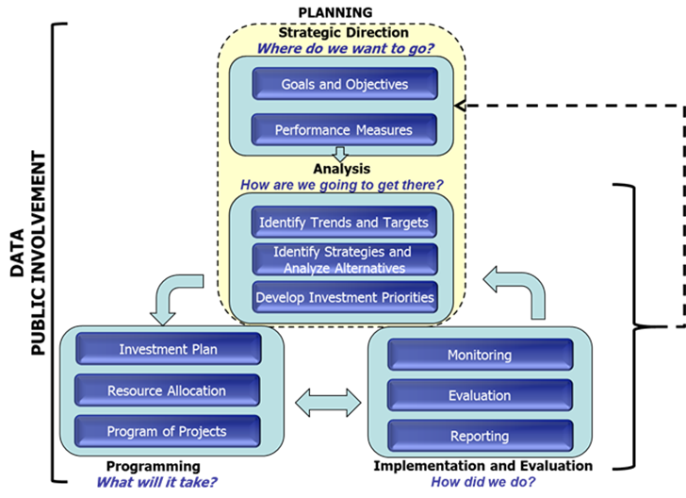
Performance-Based Planning & Programming
Notes:
Of course, MAP-21 is a high-level federal bill that sets general directions, leaving it to the U.S. Dept. of Transportation to work out details.
Shortly after the adoption of MAP-21, Federal Highway Administration publish its Performance-Based Planning and Programming Guidebook.
This graphic summarizes FHWA’s recommendations, which are good—as far as they go.
------
Source: Federal Highway Administration, 2013, Performance-Based Planning and Programming Guidebook, https://www.fhwa.dot.gov/planning/performance_based_planning/pbpp_guidebook/

Slide 53
MAP-21 vs. Outcomes-Based?
 | MAP-21 | Outcomes-Based
Planning | State DOTs & MPOs focus narrowly on transportation system | Account for factors interacting with transportation system: land use, economy, etc.
Funding | Do not see taxing & allocating as performance-based decisions | Focus especially on allocating to ensure flexibility / eliminate constraints to invest in most effective projects
Programming | Not necessarily tightly linked with planning | Strong planning should mostly inform programming
Evaluating | Not tracking cause & effect | Integrate planning, programming & evaluating to analyze cause & effect
Notes:
So how do MAP-21 and U.S. DOT’s guidance compare to our recommended outcomes-based approach?
Planning: Under MAP-21, state DOTs and MPOs focus narrowly on the transportation system. Our recommendation is to develop integrated transportation and land use scenarios accounting for more of the relevant factors.
Funding: MAP-21 does not appear to recognize taxing and allocating a transportation decisions that deserve to be performance-based. We see a need to focus especially on allocating to ensure sufficient flexibility to invest in the most effective projects.
Programming: MAP-21’s approach to programming is good—if it is tightly linked to planning and not in practice an almost independent effort.
Evaluating: Finally, although tracking performance measures is good, as we have seen measures unmoored from actions fail to capture cause and effect relationships. A better approach is to tightly integrating planning, programming & evaluating.

Slide 54
Summary
Focus on outcomes that matter, and set priorities
Develop scenarios, and plan for uncertainty
Empower decision-makers with broad responsibilities, allocate flexible funding, and hold accountable
Invest in projects that achieve performance measures effectively: “bang for the buck”
Monitor outcomes over time, and track cause & effect
Be accountable, transparent & accessible to the public
Adjust expectations in light of experience
Notes:
In summary, we recommend:
Focus on outcomes that matter, and set priorities
Develop scenarios, and plan for uncertainty
Empower decision-makers with broad responsibilities, allocate flexible funding, and hold accountable
Invest in projects that achieve performance measures effectively: “bang for the buck”
Monitor outcomes over time, and track cause & effect
Be accountable, transparent & accessible to the public
Adjust expectations in light of experience

Slide 55
Conclusion
Planning
  Set real-world goals that matter
    Identify goals
    Consider the “three P’s / E’s”
    Set priorities
    Quantify performance
  Determine actions to achieve outcomes
    Identify actions
    Develop scenarios
    Plan for uncertainty
Funding
  Levy taxes to raise needed revenues
    Secure revenues
    Be accountable
    Price efficiently
  Empower well-positioned decision-makers
    Allocate
    Give flexibility / eliminate constraints
    Hold accountable
Programming
  Invest in effective projects
    Fund what’s planned
    Think multi-modal / jurisdictional
    Assess benefits & costs
Evaluating
  Monitor outcomes on the ground
    Measure outcomes
    Track cause & effect
  Report returns on investments to taxpayers
    Be accountable
    Be transparent
    Be accessible
  Adjust expectations in light of experience
    Analyze outcomes
    Revisit goals
Notes:
In conclusion, we set out to assess the effectiveness of transportation investments—but found too little data to be able to do so.
Instead, we offer a comprehensive framework for an outcomes-based transportation decision-making process aimed to provide greater accountability & transparency.
It is beyond the scope of this research project to explore the theoretical & practical considerations of such an approach in detail.
We also appreciate political realities and that such an improved process might not be realized any time soon.
But we are encouraged by the leadership and innovation we see by states & MPOs: laboratories of democracy.
We hope the ones we had the pleasure to study continue striving to do better.
And we hope that our humble ideas presented here might help further such work.
In the next few months, Transportation for America will be publishing these ideas as a short, practical toolkit.
And the National Institute for Transportation and Communities will be publishing the detailed findings of our research in a longer academic report.
I am happy to take your questions and comments.

Slide 56
Thank You
Rebecca Lewis, Ph.D.
541-346-4432
rlewis9@uoregon.edu
Rob Zako, Ph.D.
541-346-8617
rzako@uoregon.edu
“Effectiveness of Transportation Funding Mechanisms for Achieving National, State, and Metropolitan Economic, Health, and Other Livability Goals”
http://nitc.trec.pdx.edu/research/project/875/
Notes:
Thank you.
------
Links:
http://pppm.uoregon.edu/
http://sci.uoregon.edu/
http://nitc.trec.pdx.edu/research/project/875/

