Slide 1
LIFE-SPACE MOBILITY
& AGING IN PLACE
JA YOUNG KIM & IVIS GARCIA ZAMBRANA
University of Utah
ALAN DELA TORRE & JULIANNE RENO
Portland State University
October 25, 2018 | ACSP Annual Conference, Buffalo, New York

Slide 2
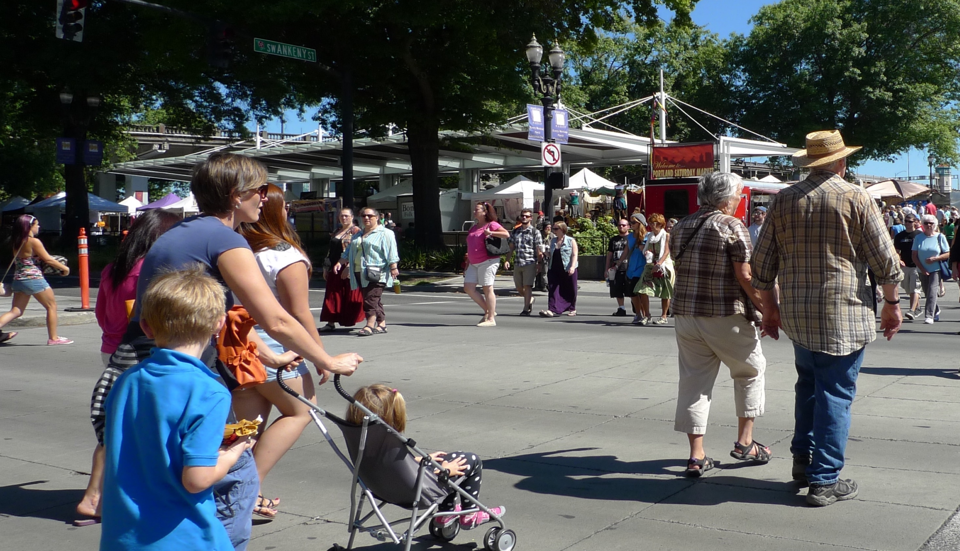
Most people want to “Age in Place”

Slide 3
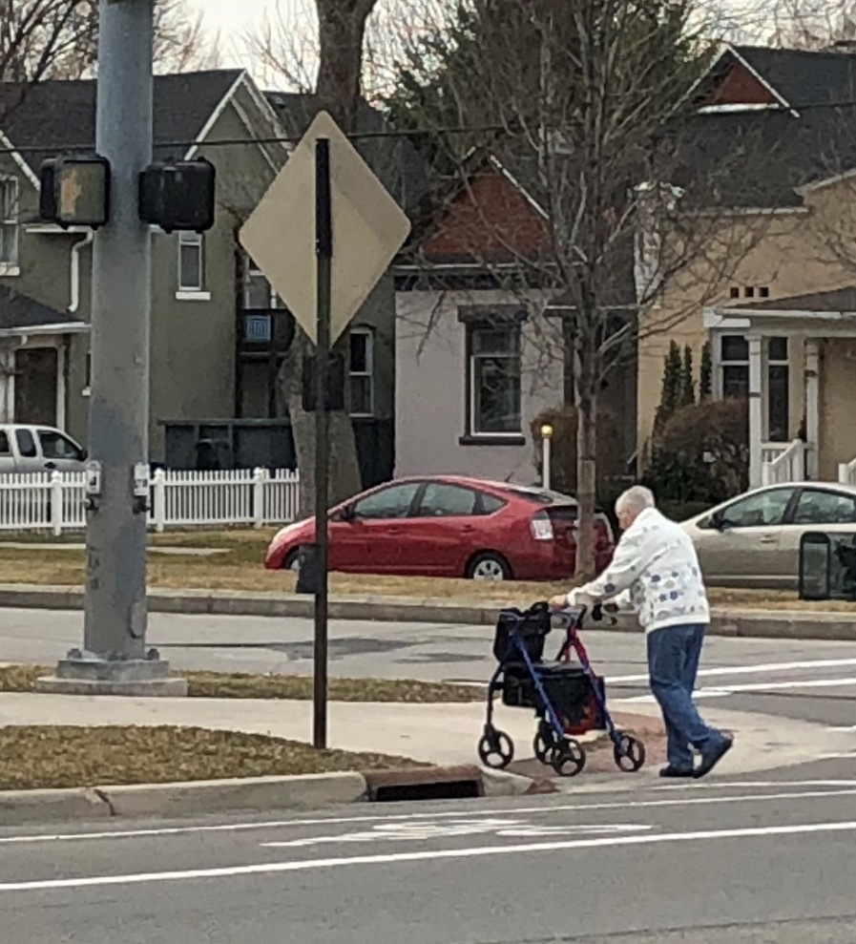
Mobility
Travel behavior (Planning)
Universal design (Architecture)
Relative ease & freedom of movement in all of its forms (Public Health: Satariano et al., 2012)
The ability to meet the basic needs to access goods, activities, services, and social interactions (Mollenkopf, 2005)
Quality of life (Metz, 2000; Spinney et al., 2009)
Mobility is essential to older adults
due to their limited, or gradually reducing
physical and cognitive abilities.

Slide 4
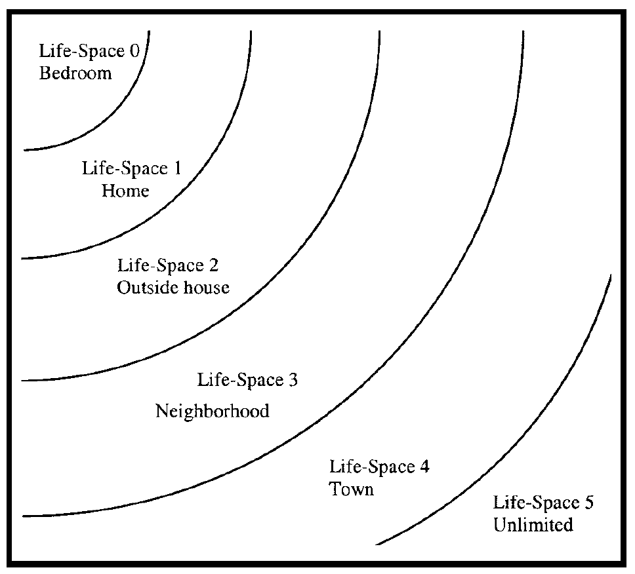
Life-Space Mobility (May et al., 1985; Peel et al. 2005)
Broad scope of mobility in different spatial locations in daily lives
Life-Space (Five Concentric Zones):
Home
Outside House (porch or backyard)
Neighborhood
Town
Outside Town (regional, national or international)

Slide 5
Life-Space Assessment
Life-Space Assessment (May et al., 1995) at 5 life-space level
Life-Space Level | Frequency | Independence
Within each life-space, | How often did you get there | Did you use any personal assistance or equipment
Life-Space Mobility Assessment at neighborhood, city & region
Life-Space Level | Place | Frequency | Independence | Mode
Within each life-space, | Where did you go | How often did you get there | Did you use any personal assistance or equipment | How did you get there

Slide 6
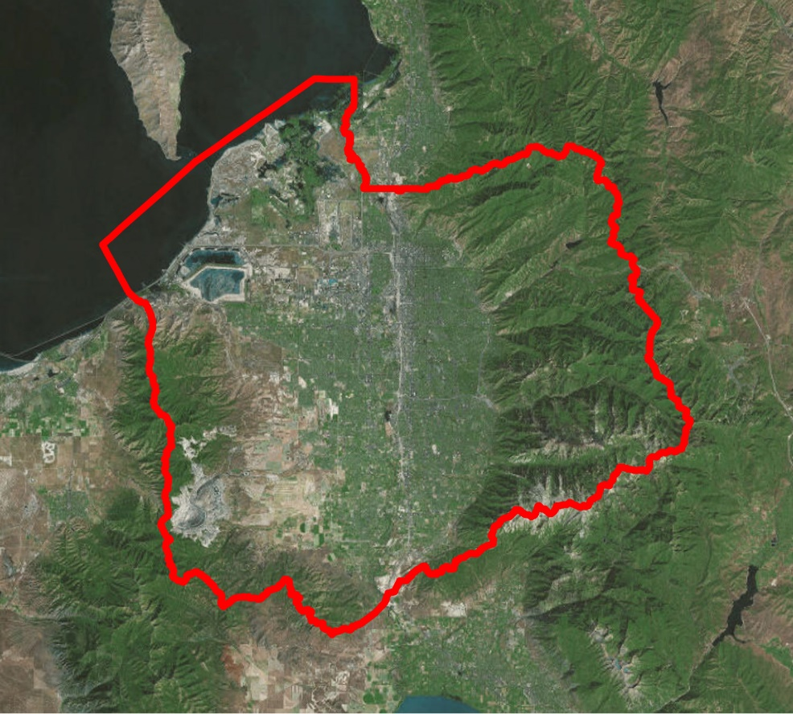
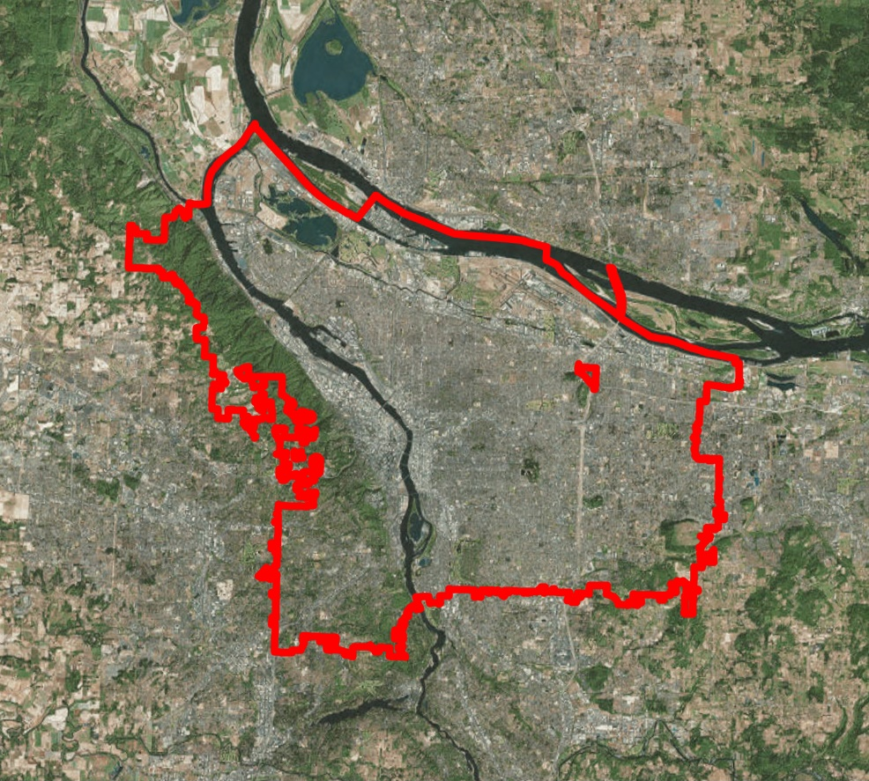
Research Design
Surveys and semi-structured interviews
50 low-income older adults (interviewed between Dec 2017 and July 2018)
Home accessibility modifications (ASSIST Inc. in Utah, Unlimited Choices in Oregon)
Funding: NITC (National Institute for Transportation and Communities)
Salt Lake County, UT
(University of Utah)
Portland, OR
(Portland State University)

Slide 7
Research Design
1. Neighborhood Boundary Mapping
The area around one’s house
Subjectively named and defined
Where performing routine tasks
Social constructions
Relationships between place & people

Slide 8
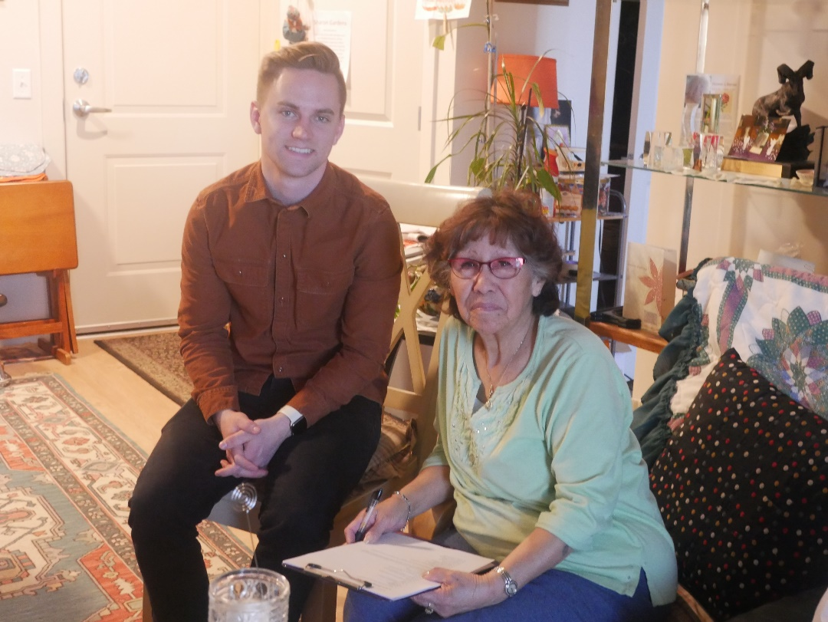
Research Design
2. Interview
Life before and after the home modifications
Aspects of satisfactions & limitations
Mobility on a typical day/week/month
Barriers to get around
Use of public transportation
What does ‘Aging in place’ mean to you?

Slide 9
Research Design
3. Survey
Validated Instruments
Life-Space Assessment (LSA) – Peel et al.
Neighborhood Environment Walkability Scale (NEWS) – Sallis et al.
The Lawton Instrumental Activities of Daily Living Scale (IADLs) – Lawton & Brody
Project-Specific
Life-Space Mobility Assessment
Socio-demographics / Home modifications / Home & neighborhood satisfaction / Mobility / Aging in place

Slide 10
Preliminary Findings
Salt Lake County Context
 | Salt Lake County, UT (n=25)
socio-demographic
Age | 78
% Female | 72%
% NONHISPANIC White | 68%
HOUSEHOLD Size | 1.8
hOUSEHOLD Income | $1,438
physical ability
IADLs score | 6 | (0-8)
LSA score | 18.9 | (0-40)
% Assistive Devices User | 80%
WALKER | 52%
CANE | 48%
Wheelchair | 24%
Electric Chair | 12%
neighborhood
WalkScore | 45.1 | (0-100)

Slide 11
Mobility at Home
“
When we moved, bought this house, I thought it was wonderful to have those stairs. I used them for exercise. I'd go up and down and up and down. And now it's an effort. It really is hard.
”

Slide 12
Mobility at Home
“
When we moved, bought this house, I thought it was wonderful to have those stairs. I used them for exercise. I'd go up and down and up and down. And now it's an effort. It really is hard.
Outside Home
Mobility
”
“
I always just come in the backdoor because I had the railing there, you know, that gave me support. So it's nice to have it out front. And it's nice to have it for other people if they come to visit me because I have a lot of elderly friends that need it also.
”

Slide 13
How Do You Get Around?
Highly Car-oriented
Related to where they live
Transit Users: 28%
Q:
Are there any reasons you don’t use public transportation often?
“
”
Probably because I have a car.
“
”
It's just more convenient with a car.

Slide 14
How Do You Get Around?
Drive
“
”
I'm still driving.
“
”
My children come and take me somewhere.
“
I had to give up the car because a car's expensive if you're on low income.
”
“
I don't have a car. And my grandson took my car when I was 92. He said, "Grandma, you can't drive anymore." So that's why I don't have a car. But people will shop for me. And, oh, they'll take me to my doctor appointment.
”

Slide 15
How Do You Get Around?
Public Transportation
“
”
I get everywhere as long as it’s on.
“
I take it because I feel quite safe. It’s more convenient. I don’t have to fight to traffic, and it’s cheap.
10 years ago, I started to ride TRAX. I learned that from my teenagers (grandchildren).
”
“
If I had more places to go, I’d take the bus in a heartbeat. Because I hate parking. Plus, I don’t like to drive on the freeway.
”

Slide 16
What would make you ride
Public Transportation more often?
“
Why I don't use it? Because it's really not accessible. You'd have to walk from here over to there.
”

Slide 17
What are the Barriers to Walk around or with assistive devices in your neighborhood?

Slide 18
Key Takeaways
Introducing the concept of life-space mobility to planning field
Mobility at home is closely related to outside home mobility for older adults
Home-modifications can improve the life-space mobility and social connectedness
Public transportation need be considered to keep them independent and mobile
Transit use is mainly affected by one’s accessibility from home to transit stops
Programs to help them experience transit systems may help
Accessible streets and safety are key concerns for older adults to walk around
Combination of validated instruments can be use in other research and policy

Slide 19
Thank You !
Contact:
JA YOUNG KIM jaykim37@gmail.com
IVIS GARCIA ZAMBRANA ivis.garcia@gmail.com

