Slide 1
MmWave Radar Point Cloud Segmentation using GMM in Multimodal Traffic Monitoring
Feng Jin¹, Arindam Sengupta¹, Siyang Cao¹ and Yao-Jan Wu²
¹Department of Electrical and Computer Engineering ²Department of Civil and Architectural Engineering and Mechanics The University of Arizona, Tucson, AZ 85721 Email:{fengjin, sengupta, caos, yaojan}@email.arizona.edu
April 29, 2020

Slide 2
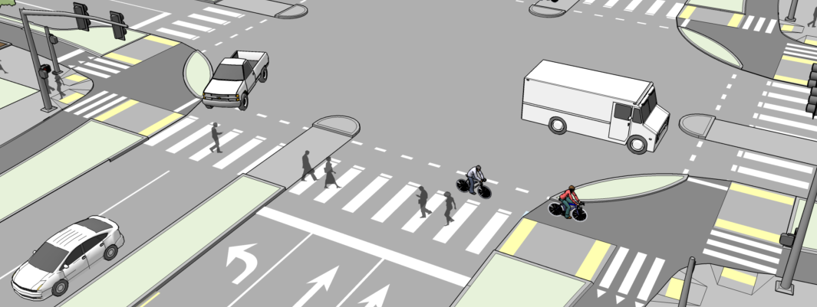
I. Concept of Multimodal Traffic Monitoring
To improve the traffic efficiency and reduce crashes
Advantages of mmWave radar sensor
Robust to adverse weather and poor light (at nights) conditions
Speed measurement through Doppler effect
High bandwidth up to 4 GHz, which leads to 3.75 cm range resolution
Low-cost and compact design
Provides the real-time traffic statistics, i.e., speed and volume of each transportation mode, such as car, pedestrian, bicycle
Key problem in this research
How to recognize different traffic modes, such as cars/pedestrians, using mmWave radar sensor
Point cloud segmentation is point-wise classification
Multimodal Traffic Monitoring System

Slide 3
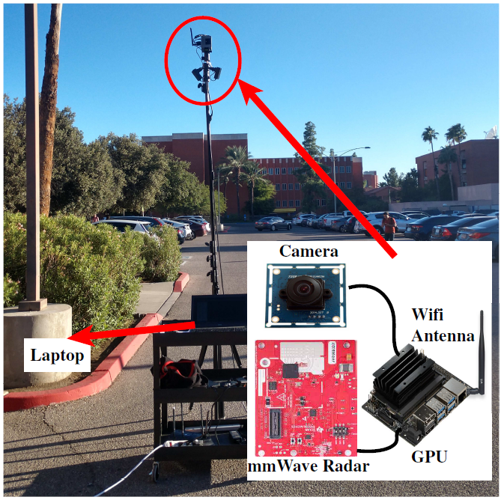
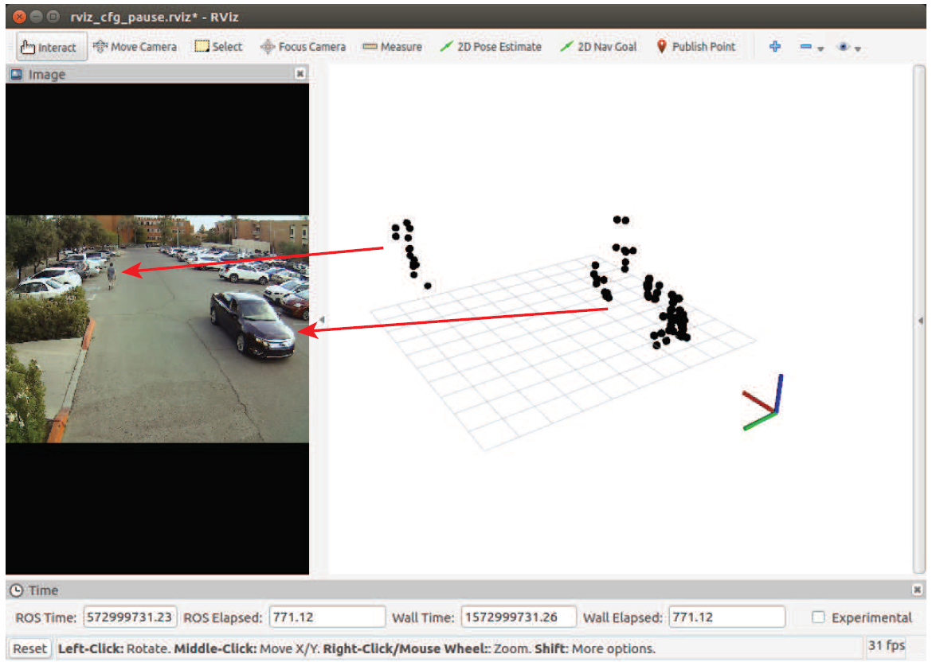
II. What can we get from a mmWave radar sensor?
Assumption: different traffic mode obeys a certain multivariate Gaussian distribution

Slide 4
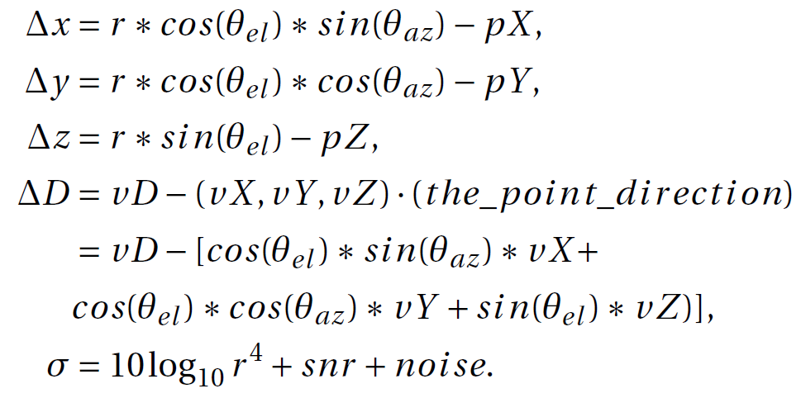
III. A new feature vector for each point
Original measurement from mmWave radar sensor
Body extent
Relative Doppler
RCS

Slide 5
IV. Gaussian Mixture Model (GMM)
Feature vector
$$x=$$
Assumption
GMM
Unknows: Prior and Gaussian statistics of each class
Posterior
Expectation–maximization (EM) Algorithm
Maximize a posterior (MAP)

Slide 6
V. Experiment
Training Dataset
One car driving randomly and one pedestrian walking randomly
8035 radar frames
No labeling (GMM is an unsupervised approach)
Testing Dataset
1222 radar frames
Let a pedestrian walk on the left side of line-of-sight (LOS), in this case y>0
Let a car drive on the right side of LOS, in this case y<0
Label the points with a distinct integer according to its y value. We have ground truth for testing.
Experiment Procedure
Apply GMM on the training dataset
Visualize the result to assign GMM output (an integer) to a class
Save the GMM model
Test the saved GMM model on the testing dataset
Compute performance matrices

Slide 7
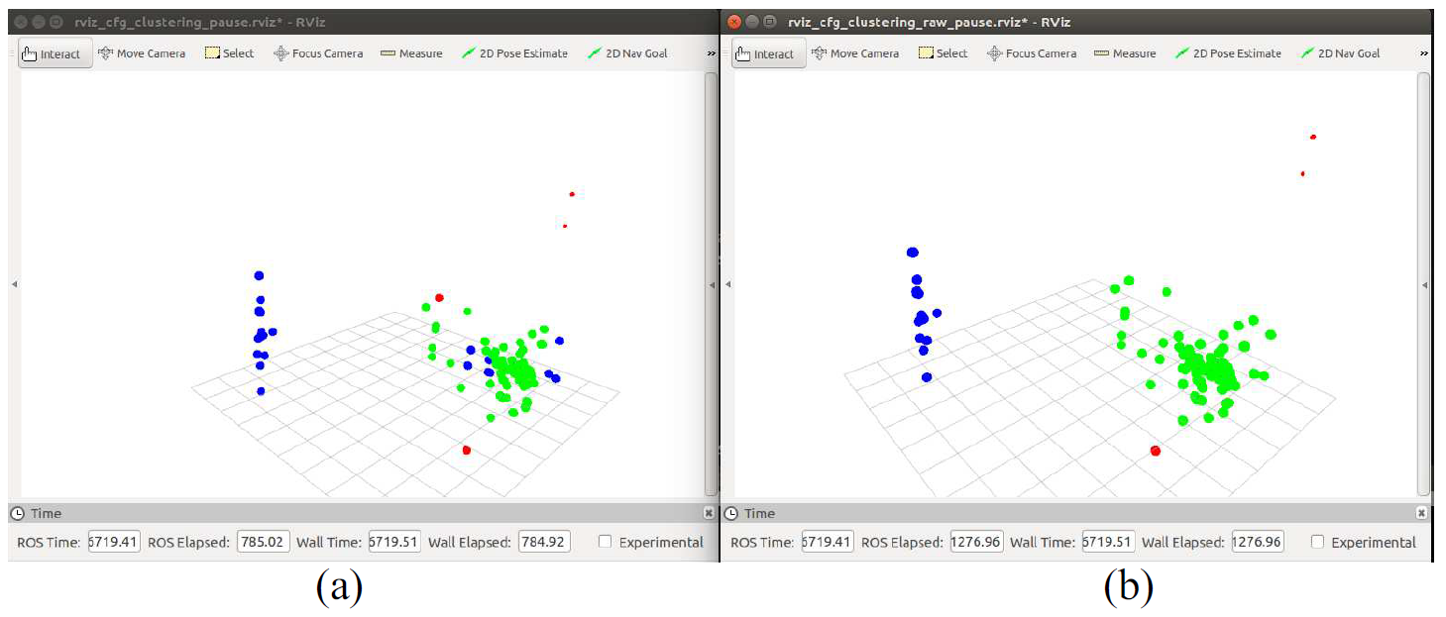
VI. A single frame result
Blue: pedestrian; Green: car; Red: clutter.
Prediction on one frame testing data; (b) The associated ground truth

Slide 8
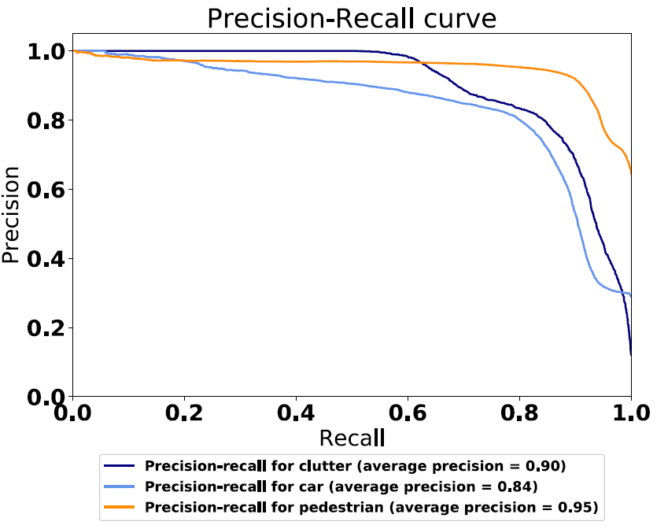
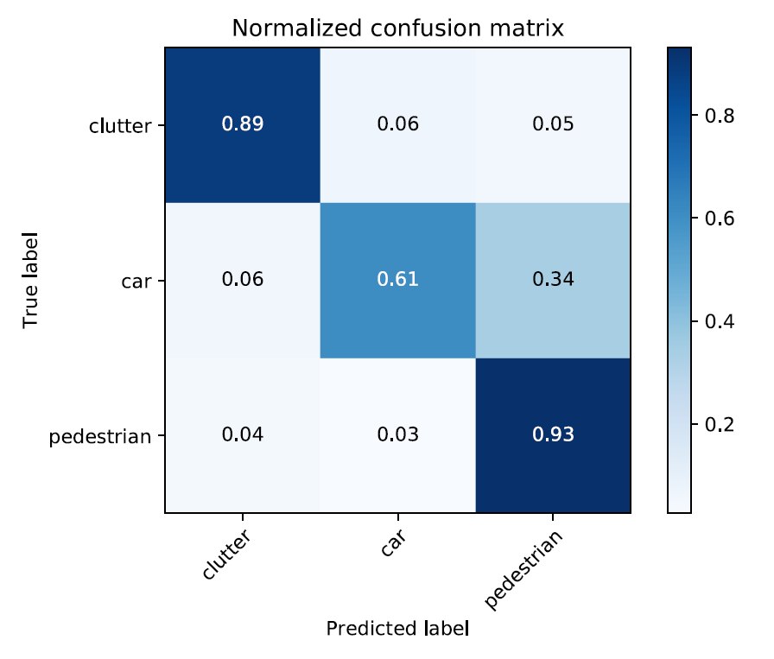
VII. Confusion Matrix

Slide 9
GitHub Repository for Public Access
https://github.com/radar-lab/traffic_monitoring
Thanks!
Q&A

