Slide 1
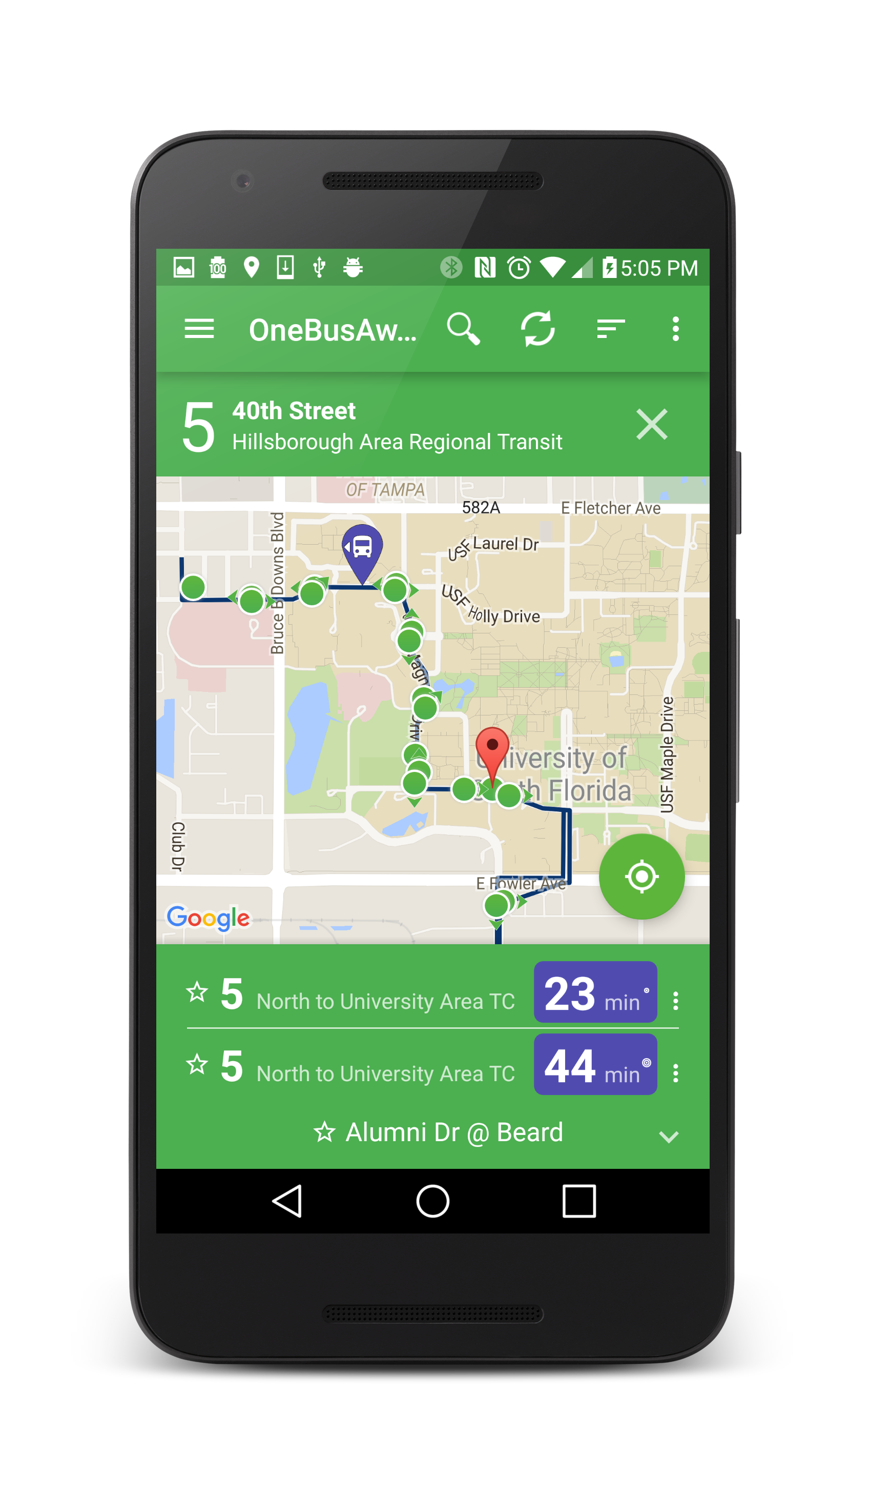
GTFS-realtime v2.0
Sean J. Barbeau, Ph.D.
Principal Mobile Software Architect for R&D
Center for Urban Transportation Research
University of South Florida

Slide 2
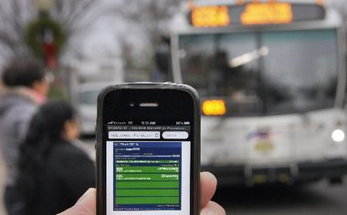
Why real-time transit info?
Tony Kurdzuk/The Star-Ledger
Real-time information (RTI) has many benefits
  Shorter perceived wait time [1][8]
  Shorter actual wait time [1]
  Lowers learning curve for new riders [2]
  Increased feeling of safety (e.g., at night) [5][6]
  Improved perception of agency[8]
  Increased ridership[3][7]
Improve the rider experience without increasing vehicle frequency
Emerging analytics tools are powered by this data
[1] Kari Edison Watkins, Brian Ferris, Alan Borning, G. Scott Rutherford, and David Layton (2011), "Where Is My Bus? Impact of mobile real-time information on the perceived and actual wait time of transit riders," Transportation Research Part A: Policy and Practice, Vol. 45 pp. 839-848.
[2] C. Cluett, S. Bregman, and J. Richman (2003). "Customer Preferences for Transit ATIS," Federal Transit Administration. Available at http://ntl.bts.gov/lib/jpodocs/repts_te/13935/13935.pdf#sthash.jwn5Oltr.dpuf
[3] Lei Tang and Piyushimita Thakuriah (2012), "Ridership effects of real-time bus information system: A case study in the City of Chicago," Transportation Research Part C: Emerging Technologies, Vol. 22 pp. 146-161.
[4] Aaron Steinfeld and John Zimmerman, "Interviews with transit riders in San Francisco and Seattle," ed, 2010.
[5] Brian Ferris, Kari Watkins, and Alan Borning (2010), "OneBusAway: results from providing real-time arrival information for public transit," in Proceedings of the 28th International CHI Conference on Human Factors in Computing Systems, Atlanta, Georgia, USA, pp. 1807-1816.
[6] A. Gooze, K. Watkins, and A. Borning (2013), "Benefits of Real-Time Information and the Impacts of Data Accuracy on the Rider Experience," in Transportation Research Board 92nd Annual Meeting, Washington, D.C., January 13, 2013.
[7] Brakewood, Macfarlane and Watkins (2015). The Impact of Real-Time Information on Bus Ridership in New York City. Transportation Research Part C: Emerging Technologies, Volume 53, pp. 59-7
[8] Brakewood, Barbeau, and Watkins (2014). An experiment evaluating the impacts of real-time transit information on bus riders in Tampa, Florida,, Transportation Research Part A, Volume 69, pp. 409-422.

Slide 3
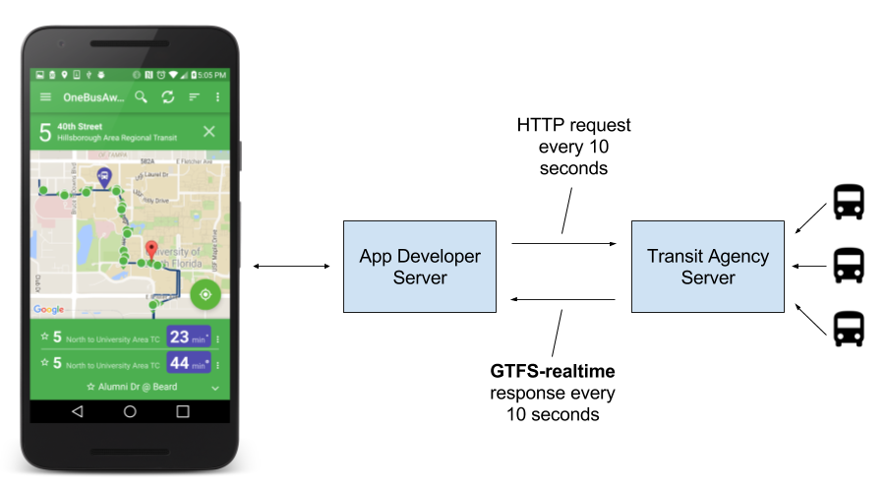
GTFS-realtime is becoming de facto standard
  Over 50 agencies now have GTFS-realtime feeds!

Slide 4
Quality is important!
In one study, 9% of riders said they took the bus less often due to errors in RTI[9]
GTFS-realtime v2.0 will help agencies produce better quality RTI
[9] A. Gooze, K. Watkins, and A. Borning (2013), “Benefits of Real-Time Information and the Impacts of Data Accuracy on the Rider Experience,” in Transportation Research Board 92nd Annual Meeting, Washington, D.C., January 13, 2013.

Slide 5

What’s wrong with
GTFS-realtime v1.0?

Slide 6
Problem with GTFS-realtime v1.0
A LOT of optional fields – 56 out of 63 (89%)
  Quirk of Protocol Buffer docs (for details see http://bit.ly/gtfs-realtime-2)
Leads to sub-optimal feeds
  Poor data quality
  Bad rider experience
  Inaccurate analytics – garbage in, garbage out

Slide 7
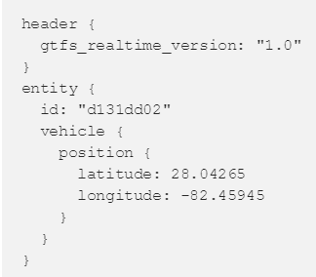
Example 1 – Vehicle Position
All timestamps are optional
When was position calculated?

Slide 8
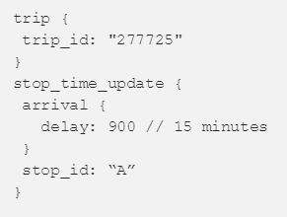
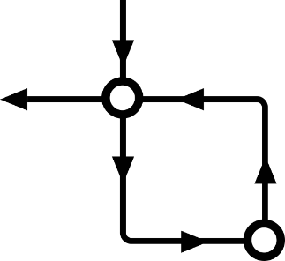
Example 2 – Loop route
Delay?
stop_id = A
stop_id = B
stop_sequence field is optional
Is 15 minute delay before or after stop_id B?

Slide 9
~75% of feeds we analyzed had errors
https://github.com/CUTR-at-USF/gtfs-realtime-validator

Slide 10

GTFS-realtime v2.0
Clarifying what’s really optional

Slide 11
GTFS-realtime v2.0
Defines new transit-specific requirements
Each field is labeled as either:
  Required
  Optional
  Conditionally required
    See Description field for when this field is required

Slide 12
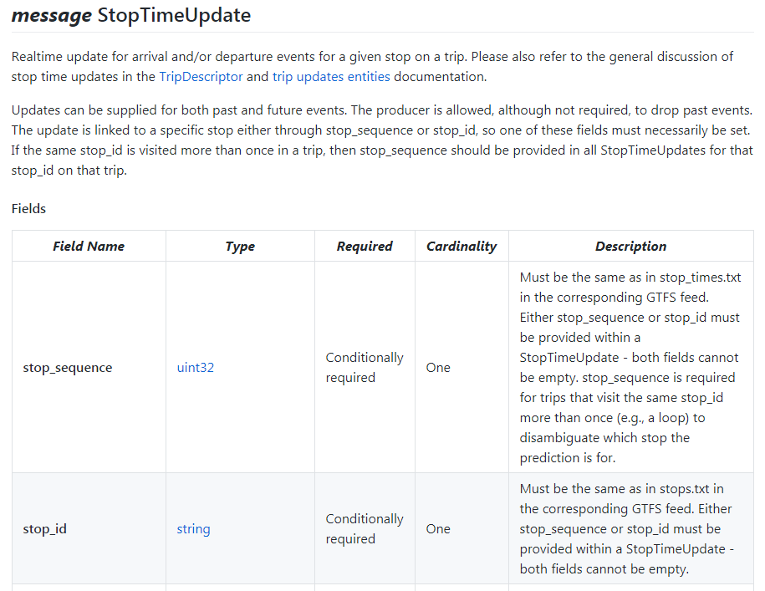

Slide 13
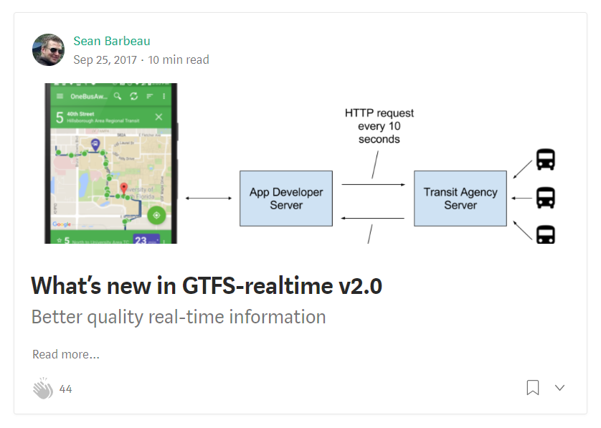
http://bit.ly/gtfs-realtime-2

Slide 14


GTFS-realtime Validator
Quick analysis of feeds

Slide 15
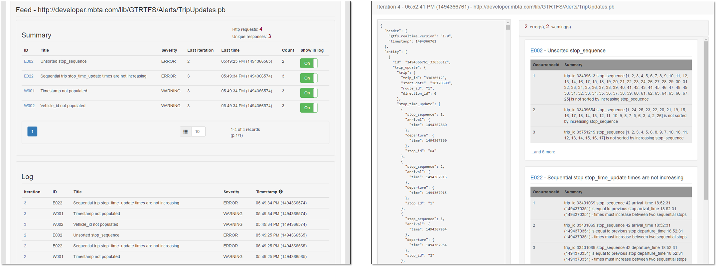
GTFS-realtime Validator
Test your v1 and v2 feeds for errors
  Live demo - http://transittools.forest.usf.edu/
  Open-source at https://github.com/CUTR-at-USF/gtfs-realtime-validator

Slide 16
GTFS-rt Validator – View data & errors

Slide 17
Evaluation of industry feeds
Created open-source tool to batch validate 78 out of 130 GTFS-realtime feeds catalogued on TransitFeeds.com
  https://github.com/CUTR-at-USF/transit-feed-quality-calculator
69% (54) feeds had errors, and 74% (58) had warnings

Slide 18
http://bit.ly/gtfs-realtime-rules

Slide 19
What’s next for Transit Agencies?
Require that all AVL vendors provide GTFS-realtime v2.0 feeds (especially in RFPs)
  Github is official new home of GTFS/GTFS-realtime specs - https://github.com/google/transit
Run GTFS-realtime validator frequently
  https://github.com/CUTR-at-USF/gtfs-realtime-validator
Also require that vendors follow GTFS Best Practices
  http://gtfs.org/best-practices/

Slide 20
What’s next for GTFS-rt Community?
Create GTFS-realtime Best Practices
  “Warning” from GTFS-realtime validator^{[1]}
  Proposals without unanimous agreement
  Other community input
Clarify more GTFS-realtime gray areas
  See list at http://bit.ly/gtfs-realtime-open-topics
  Either new proposals, or in best practices
Better targeted documentation
  More focused on use cases and features (e.g., ability to cancel trips)
[1] http://bit.ly/gtfs-realtime-rules

Slide 21
What’s next for GTFS-rt Community?
Continue to add new rules to GTFS-realtime Validator
  http://bit.ly/gtfs-realtime-rules
Hosting GTFS-realtime Validator as a service for agencies and vendors
  Alpha at http://transittools.forest.usf.edu
Tackle GTFS-sometimes-ish use cases
  Different endpoint for major changes to trips
Develop additional open-source tooling for prediction generation
  Including data warehousing
  Leverage TheTransitClock (formerly Transitime)
    http://thetransitclock.org

Slide 22



Thanks!
Sean J. Barbeau, Ph.D.
barbeau@cutr.usf.edu
813.974.7208
linkedin.com/in/seanbarbeau
@sjbarbeau
Funding from:
More on GTFS-realtime v2.0 - http://bit.ly/gtfs-realtime-2

Slide 23
Why so many optional fields?

Slide 24
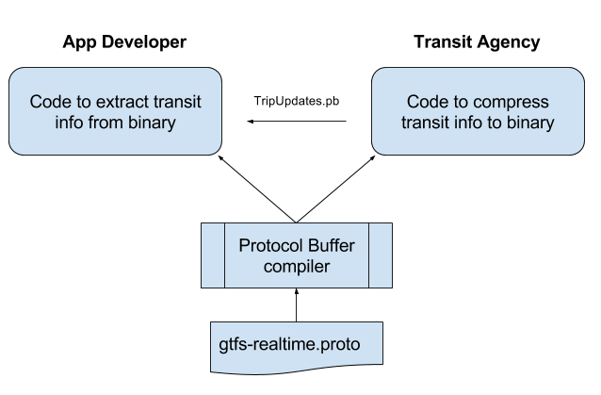
GTFS-rt uses Protocol Buffer (PB) format
PB config file
gtfs-realtime.proto PB file defines elements to exchange

Slide 25
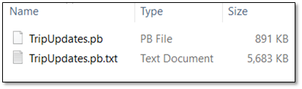
Protocol Buffers save space
Compressed binary is around 6 times smaller than plain text

Slide 26
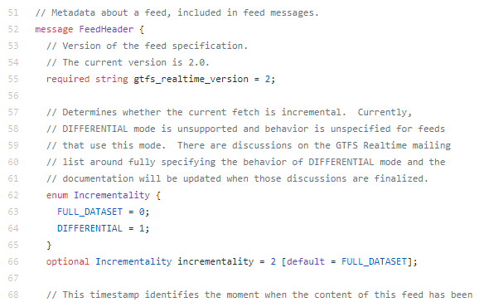
PB required = transit required
v1.0 - Optional/required for Cardinality field values were copied from .proto file

