Slide 1
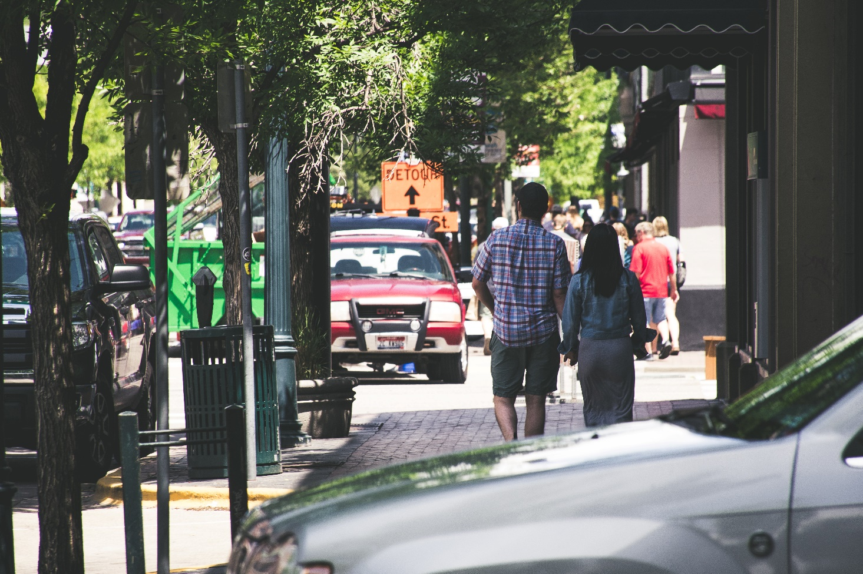
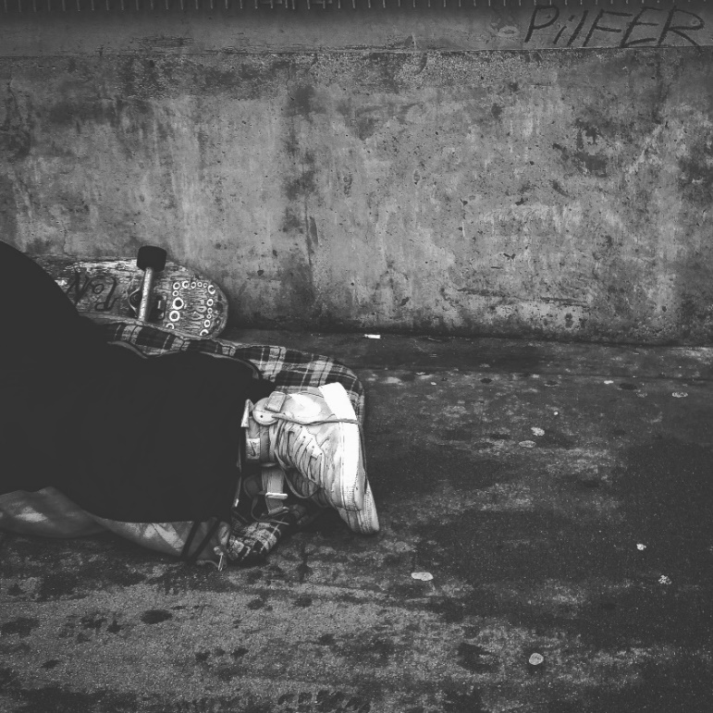
WHO GETS LEFT BEHIND IN BOOMTOWN?: RESEARCH FOR EQUITY
Erin Findley, LMSW
School of Social Work, The University of Texas at Arlington, Arlington, Texas 76019
BACKGROUND
Researchers from UTA School of Social Work and College of Engineering have partnered with the Collin County Homeless Coalition (CCHC) to investigate gaps in transportation services/infrastructure for lower-income individuals, particularly those experiencing homelessness and/or housing insecurity.
METHODS
Mixed Methods
Focus Groups
Surveys
Statistical Modeling
Examples of focus group questions:
How do you use public transportation systems in Collin County?
How would you describe the economic growth in Collin County over the last 5 years?
How well do you think residents of Collin County can access services like doctors’ offices, schools, jobs, and homes?
PRELIMINARY RESULTS
Excerpts from focus group of Collin County residents with limited or no transportation access
Lived Experience with No Vehicle
“I came from Plano, and I was able to catch the bus [there]. It was a big transition from going from Plano to here [McKinney] and not having any transportation. I had to pretty much walk everywhere or try to hitch rides until I saved up money for Uber…I would walk to work and then walk from my work to my daycare and then me and my baby would have to walk back [home]. It was kinda rough…it’s like six miles from my job to the daycare.” -Female Resident
Economic Growth & Infrastructure Gaps
“They [Collin County] want employees to manage the restaurants and the grocery stores and the Wal-Marts and all those type of things. They want service workers, but there needs to be transportation for somebody that earns that type of salary.” -Male Resident
Limited Transportation Access Limits Opportunity for Upward Mobility
“I have to walk to work, and luckily it’s just right there next door. But that prohibits me from getting a better job since I do not have transportation to go somewhere else.” -Female Resident
“I’m very fortunate, I have a vehicle right now, but it’s…gonna be 20 years old this year, so it has quite a few issues. I was able to secure a really decent job, but it’s eight miles from here [a supportive housing program]…[so] if it breaks down once I get out there, then I’m gonna fall right back down the rabbit hole again. I’ll lose that job.” -Male Resident
Research as Advocacy: Amplifying Voices
“We made a decision to come today to the meeting to…see if our voice could help maybe change the transportation situation in [Collin County]. I am a consumer. It bothers me – it affects me – not being able to have transportation.” -Female Resident
“I’m very prideful, I don’t like to ask people to help me…I want to be on my own feet. I’m a[n] older woman. I want to be able to stand up – be able [for] people to hear my voice. I hope whoever this [data] goes to knows how hard it is not to have transportation.” -Female Resident
NEXT STEPS
Online focus group of Collin County residents with access to personal transportation
In-person focus group for Collin County residents with limited or no transportation access
Survey development from focus group results
Distribution of survey to 100 residents with transportation access and 100 residents with limited or no transportation access
Analysis of results & report provided to Collin County Homeless Coalition
ABSTRACT
This project, a component of a graduate research assistantship with Dr. Jandel Crutchfield, is an interdisciplinary transportation equity study in Collin County funded through the National Institute for Transportation and Communities (NITC). The project aim is to evaluate transportation infrastructure of a suburban boomtown as it relates to environmental justice populations who reside there. This study utilizes a community-engaged, interdisciplinary approach to assess divergence between economic growth and transportation infrastructure development by measuring residents’ perspectives of this development in the area over the past decade. The mixed-methods exploratory design will collect responses from a diverse sample of stakeholders, including both environmental justice populations (i.e. transportation disadvantaged) and those who have greater transportation mobility (e.g., own personal vehicles). Researchers will also measure residents’ perspectives about the extent to which economic growth and infrastructure development impact access to affordable quality housing, employment, quality public education, and cultural and social activities. Additionally, a team member from civil engineering will conduct statistical modeling to map census data onto transit access. At the conclusion of the analysis, the researchers will produce a regional infrastructure profile to inform public policies supporting transportation infrastructure development, specifically to meet the needs of environmental justice populations.
IMPLICATIONS FOR SOCIAL WORK
A report will be provided to the Collin County Homeless Coalition to inform and advance future advocacy efforts for transportation-related needs of environmental justice populations.
Researchers will measure residents’ perspectives about the extent to which economic growth and infrastructure development impact access to:
Affordable quality housing;
Employment;
Quality public education; and
Cultural and social activities.
“Access to those things is those things.”
-Craig Keaton, MSW, PhD Candidate
LIMITATIONS
Self-report measures always contain possibility of social desirability bias.
Generalizability of results may be limited by convenience sampling and by data collection exclusively in Collin County, Texas.
REFERENCES
Poster based on research project entitled, “Helping Environmental Justice Populations Maintain Access to Opportunities in a Boomtown: An Interdisciplinary, Mixed-Methods Approach to Addressing Infrastructure Needs.”

