Slide 1
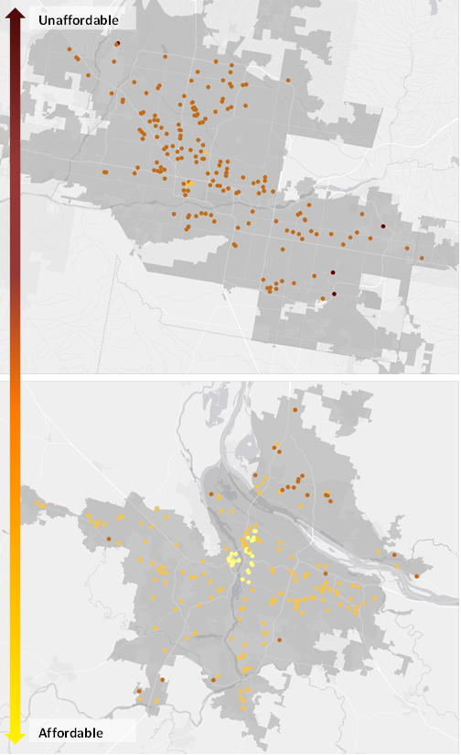
HOW AFFORDABLE IS HUD AFFORDABLE HOUSING?
Phoenix, AZ
Portland, OR
Reid Ewing, PhD
Professor and Director of Metropolitan Research Center
College of Architecture + Planning
University of Utah
375 S 1530 E
Salt Lake City, Utah 84112
P: 801-585-3745
ewing@arch.utah.edu
Shima Hamidi, PhD Candidate
College of Architecture + Planning
University of Utah
375 S 1530 E
Salt Lake City, Utah 84112
P: 801-809-3569
shima.hamidi@gmail.com
Notes:
Thanks for having me and thank you for the introduction
Today, I am going to be speaking about urban sprawl and its quality of life impacts.

Slide 2
HUD’s Measure of Housing Affordability
Total housing costs at or below 30% of gross annual income
It is considered the definition of housing affordability nationally and internationally
It is also the legislative standard used to qualify applicants for housing assistance (no less than 30%, no more than 40%)

Slide 3
So we can assume, therefore, that housing costs alone are affordable for households participating in HUD rental assistance programs.
But how about Transportation Costs?

Slide 4
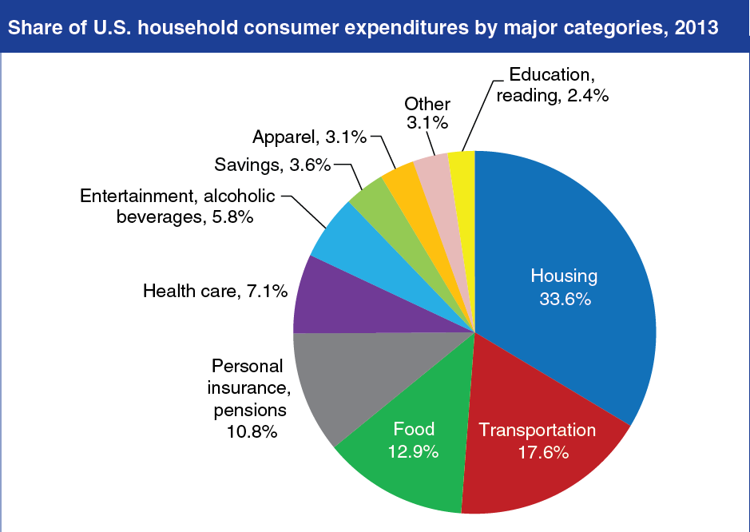
http://www.locationaffordability.info/lai.aspx

Slide 5
This study seeks to determine whether HUD rental assistance programs provide “affordable housing” when transportation costs are factored in.
This study is built on the work of the Center for Neighborhood Technology (CNT) with their Housing + Transportation (H+T) Affordability Index and the more recent Location Affordability Index (LAI).

Slide 6
H+T Index and Location Affordability Index
A location is affordable if total transportation costs at or below 15% of gross annual income

Slide 7
Location Affordability Index
http://www.locationaffordability.info/lai.aspx

Slide 8
Shortcomings of LAI
Limited characterization of the built environment in their modeling
Reliance on VMT data from only one state (Illinois )
Some models based on aggregate (block group or census tract) data rather than disaggregate (household) data
Use of national-level unit cost data
Models are for typical households and not low income

Slide 9
This study is built on the work of the CNT and LAI. But, addresses their shortcomings,
Using disaggregate data to develop cost models
Accounting for all the so-called D variables
Being specific to low-income households

Slide 10
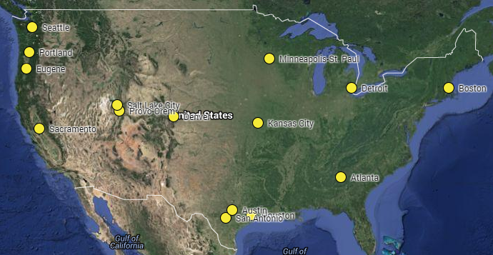
External Validity
This study addresses the external validity issue by pooling household travel and built environment data from 15 diverse U.S. regions
Department of City & Metropolitan Planning, University of Utah

Slide 11
Data
A main criterion for inclusion of regions in this study was data availability. Regions had to offer:
regional household travel surveys with XY coordinates for trip ends, so we could geocode the precise locations of residences and measure the precise lengths of trips; and
land use databases at the parcel level with detailed land use classifications, so we could study land-use intensity and mix down to the parcel level for the same years as the household travel surveys.
Department of City & Metropolitan Planning, University of Utah

Slide 12
Sample
Households and trips
 | Survey Date | Surveyed Households | Surveyed Trips
Atlanta | 2011 | 9,575 | 93,681
Austin | 2005 | 1,450 | 14,249
Boston | 2011 | 7,826 | 86,915
Denver | 2010 | 5,551 | 67,764
Detroit | 2005 | 939 | 14,690
Eugene | 2011 | 1,679 | 16,563
Houston | 2008 | 5,276 | 59,552
Kansas City | 2004 | 3,022 | 31,779
Minneapolis-St. Paul | 2010 | 8,234 | 79,236
Portland | 2011 | 4,513 | 47,551
Provo-Orem | 2012 | 1,464 | 19,255
Sacramento | 2000 | 3,520 | 33,519
Salt Lake City | 2012 | 3,491 | 44,576
San Antonio | 2007 | 1,563 | 14,952
Seattle | 2006 | 3,908 | 40,450
Total |  | 62,011 | 664,732
Department of City & Metropolitan Planning, University of Utah

Slide 13
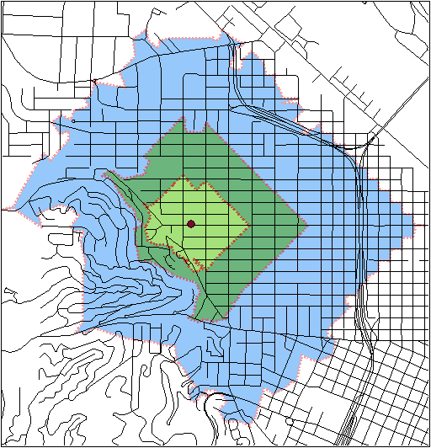
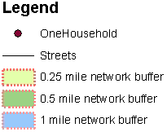
Buffer Widths
Road network buffer were established around household geocode location at three scales: 0.25 mile, 0.5 mile, 1 mile. Built environmental variables were computed for each household and all three buffer scales.
Department of City & Metropolitan Planning, University of Utah
Notes:
Buffers were established around household geocode locations with three different buffer widths, one quarter mile, one half mile, and one mile. Built environmental variables were computed for each household and all three buffer widths. The rationale for using different buffers is that different travel outcomes may depend on the built environment at different scales around home locations. For example, the number of walk trips may depend on conditions within a shorter distance of the home location than does the number of automobile trips.

Slide 14
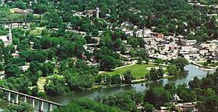
7D variables consistently defined
Density
Diversity
Design
Destination Accessibility
Distance to Transit
Development Scale
Demographics
Department of City & Metropolitan Planning, University of Utah

Slide 15
Metropolitan Areas
Metropolitan area population
Metropolitan area employment
Compactness index
Individual Households
Household VMT
Household number of transit trips
Number of household vehicles
Household size
Household income
Transit frequencies
Activity density
Job-population balance
Land use mix
Intersection density
Proportion of 4-way intersections
Single family housing unit
Hierarchical Linear Modeling

Slide 16
Statistical Analysis
Multilevel modeling (MLM / HLM) partitions variance between the household/neighborhood level (Level 1) and the region level (Level 2) and then seeks to explain the variance at each level in terms of D variables.
Two-stage “hurdle” model
The stage 1 categorizes households as either generating VMT and transit trips or not.
The stage 2 model estimates the amount of VMT and number of transit trips generated for households with any VMT and transit trips.
Department of City & Metropolitan Planning, University of Utah

Slide 17
Household Vehicle ownership
Negative Binomial Model of Household Vehicle ownership
 | coefficient | standard error | t-ratio | p-value
constant | -0.108 | 0.042 | -2.56 | 0.027
hhsize | 0.060 | 0.008 | 7.86 | <0.001
hhworkers | 0.142 | 0.011 | 13.21 | <0.001
hhincome | 0.0086 | 0.0006 | 14.71 | <0.001
sf | 0.301 | 0.021 | 14.11 | <0.001
emp10a | -0.0019 | 0.0009 | 2.094 | 0.036
actdenqmi | -0.0057 | 0.0010 | -5.90 | <0.001
entropyqmi | -0.142 | 0.021 | -6.81 | <0.001
intdenhmi | -0.00089 | 0.0001 | -7.86 | <0.001
int4whmi | -0.0013 | 0.0003 | -4.90 | <0.001
tfreq | -0.00029 | 0.00008 | -3.83 | <0.001

Slide 18
VMT
Logistic Regression Model of Log Odds of Any Household VMT
 | coefficient | standard error | t-ratio | p-value
constant | 1.72 | 0.172 | 9.96 | <0.001
hhsize | 0.226 | 0.052 | 4.36 | <0.001
hhworkers | 0.315 | 0.103 | 3.054 | 0.003
hhincome | 0.0331 | 0.0030 | 11.00 | <0.001
sf | 0.850 | 0.102 | 8.33 | <0.001
emp10a | -0.0224 | 0.0061 | -3.67 | 0.001
entropyqmi | -0.709 | 0.115 | -6.14 | <0.001
intdenhmi | -0.0025 | 0.0006 | -4.039 | <0.001
int4whmi | -0.0129 | 0.0015 | -8.51 | <0.001
tfreq | -0.00092 | 0.0002 | -5.33 | <0.001
Linear Regression Model of Log of Household VMT (for households with any VMT)
 | coefficient | standard error | t-ratio | p-value
constant | 2.55 | 0.081 | 31.69 | <0.001
hhsize | 0.164 | 0.024 | 6.97 | <0.001
hhworkers | 0.185 | 0.0076 | 24.28 | <0.001
hhincome | 0.0072 | 0.0008 | 9.06 | <0.001
emp10a | -0.0076 | 0.0018 | -4.13 | <0.001
actdenhmi | -0.0046 | 0.0014 | -3.03 | 0.001
entropyhmi | -0.297 | 0.037 | -8.02 | <0.001
intdenhmi | -0.0015 | 0.00018 | -8.37 | <0.001
int4whmi | -0.0026 | 0.0005 | -5.49 | <0.001
tfreq | -0.000089 | 0.00003 | -3.39 | 0.001

Slide 19
Household Transit Trips
Logistic Regression Model of Log Odds of Any Transit Trips
 | coefficient | standard error | t-ratio | p-value
constant | -2.82 | 0.24 | -12.10 | <0.001
hhsize | 0.157 | 0.025 | 6.27 | <0.001
hhworkers | 0.266 | 0.051 | 5.26 | <0.001
hhincome | -0.021 | 0.0032 | -6.43 | <0.001
sf | -0.791 | 0.083 | -9.47 | <0.001
entropyqmi | 0.480 | 0.098 | 4.89 | <0.001
intdenhmi | 0.0029 | 0.0003 | 9.34 | <0.001
int4whmi | 0.013 | 0.0027 | 4.77 | <0.001
tfreq | 0.00093 | 0.0002 | 5.93 | <0.001
Negative Binomial Regression Model of Household Transit Trips (for households with any transit trips)
 | coefficient | standard error | t-ratio | p-value
constant | 0.853 | 0.107 | 7.96 | <0.001
hhsize | 0.135 | 0.015 | 8.96 | <0.001
hhincome | -0.0057 | 0.0015 | -3.79 | <0.001
entropyqmi | 0.173 | 0.084 | 2.05 | 0.040

Slide 20
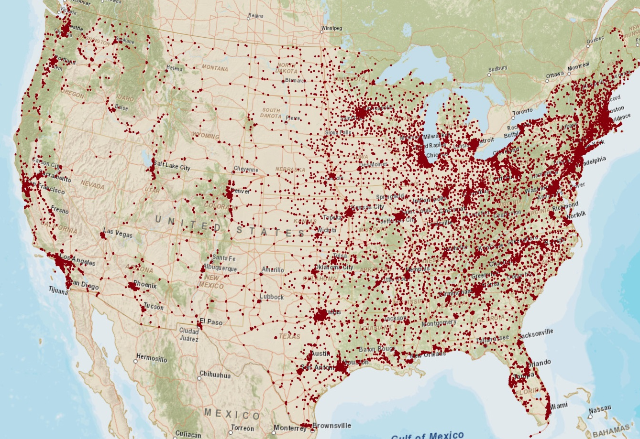
HUD’s Multifamily Portfolio Dataset

Slide 21
Cost Calculations:
Household Transportation Costs = $\left[auto ownership∗vehicle fixed costs per car\right]+ \left[auto use∗fuel costs pre gallon\right]+ \left[transit use∗transit fare per trip\right]$

Slide 22
$$\left[auto ownership∗vehicle fixed costs per car\right]$$
NHTS 2009
Top 15 popular automobiles for low income households according to NHTS
Rank | make name | model name | Number of cases
1 | FORD | F-Series pickup | 3,934
2 | CHEVROLET | C, K, R, V-Series pickup | 2,842
3 | TOYOTA | Camry | 2,691
4 | HONDA | Accord | 2,023
5 | FORD | Taurus/Taurus X | 2,018
6 | TOYOTA | Corolla | 1,781
7 | DODGE | Caravan/Grand Caravan | 1,644
8 | FORD | Ranger | 1,642
9 | HONDA | Insight | 1,534
10 | FORD | Bronco II/Explorer | 1,272
11 | CHEVROLET | Impala/Caprice | 1,238
12 | DODGE | Ram Pickup | 1,194
13 | CHEVROLET | Fullsize Blazer/Tahoe | 1,136
14 | JEEP | Cherokee | 1,088
15 | MERCURY | Marquis/Monterey | 990

Slide 23
$$\left[auto use∗fuel costs pre gallon\right]$$
Five Most and Least Expensive Regions for Average Gasoline Price per Gallon (2010)
Most expensive regions ($ per gallon)
Honolulu, HI | $3.37
Anchorage, AK | $3.35
San Francisco, CA | $3.19
Bakersfield, CA | $3.16
Santa Barbara-Santa Maria, CA | $3.15
Least expensive regions ($ per gallon)
Springfield, MO | $2.55
Joplin, MO | $2.56
Augusta-Aiken, GA-SC | $2.56
Greenville-Spartanburg, SC | $2.57
Cheyenne, WY | $2.57

Slide 24
$$\left[transit use∗transit fare per trip\right]$$
We computed average transit fare for each region by dividing the total transit revenue by total number of unlinked passenger trips for the region

Slide 25
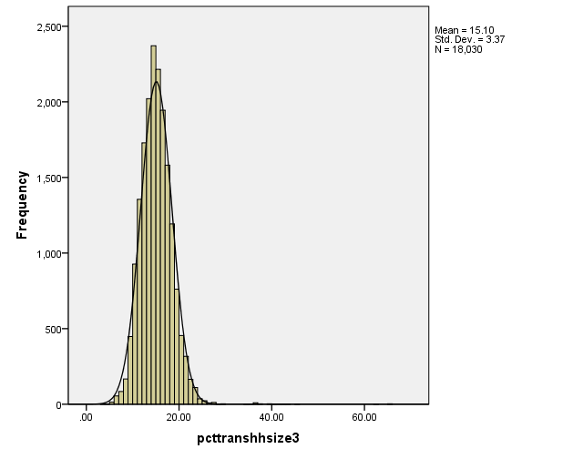

Slide 26
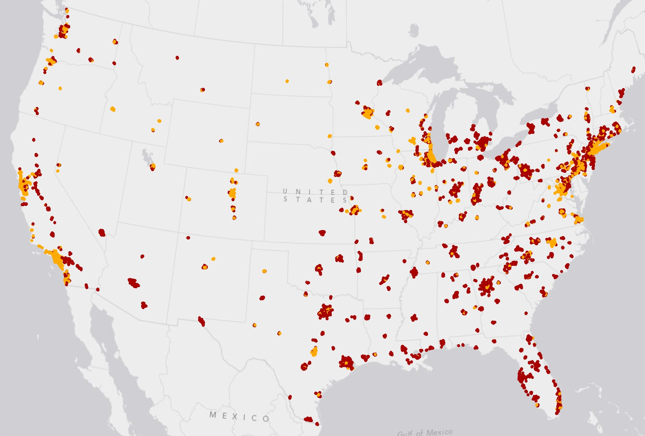
Transportation Affordability
Red: Unaffordable
Orange: Affordable

Slide 27
Fifteen Metropolitan Areas with Highest Number of Unaffordable HUD Assistance Properties in Terms of Transportation Costs
MSA name | Number of affordable properties | Total number of properties | % of properties affordable
Columbus, OH | 82 | 217 | 37.79
Cincinnati-Middletown, OH-KY-IN | 90 | 260 | 34.62
Cleveland-Elyria-Mentor, OH | 75 | 262 | 28.63
Dallas-Plano-Irving, TX | 60 | 212 | 28.3
Atlanta-Sandy Springs-Marietta, GA | 63 | 246 | 25.61
Detroit-Livonia-Dearborn, MI | 48 | 208 | 23.08
Indianapolis-Carmel, IN | 43 | 195 | 22.05
Houston-Sugar Land-Baytown, TX | 46 | 240 | 19.17
Pittsburgh, PA | 57 | 321 | 17.76
Buffalo-Niagara Falls, NY | 24 | 145 | 16.55
San Antonio-New Braunfels, TX | 18 | 133 | 13.53
Riverside-San Bernardino-Ontario, CA | 11 | 129 | 8.53
Tampa-St. Petersburg-Clearwater, FL | 5 | 182 | 2.75
Phoenix-Mesa-Glendale, AZ | 5 | 191 | 2.62
Warren-Troy-Farmington Hills, MI | 1 | 147 | 0.68

Slide 28
Fifteen Metropolitan Areas with Highest Number of Affordable HUD Assistance Properties in Terms of Transportation Costs
MSA name | Number of affordable properties | Total number of properties | % of properties affordable
San Francisco-San Mateo-Redwood City, CA | 156 | 156 | 100
Los Angeles-Long Beach-Glendale, CA | 763 | 787 | 96.95
Denver-Aurora-Broomfield, CO | 220 | 233 | 94.42
New York-White Plains-Wayne, NY-NJ | 686 | 756 | 90.74
Portland-Vancouver-Hillsboro, OR-WA | 197 | 220 | 89.55
Minneapolis-St. Paul-Bloomington, MN-WI | 376 | 423 | 88.89
Oakland-Fremont-Hayward, CA | 160 | 181 | 88.4
Washington-Arlington-Alexandria, DC-VA | 311 | 353 | 88.1
Chicago-Joliet-Naperville, IL | 596 | 693 | 86
Kansas City, MO-KS | 164 | 208 | 78.85
Philadelphia, PA | 205 | 261 | 78.54
Milwaukee-Waukesha-West Allis, WI | 151 | 205 | 73.66
Baltimore-Towson, MD | 188 | 281 | 66.9
Providence-New Bedford-Fall River, RI-MA | 161 | 267 | 60.3
St. Louis, MO-IL | 168 | 281 | 59.79

Slide 29
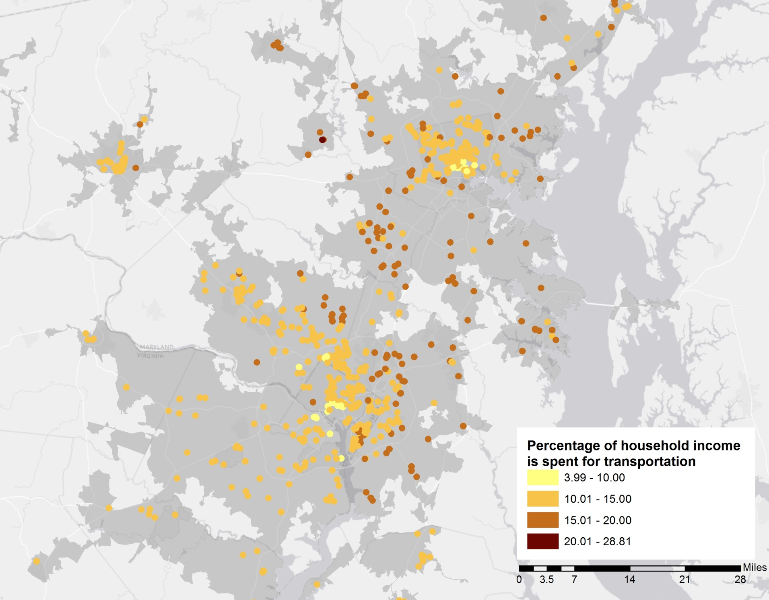
Washington D.C

Slide 30
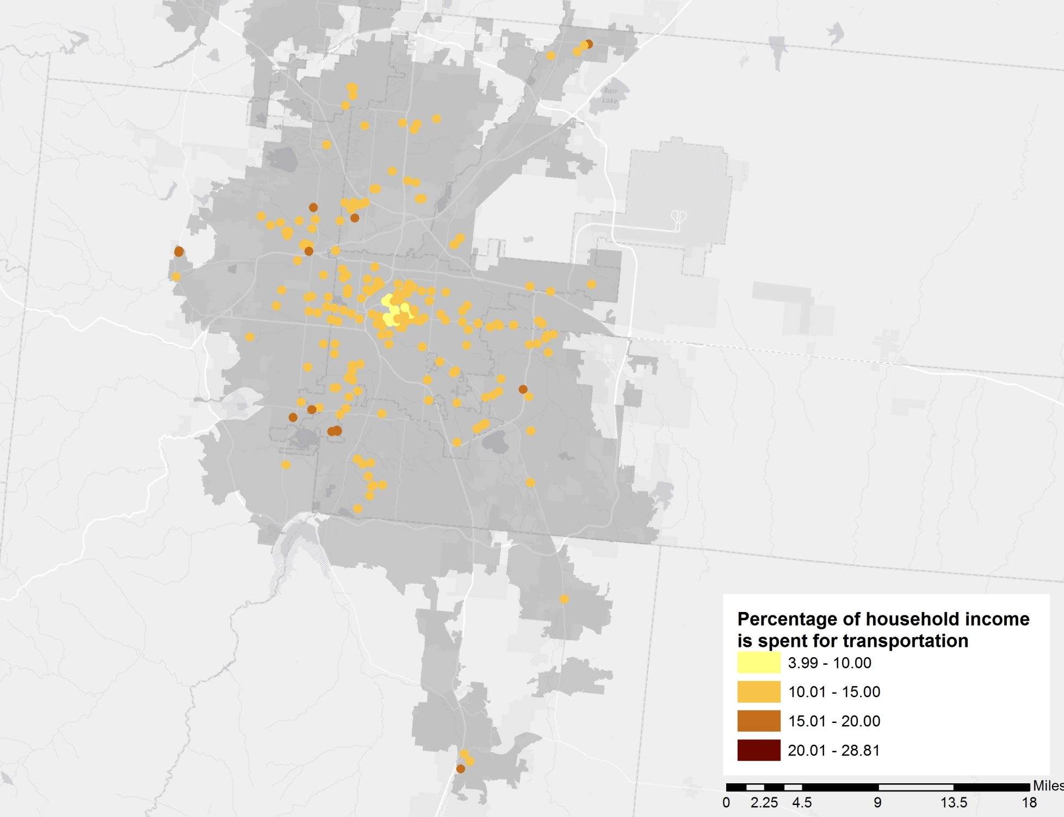
Denver, CO

Slide 31
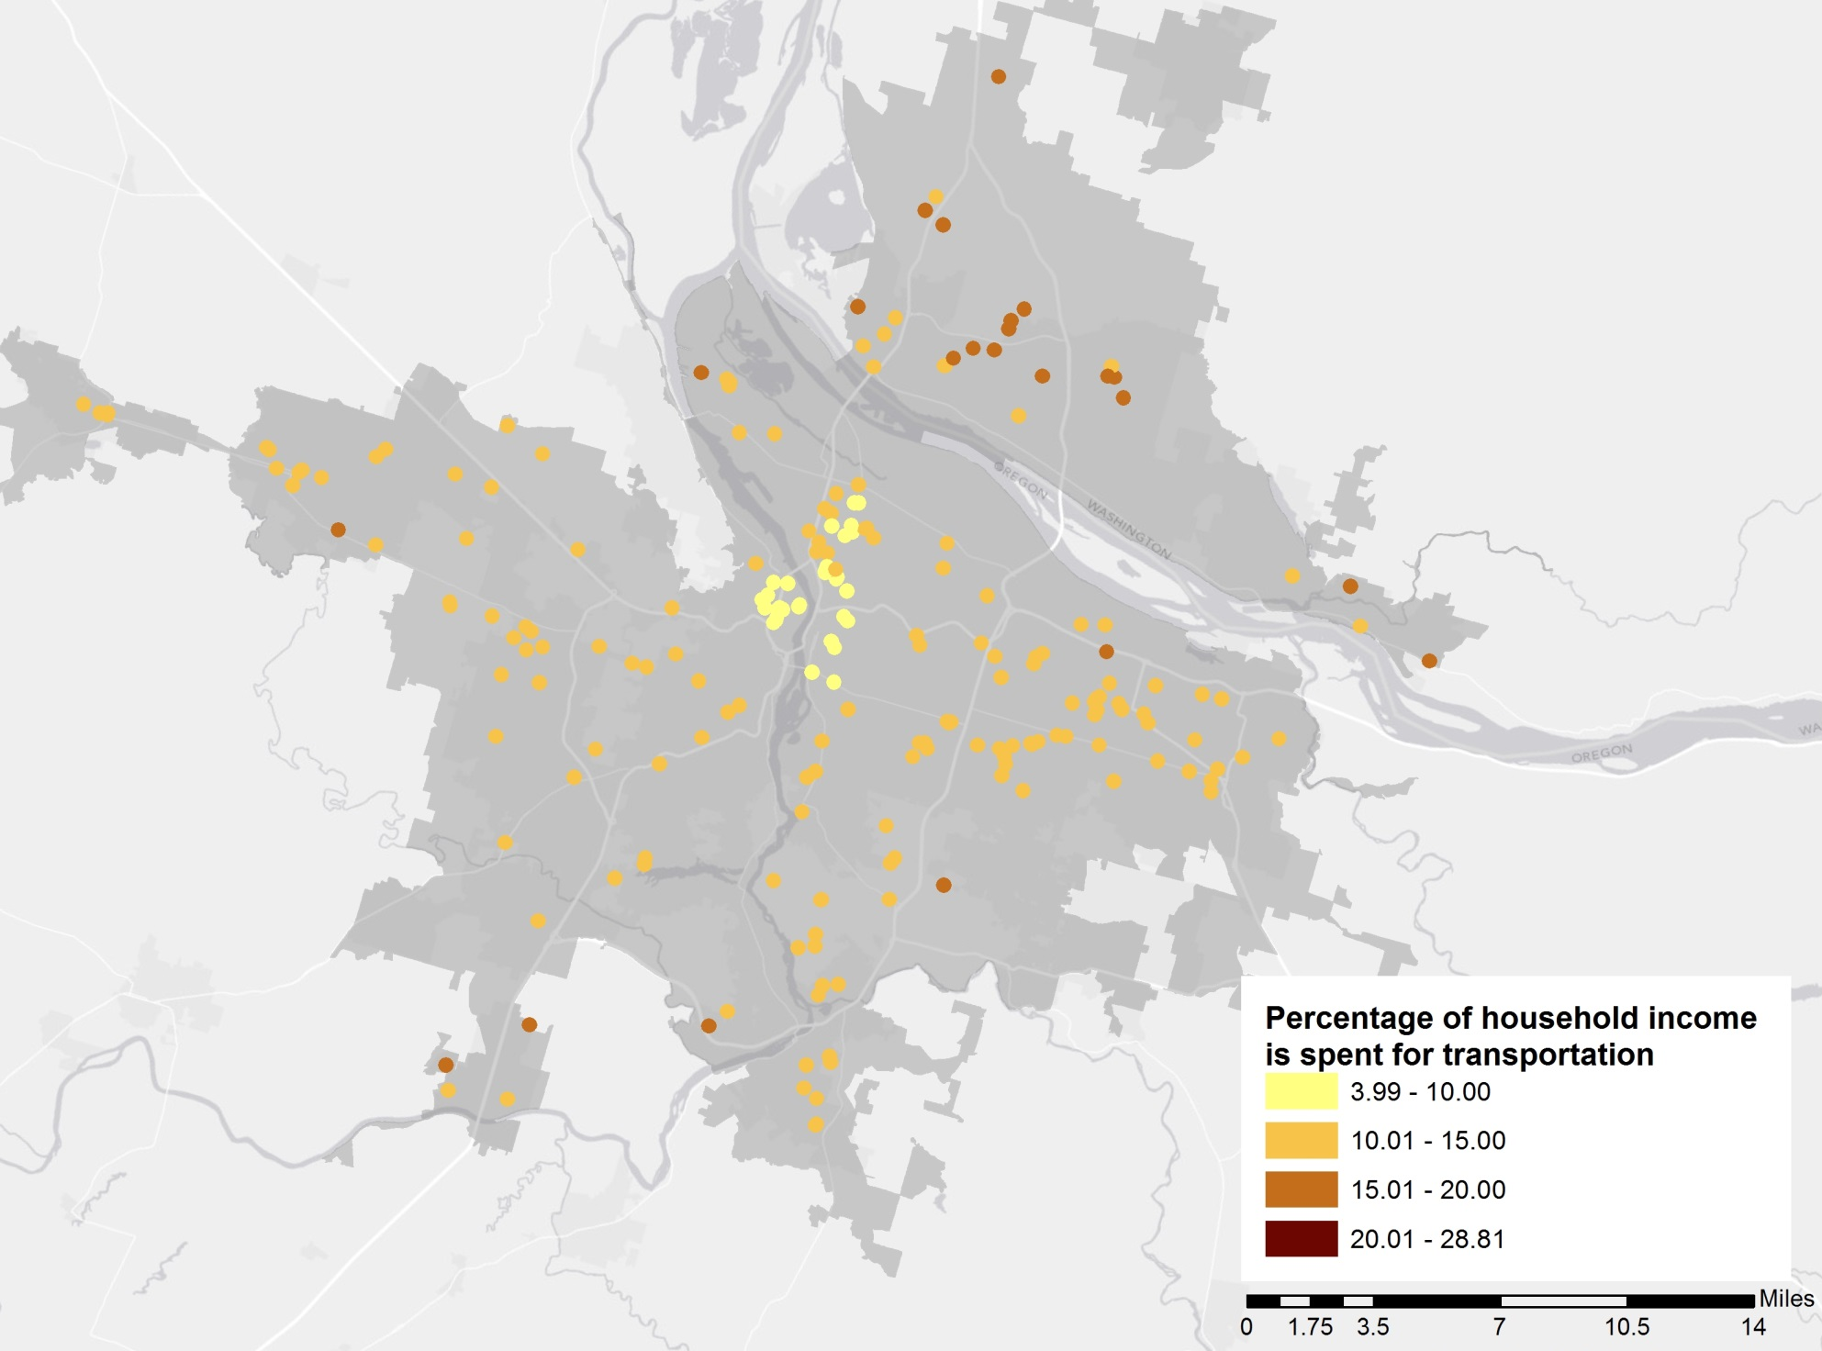
Portland, OR

Slide 32
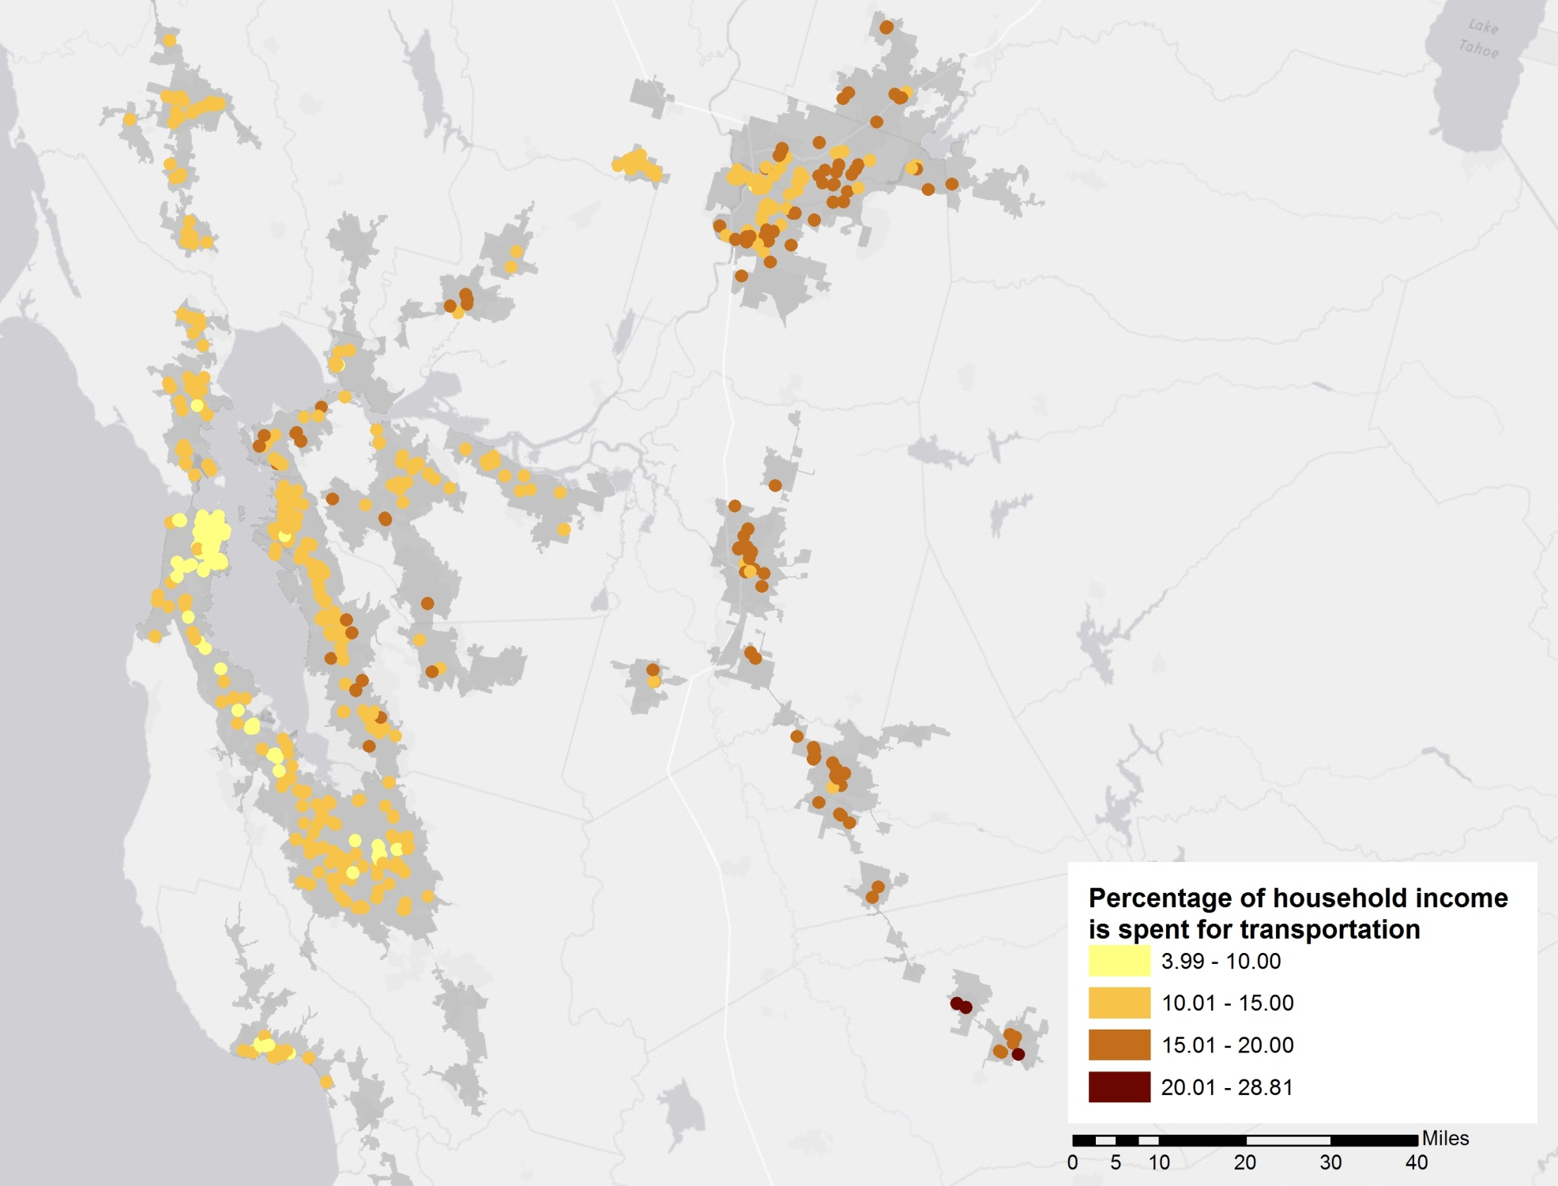
San Francisco, CA

Slide 33
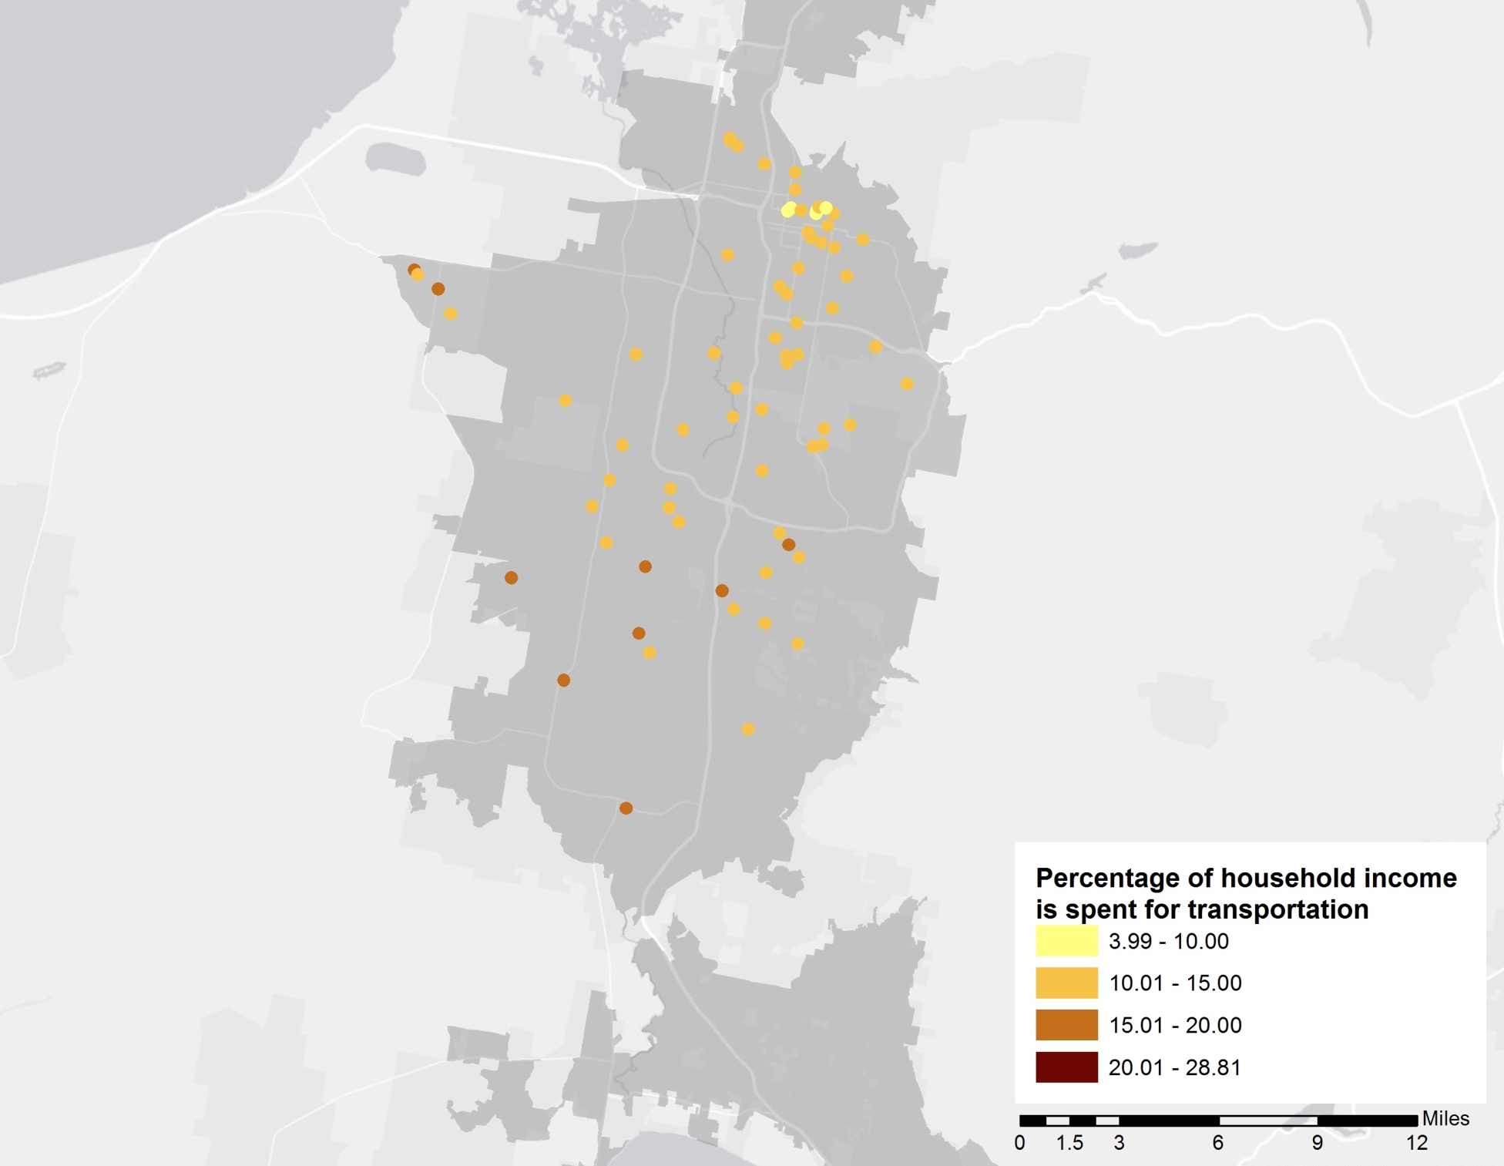
Salt Lake City, UT

Slide 34
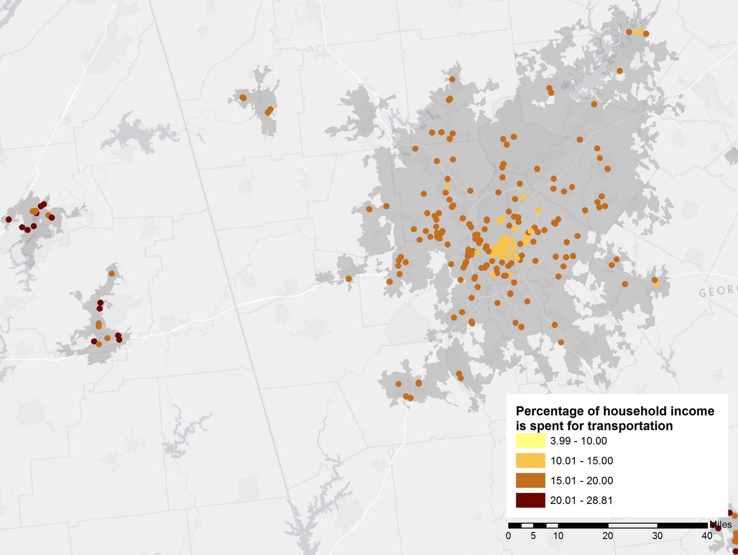
Atlanta, GA

Slide 35
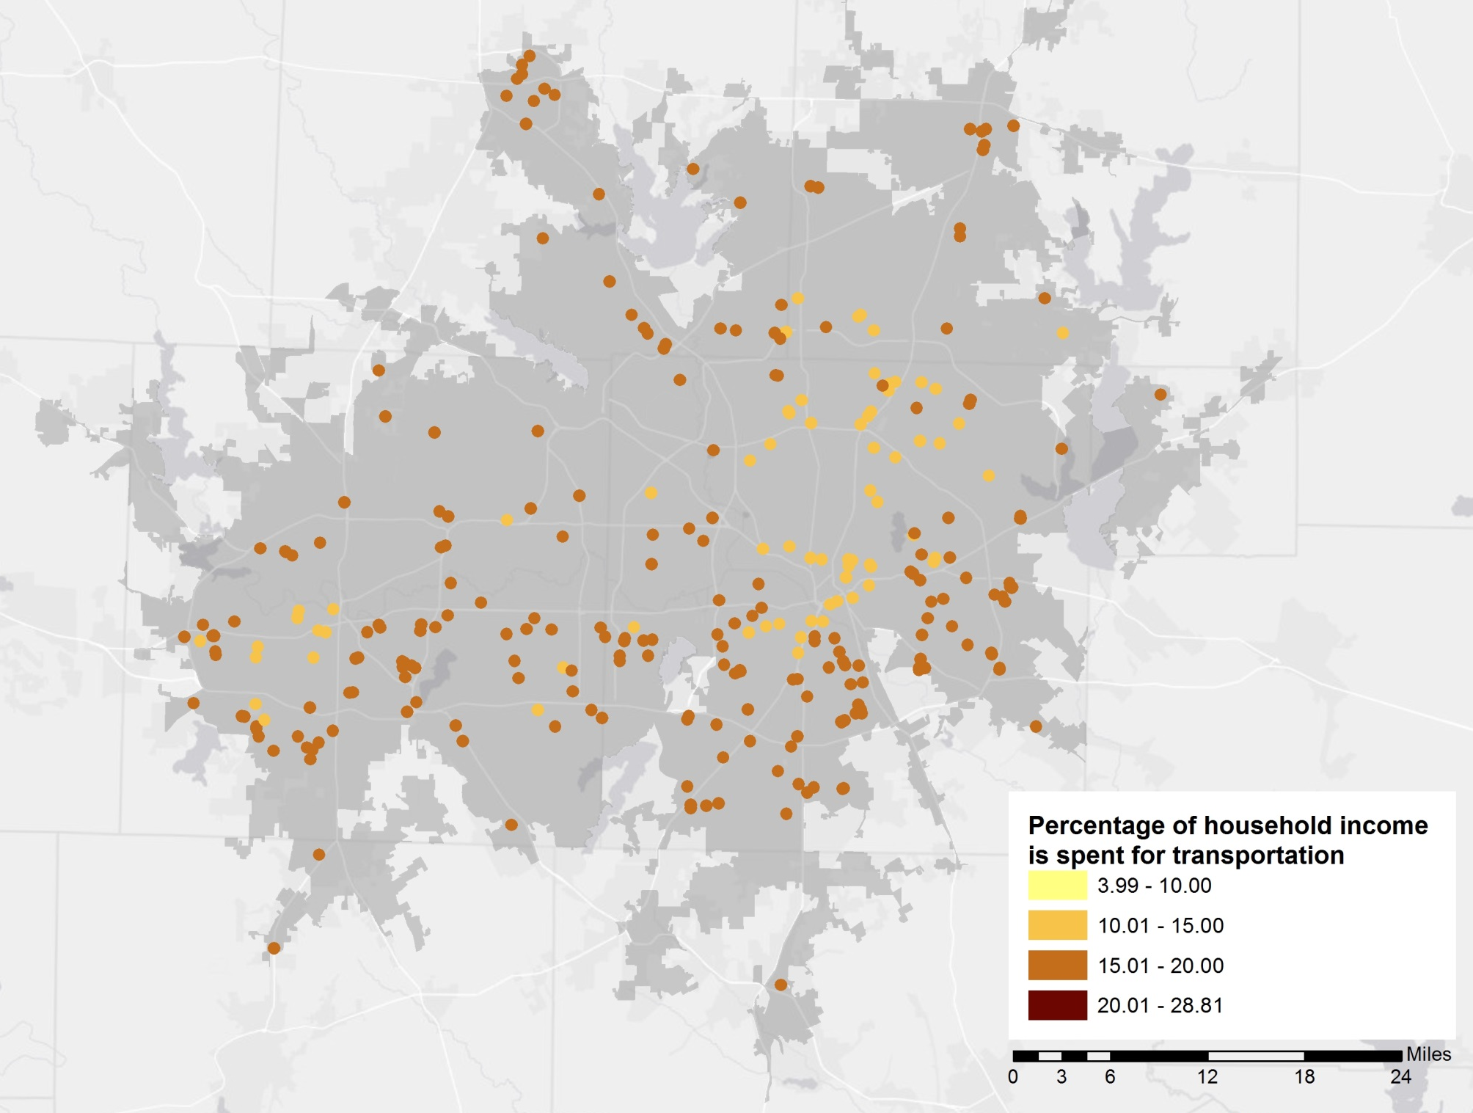
Dallas, TX

Slide 36
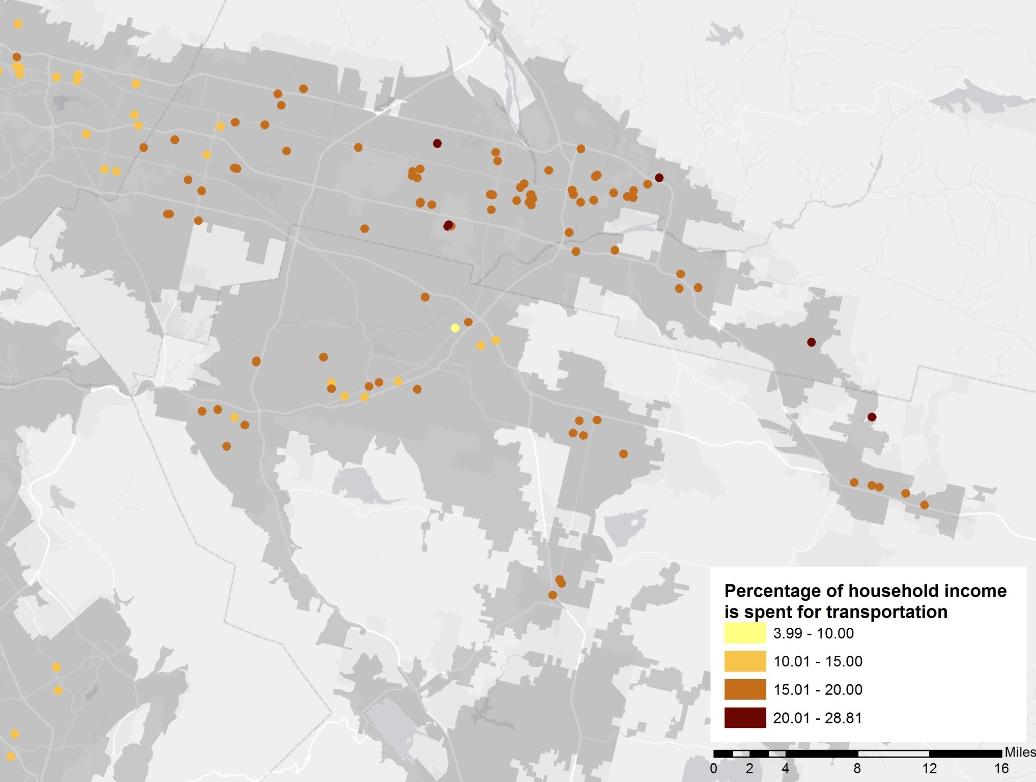
Riverside, CA

Slide 37
Conclusions
This study is the first attempt to evaluate the affordability of HUD rental assistance program units at the national scale
The high quality of this research results from :
its assemblage of household travel data for 15 diverse regions
its linkage of these data to built environmental and transit data for buffers around individual households
its use of multi-level and hurdle modeling
specific to low-income households, a group that has received little attention in the travel literature
This research suggests that HUD rental assistance programs, when they subsidize housing in sprawling auto-dependent areas, are not holistically affordable
It also suggests that HUD can provide more affordable units to low income families by directing subsidies to better (more compact, walkable, and transit-served) locations.

