Slide 1
Optimizing Mobility, Housing, and Services for Re-Entry Success
Michael Mitchell, Department of Criminology and Criminal Justice
Jaya Davis, Department of Criminology and Criminal Justice
Anne Nordberg, School of Social Work
Sarah Robinson, School of Social Work
Craig Keaton, School of Social Work

Slide 2
The Problem
Re-entry
More than 600,000 individuals return to communities from prisons each year
People cycle through jails more than 10.5 million times annually
Recidivism
83% re-arrest within 9 years
55% re-incarceration within 5 years
(BJS, 2018; NIJ, 2014; Sawyer & Wagner, 2019)

Slide 3
Most Commonly Identified Needs for Successful Reentry
Housing
Employment
Access to health/mental health services
Support system
Meeting parole/probation obligations
Transportation
(La Vigne, Davies, Palmer, & Halberstadt, 2008; Morani, Wikoff, Linhorst, & Bratton, 2011)

Slide 4
The Project
National Institute for Transportation and Communities (NITC)
Objectives
Given existing transportation networks, reentry obligations, and service provider locations; identify optimal housing locations (existing or proposed) for individuals returning to Dallas, Texas from incarceration.
Given existing residential clusters of individuals returning from incarceration, transportation networks, and reentry obligations; identify optimal service provider locations (existing or proposed).
Given existing residential clusters of individuals returning from incarceration, service provider locations, and reentry obligations; identify optimal residential assignments both overall and for individual clients.

Slide 5
The Project
QIMS
Mixed methods
Informing the facility location problem (qualitative)
Clients/Returning from incarceration
Brokers
TAC/CAB
Facility location problem structure to formulate a strategy (quantitative)
Siting housing for inmates reentering society
Select optimal locations for social and health services
Select the optimal location to house a single client

Slide 6
Qualitative Interpretive Meta-Synthesis (QIMS)
Synthesizes published qualitative data to come to a deeper understanding of a phenomenon
Environmental influences on services and the mental health for incarcerated populations (Terry, Praetorius, & Nordberg, 2018)
Lived experiences of life without parole (Silva, 2015)
Units of Study (n=11)
Analysis using cloud based software

Slide 8
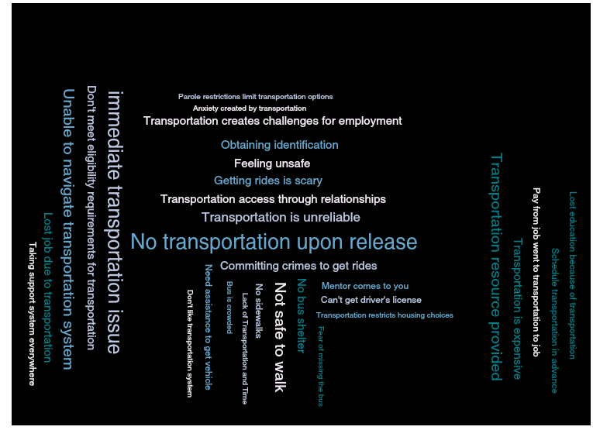

Slide 9
Most common codes from QIMS
Public transportation takes lots of time
Transportation creates challenges for parole requirements
Lack of financial means for transportation
No transportation upon release/Immediate transportation issue
Not safe to walk

Slide 10
Major Themes
Obligations linked to transportation;
Challenges of public transportation, and;
Losses due to inadequate transportation.

Slide 11
Informing the Facility Location Problem
Semi-structured interviews
Clients
Brokers*
TAC/CAB

Slide 12
Initial Findings from Broker Interviews
Dynamic nature of prioritization of client needs
Client
Strengths – support structure, education, veteran status
Deficits – homelessness
Broker
Mentor vs facilitator
Sustainable transportation
Time – 30-40 min
Weather
Modes of transport
Independence

Slide 13
References
BJS (2018) https://www.bjs.gov/index.cfm?ty=pbdetail&iid=6267
La Vigne, N., Davies, E., Palmer, T., & Halberstadt, R. (2008). Release planning for successful reentry: A guide for corrections, service providers, and community groups. Urban Institute: Justice Policy Center. https://www.urban.org/sites/default/files/publication/32056/411767-Release-Planning- for-Successful-Reentry.PDF
NIJ (2014) https://www.bjs.gov/content/pub/pdf/rprts05p0510.pdf
Sawyer, W., & Wagner, P. (2019). Mass incarceration: The whole pie 2019. Prison Policy Initiative: https://www.prisonpolicy.org/reports/pie2019.html
Silva, S.M. (2015). On the meaning of life: A qualitative interpretive meta-synthesis of the lived experience of life without parole. Journal of Social Work, 15(5), 498-515. doi: 10.1177/1468017314550748.
Terry, L.F., Praetorius, R.T., & Nordberg, A. (2018). Environmental influences on services for and mental health of incarcerated populations: A review. Journal of Social Work, 18(1), 46-65. doi: 10.1177/1468017316651999.

