Slide 1
Transportation Experiences Among Former Offenders: Informing a Facility Location Intervention

Slide 2
Notes:
We are a multidisciplinary team of social work, criminal justice and engineering working with a Dallas reentry service provider, Unlocking doors

Slide 3
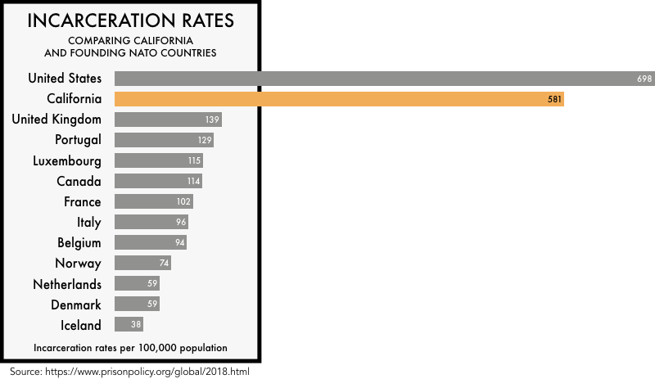
Notes:
The US incarcerates more people than any country in the world.
More than 600,000 individuals return to communities from prisons each year

Slide 4
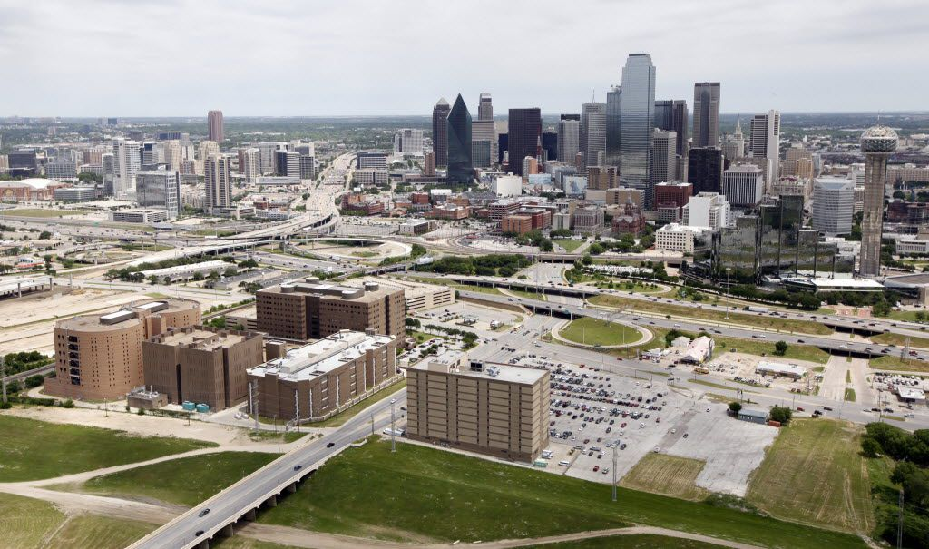
Notes:
Most Unlocking doors clients come out of here, the dallas county jail. This jail houses roughly 7000 men and women.

Slide 5
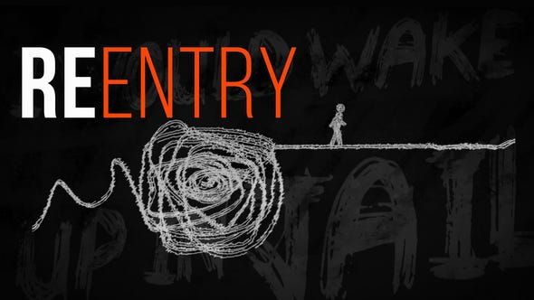
Notes:
Reentry from jail and prison is complicated. People are released with specific conditions they MUST meet or face returning to jail, so failure to meet the court’s obligations could mean losing their freedom.

Slide 6
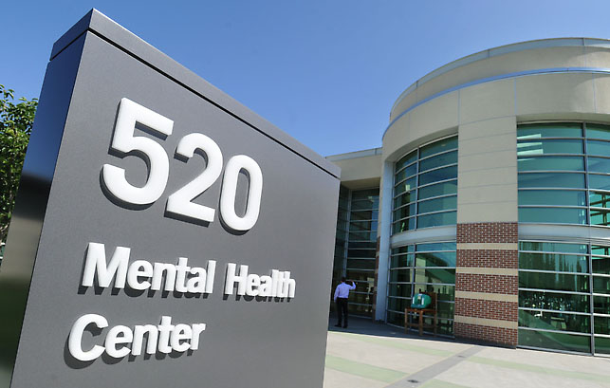
Notes:
Frequently, former prisoners must find mental health services. Mental health and addictions issues are much higher among returning citizens so this is crucial for their success on the outside.

Slide 7
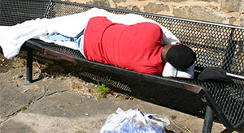
Notes:
Safe and available housing is especially difficult and many people have little choice but to sleep on the streets.

Slide 8
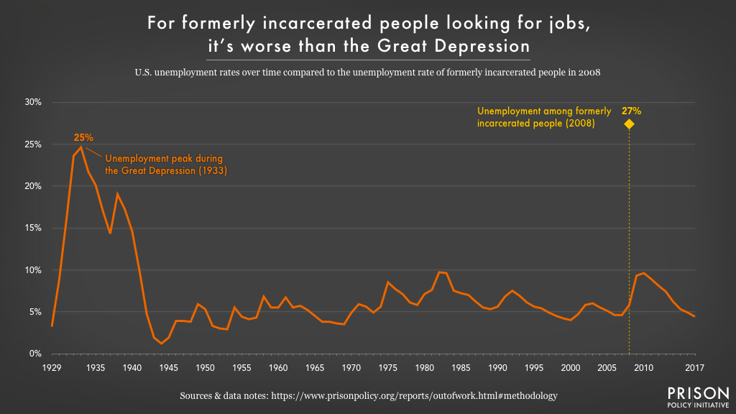
Notes:
Employment is one of the largest challenges faced by this population. Here you can see that unemployment rates among people with criminal records is greater than that of the depression.

Slide 9
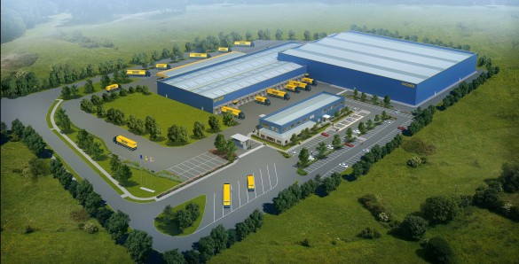
Notes:
One reason for this is the siting of employers who might employ someone with a record, like factories or warehouses – often appear in areas zoned for industrial use, which is often distant from most housing zones.

Slide 10
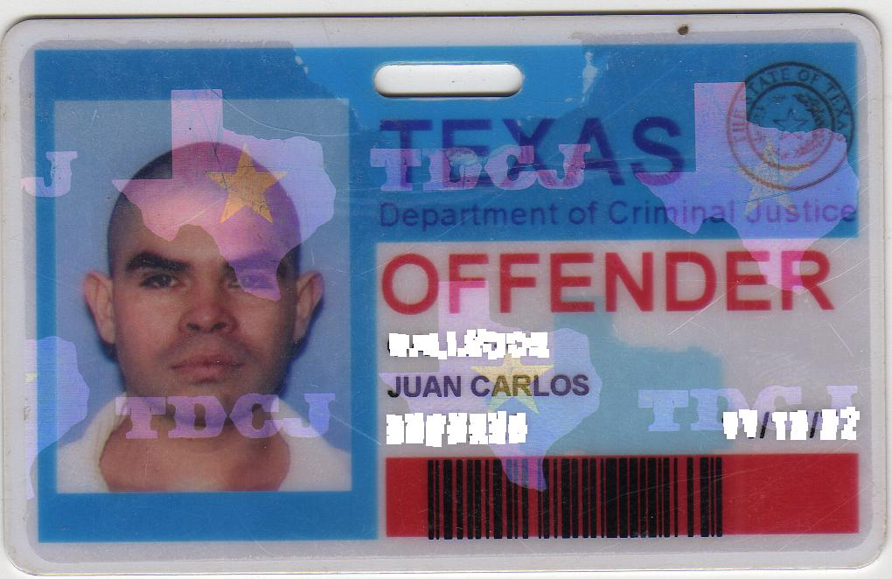
Notes:
This is an example of often the only ID returning citizens possess and use to apply for jobs, apartments, bank accounts, bus passes etc. It is very hard to escape the stigma.

Slide 11
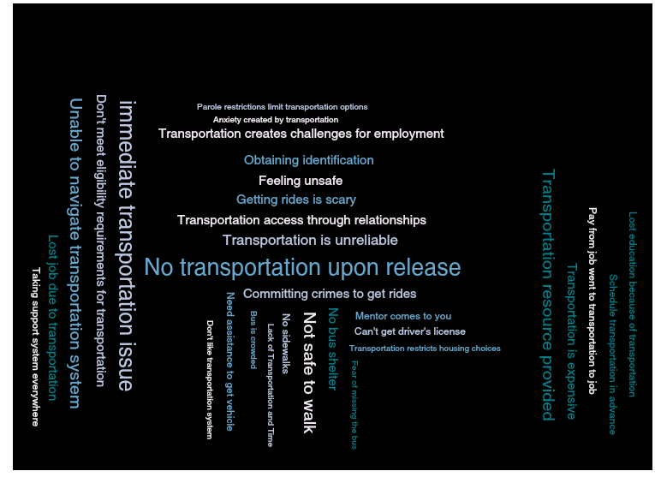
Notes:
Our team first reviewed the literature about transportation barriers among returning citizens and found that transportation is central to the success and failure of reentry. And transportation problems start the moment a person walks out of jail or prison.

Slide 12
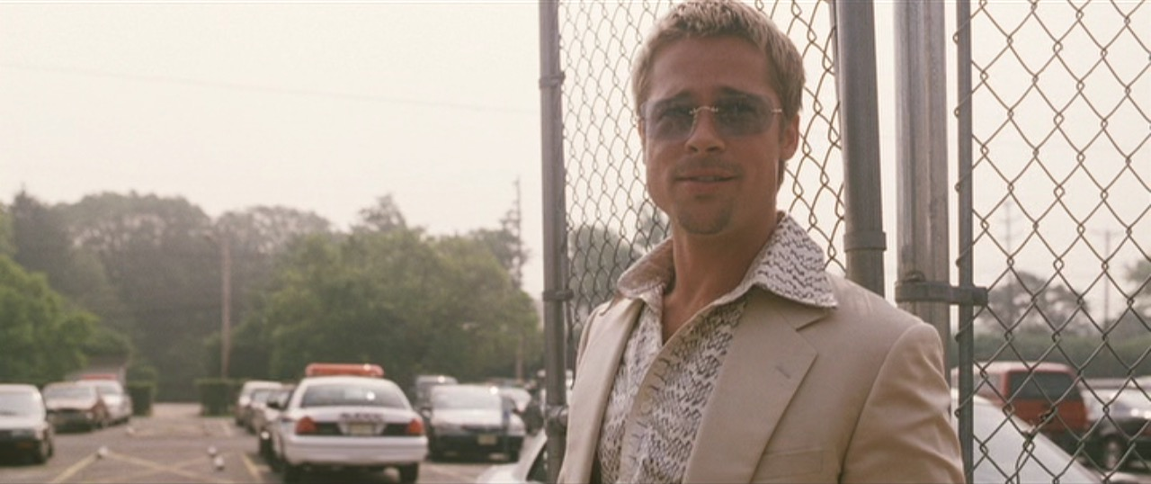
Notes:
Unlike George Clooney leaving jail in ocean’s 12, brad pitt will not be waiting for you. No one knows when they will be released so they cannot call friends and family for a ride.

Slide 13
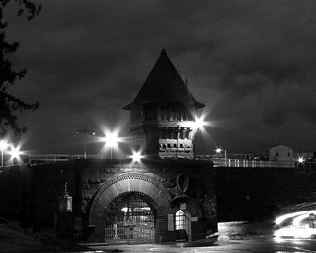
Notes:
Many people are purposely released after midnight when taxis and buses are not operating if the jail is actually located in a city where those options are available.

Slide 14
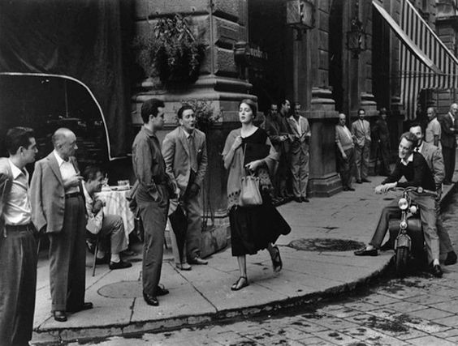
Notes:
One women described her exit from jail as “blah, blah, blah”

Slide 15
Notes:
One returning citizen we interviewed said, “not having transportation is like still being incarcerated, it takes away your freedom of movement”

Slide 16
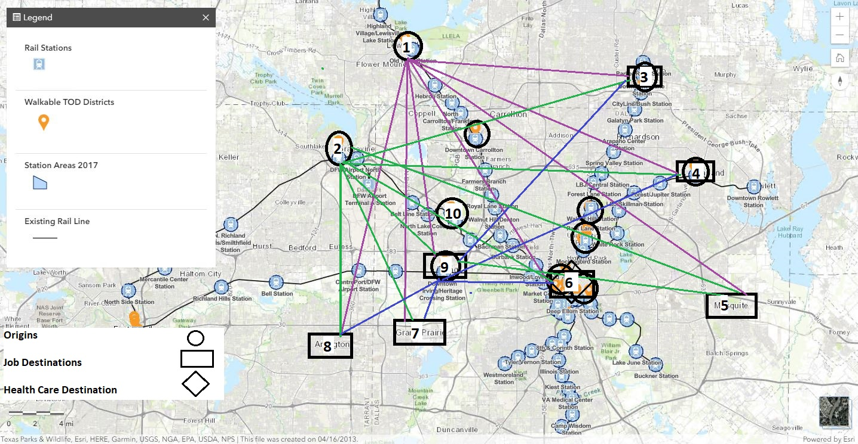
Notes:
The facility location problem formulation is beginning now. Using Unlocking doors client data, we have mapped origins, job locations (rectangles) and health care facilities clustered in downtown dallas.

Slide 17
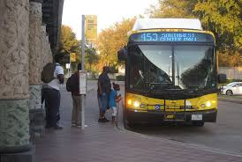
Notes:
We know that the public transportations system in dallas is woefully inadequate for returning citizens to meet their court obligations and make a successful reentry and we are aiming to improve their chances with this research.

Slide 18
Thank you!
Dr. Anne Nordberg
annenordberg@uta.edu
This project was funded by the National Institute for Transportation and Communities (NITC; NITC2016-UT-10, PPMS #1241), a U.S. DOT University Transportation Center.

