Slide 1

Is Accessibility Planning Feasible in U.S. Shrinking Cities?
Joanna Ganning, PhD
Executive Director, Metropolitan Research Center
Assistant Professor, Department of City & Metropolitan Planning
University of Utah

Slide 2
MISSION ACCOMPLISHED……Or not?
For fifteen years, scholars have written that the dawn of accessibility-based transportation planning has arrived. Yet according to as many scholars, that proclamation of victory has been premature.

Slide 3
Outline of paper
This paper argues that accessibility is especially needed in shrinking cities, and among those cities, especially among minority populations. However, just as these neighborhoods face especial need for improved accessibility, they also face distinct challenges in implementation.
Conceptualizing accessibility
Evidence of need in shrinking cities
Evaluation of the distinct challenges faced by shrinking cities
Recommendations for researchers and practitioners

Slide 4
Conceptualizing accessibility
Mobility is measured as the generalized cost of travel (time and money) per km, and accessibility is measured as the generalized cost of travel per destination. Thus:
Accessibility
Mobility
Proximity
Accessibility and mobility are related, but not mutually dependent.
Increased mobility can improve accessibility, but several scholars argue that accessibility does not depend on mobility necessarily, since it can be improved through walking, biking, or other means of movement.
More recently, Grengs (2010), suggests that accessibility is made up of mobility and proximity. This conceptualization moved mobility beyond “car only”.

Slide 5
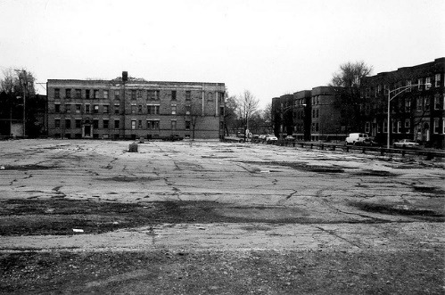
shrinking cities: evidence of need

Slide 7
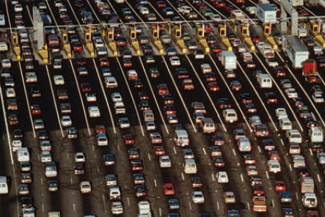
Benefits of increased accessibility
Various scholars claim that increasing accessibility can improve environmental sustainability (Banister, 2008; Bartholomew, 2009; de Sousa Vale, 2007), largely through decreasing vehicle miles traveled (VMT).
Image Source: www.reconnectingamerica.org

Slide 8
Challenges for implementation
Just as shrinking cities demonstrate an especial need for high quality, cost effective transportation solutions, they also provide unique challenges to planning generally, and transportation specifically.
Over-arching challenge: Public mistrust in planning in general
Transit-specific challenge: shrinking cities are, by definition, losing population

Slide 9
Challenge 1: public mistrust
“We have to reverse the effects of Team Four, when you decide to cut off services to a large segment of the City, diminish services, when you decide to not enforce codes—building codes, housing codes—when you decide to not steer businesses too. It’s a tragedy, it’s a crime….It became the policy, the official policy of this city for many administrations since the 1970s, since they started talking about it, since it was revealed to the public. Whether it became law or not is irrelevant. The effects of it took effect, took place. It actually happened. This is no fairy tale. This is something that actually occurred and is occurring to this day” (French 2008).

Slide 10
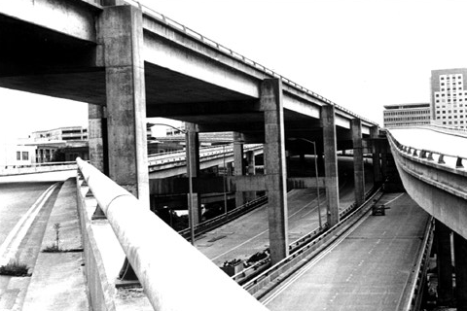
Challenge 1: public mistrust
Success of urban planning projects rely on public buy-in, but the perception of planning in shrinking cities is often a barrier.
  Highway development in the 1950s and 1960s
  Racial tensions in the planning process
Image source: www.roughlydrafted.com

Slide 11
Challenge 2: shrinking cities are….shrinking
Population loss is a defining characteristic of shrinking cities, and public transportation relies on density.
Between 1950 and 2010, the City of St. Louis lost 63% of its population; Detroit lost 61%.
Like the shrinking cities challenges of income and private vehicle use, population decline also especially burdens minority neighborhoods.

Slide 12
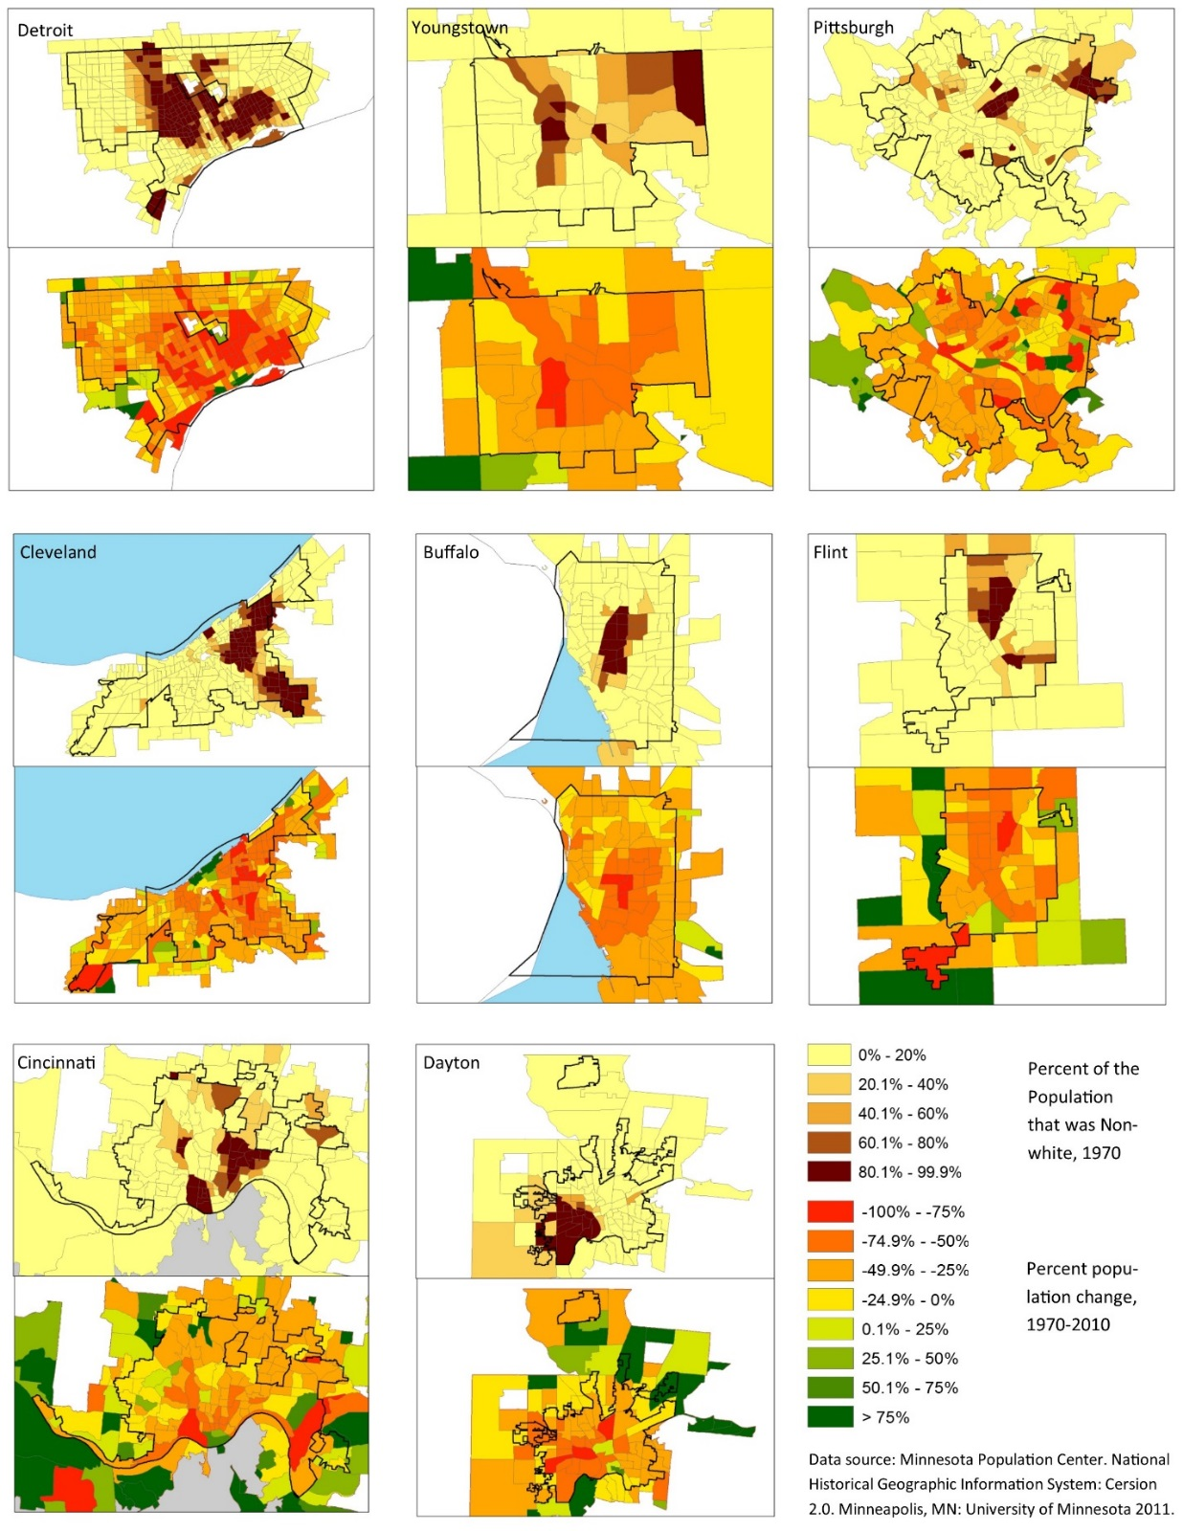
Across the 9 cities identified by Mallach, each 1970 tract lost, on average, 1,259 people between 1970 and 2010.
Collectively, these cities lost on net 1.68 million residents over that period.
These losses occurred disproportionately in minority neighborhoods: the correlation coefficient between percent non-white in 1970 and population change to 2010 is -0.36, significant at the 0.001 level.

Slide 13
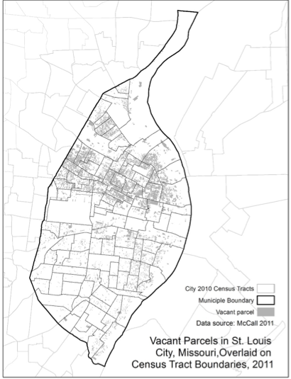
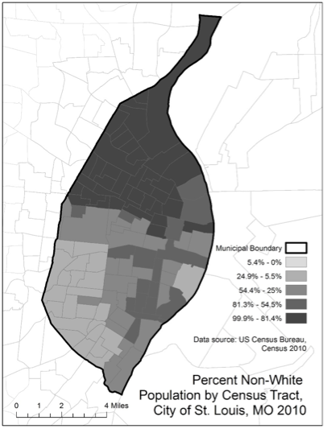
Challenge 2: shrinking cities are….shrinking

Slide 14
Challenge 2: population decline
Accessibility
Mobility
Proximity
Vacancy tangibly reflects a real estate market failing to provide sufficient demand for current levels of supply, or vice versa.
The notion of increasing proximity relies on the assumption of real estate development; shrinking cities exist out of the reality of population decline, especially in minority neighborhoods.
The idea of improving existing neighborhoods assumes a budget capable of servicing those programs, and shrinking cities have a declining tax base.

Slide 15
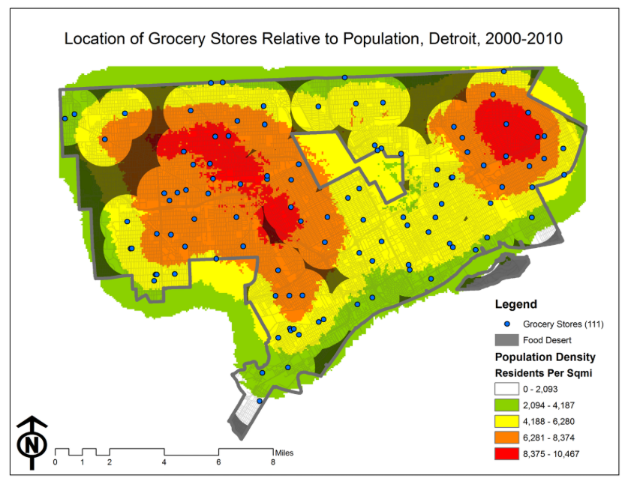
Challenge 2: shrinking cities are….shrinking
Consider, for example, that 500,000 residents in Detroit live with limited or no access to a grocery store, and residents spend over $200 million on grocery expenditures outside their neighborhoods.
Image Source: mapdetroit.blogspot.com

Slide 16
Conclusion: what can be done?
For Practitioners:
Improve walkability by securing, cleaning up, and policing vacant land and buildings, programming sidewalk upgrades, crosswalk improvements, provision of street trees, etc.
Seek ways to engage in equity planning, and improve participatory planning methods
For Researchers:
Completing the computation of accessibility metrics not just for metropolitan regions, but for sub-geographies within them.
Develop better knowledge regarding affordability in inner-city neighborhoods once transportation is accounted for
Improve knowledge about how households cope with costs or find alternative transportation solutions

Slide 17
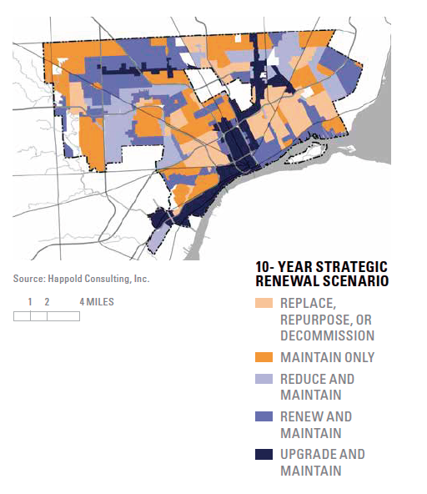
Other actions
Two other contentious programmable areas that could address accessibility in shrinking cities: decommission neighborhoods and support for car ownership programs.
Decommissioning is a proposed action in Detroit’s 10-Year Strategic Renewal Scenario.
Youngstown, OH has a proposed project called the Eastside Decommission Project.

Slide 18
Conclusion
Planning in shrinking cities faces tensions at every turn. Growth is a hegemony in planning; shrinking cities exist in decline. Planning for accessibility presents a special case of this difficulty found in re-tooling planning for decline.
joanna.ganning@utah.edu

