Slide 1
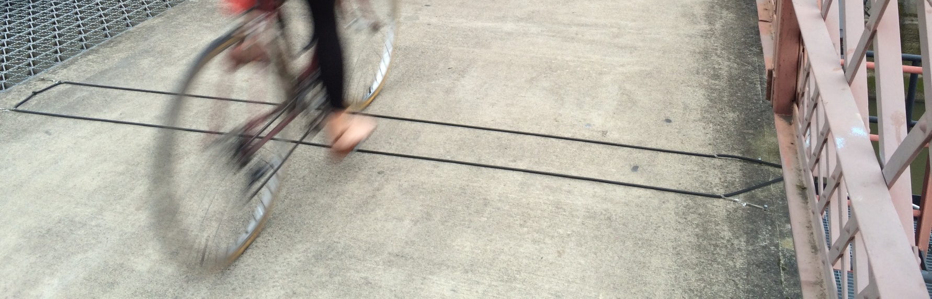


Creating a National Online
Non-motorized Traffic Count Archive:
Process and Progress
Krista Nordback, Ph.D., P.E.,
Kristin Tufte, Ph.D., Morgan Harvey, Nathan McNeil, Jolene Liu
and
Elizabeth Stolz
Notes:
15 minutes for TRB

Slide 2
















Thank you to our partners!
Oregon Community Foundation
Funded by NITC, ODOT, Oregon MPOs, Cities of Boulder and Austin, and FHWA
Bend Metropolitan Planning Organization (Bend, OR), Mid-Willamette Valley Council of Governments (Salem, OR)
Rogue Valley Council of Governments (Medford, OR), Cycle Oregon or Oregon Community Foundation, Eugene

Slide 3
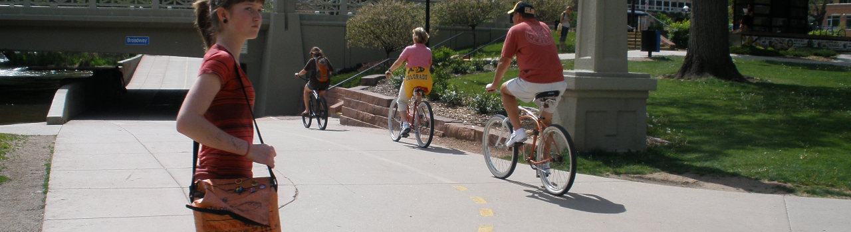
Overview
Motivation
Functional Requirements
Architecture
Schema
Conclusions/Next Steps

Slide 4
Motivation

Slide 5
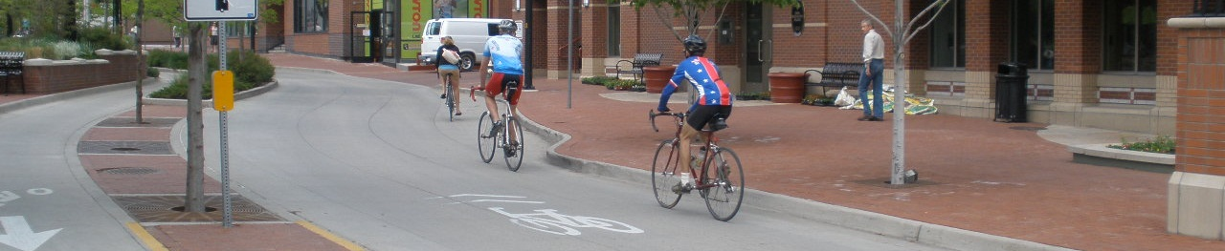
Why aggregate bicycle and pedestrian count data?
Notes:
Performance metrics, safety

Slide 6
Non-motorized Traffic Data
Local Agency
State DOT
Local Agency
Researchers
Local Agency
Local Agency
State DOT
Regional Agency
National
Archive
Source: Nordback

Slide 7
Non-motorized Traffic Data
Local Agency
State DOT
Local Agency
Researchers
Local Agency
Local Agency
State DOT
Regional Agency
National
Archive
Source: Nordback

Slide 8
Local Agency
State DOT
Local Agency
Researchers
Local Agency
Local Agency
State DOT
Regional Data
National Data
Performance Metrics
Aggregated Data
Regional Agency
AADB
National
Archive
Source: Nordback

Slide 9
Non-motorized Traffic Data
Local Agency
State DOT
Local Agency
Researchers
Local Agency
Local Agency
State DOT
Regional Agency
National
Archive
Source: Nordback

Slide 10
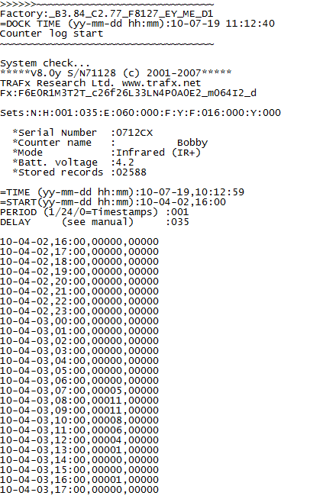
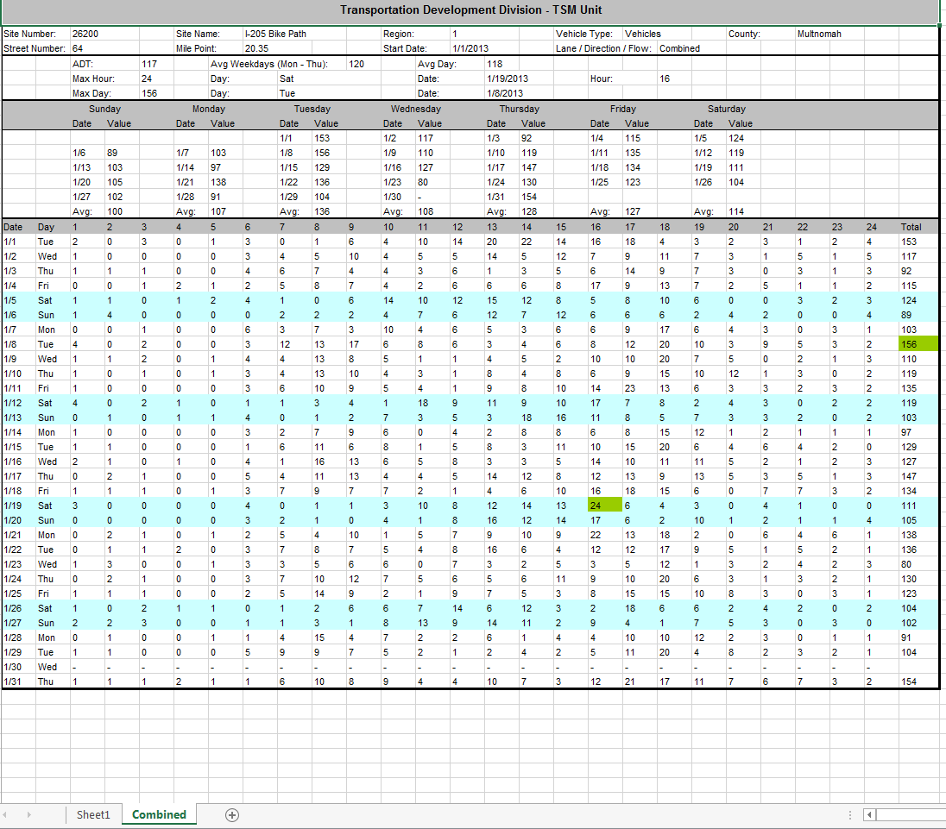
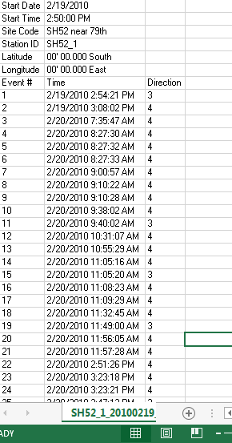
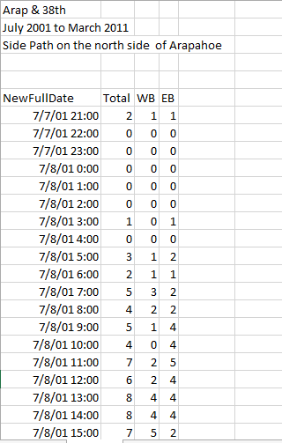
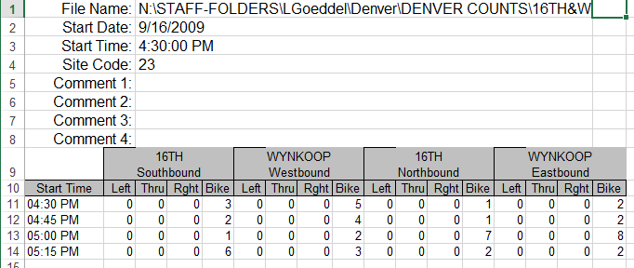
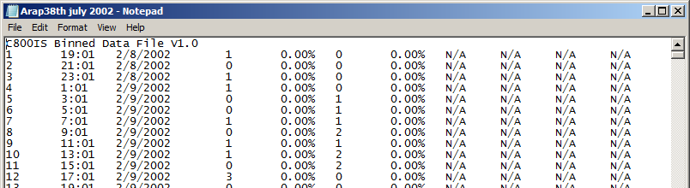
Many Formats
Notes:
More diverse than motorized data

Slide 11
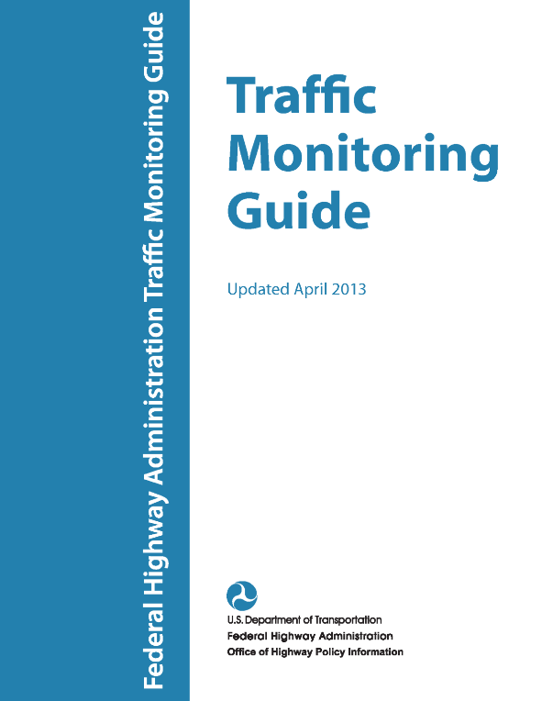
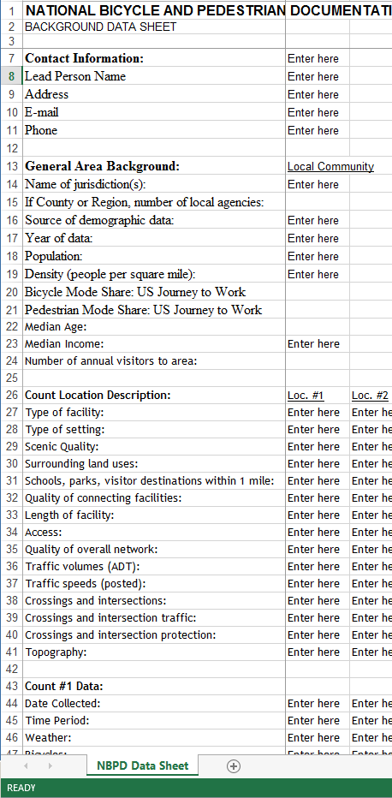
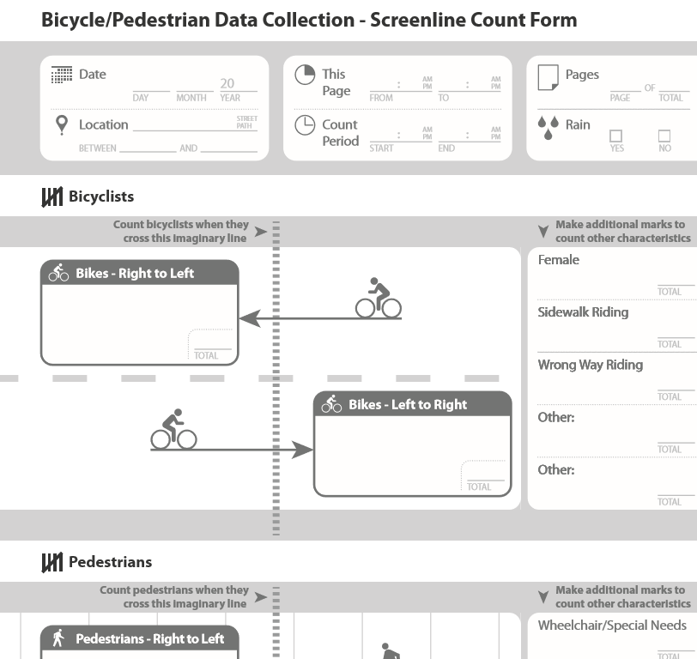
Compatibility
Include TMG format critical fields
Informed by
  National Bicycle and Pedestrian Documentation Project
  UCLA Bike Count Data
  Clearinghouse
Chapter 7
http://www.bikecounts.luskin.ucla.edu/

Slide 12
Functional
Requirements

Slide 13
Bike/Ped Portal
Upload
Storage
Download
Data Checking
(QA/QC)
Data Visualization

Slide 14
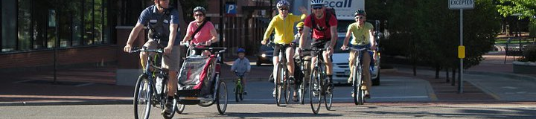
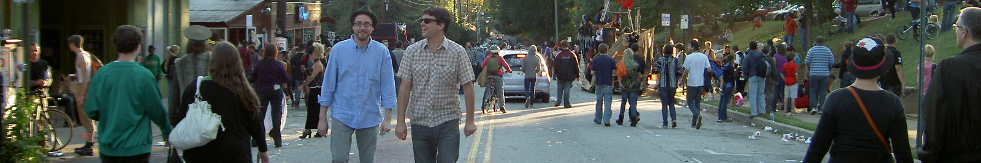
Functional Requirements
Input Tool
QA/QC Tool
Data archive and metadata
Output Tool
Data to include
  Manual and automated
  Road and path segments
  Bicycle and pedestrian counts

Slide 15
Architecture

Slide 16
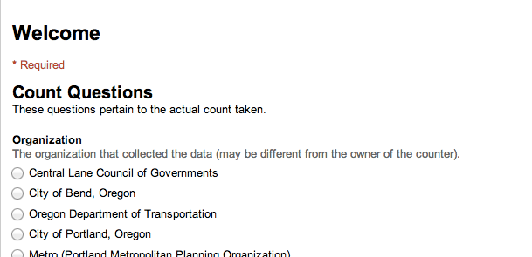
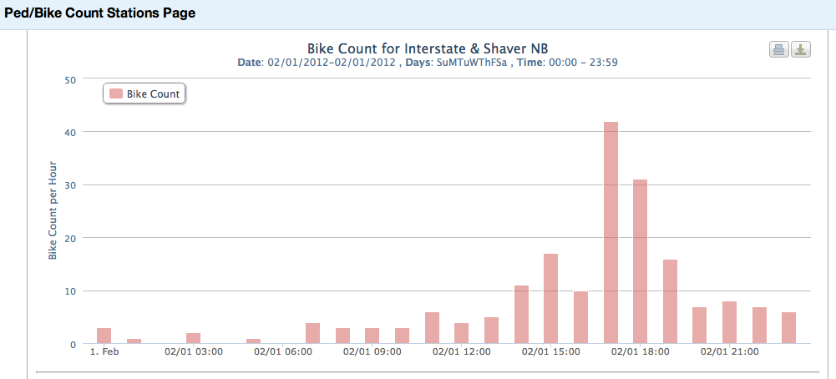
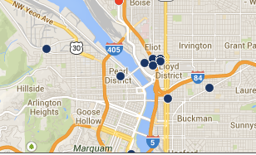
Bike-Ped Portal Web Site
Bike-Ped Portal
System Architecture
Visual Validation Interface
Data Upload Interface
Count Data Sources
Data Uploaded via Web interface
Data
Upload Script
Bike-Ped Portal Database
Meta-data
Semi-automated ftp uploads
Raw
data
Validated
data
Rejected Data
Email with approval link (automated uploads)
Automated QA/QC Checks

Slide 17
Schema

Slide 18
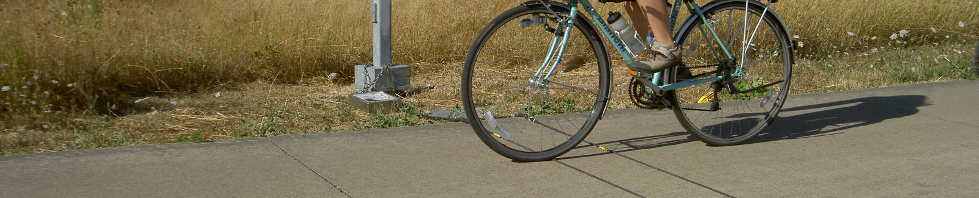
Use Case – Mobile counters
The same detector can be associated with multiple facilities and flows (at different times).

Slide 19
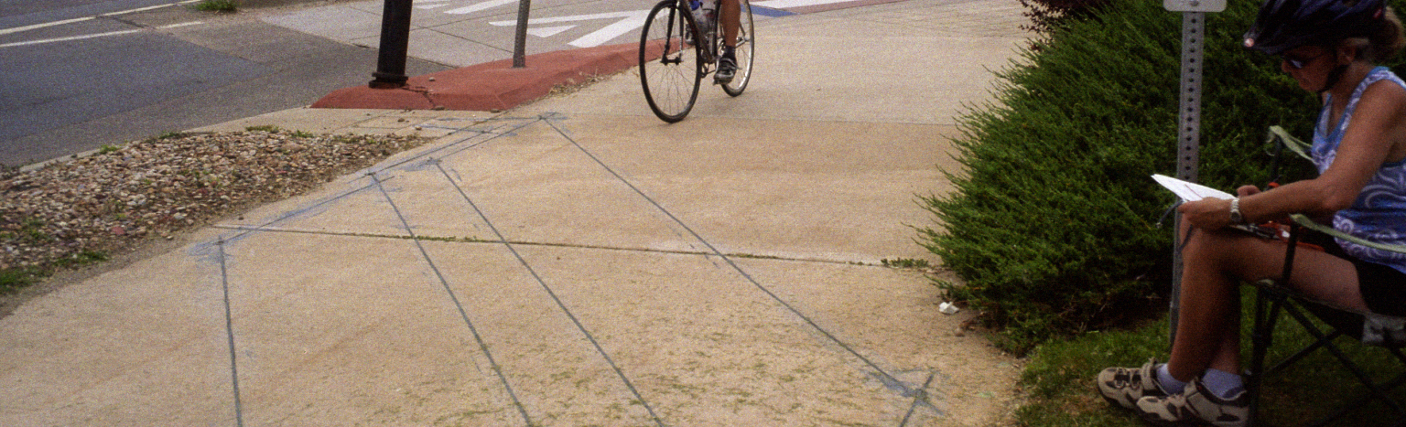
Use Case
Validation Counts – Manual counts checking automated counter
  Multiple counts of the same flow at the same time with different “detectors”
DETECTOR 2
DETECTOR 1

Slide 20
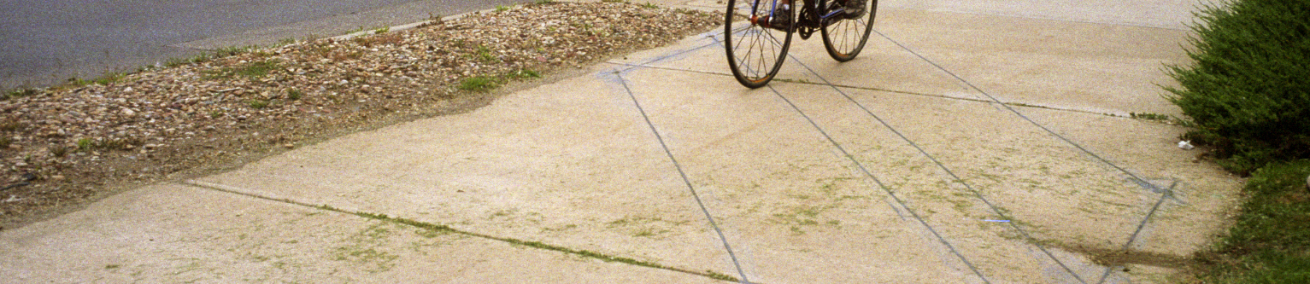
Schema Elements
Segment Area
Facility
Flow
Detector
Count Descriptor
Count Data
Notes:
Mention that we’re working on a TRB paper

Slide 21
Segment Area
A segment area is a stretch of transportation right-of-way over which the volume of non-motorized traffic is not expected to substantially change.
Segment Area
Notes:
Include all transportation-related facilities within the right-of-way, such as sidewalks, motor vehicle lanes, bicycle lanes, and multi-use paths. Do not include traffic at intersections, but driveways can be included if they don’t substantially impact non-motorized traffic volume.

Slide 22
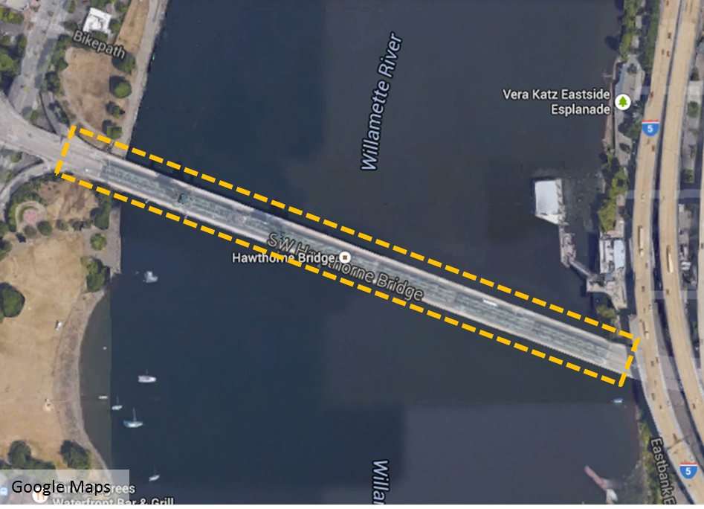
Example Segment Area
Notes:
For the Hawthorne Bridge, the segment area would be the area between the entrances and exits on either side of the bridge. A segment area is composed of all the facilities (e.g. traffic lanes, bike lanes, sidewalks, etc.) within the right-of-way along a defined stretch of road or path. In a more typical city block, the segment area might extend the length of a block, but would not include the intersections (where traffic might enter or exit the segment area)

Slide 23
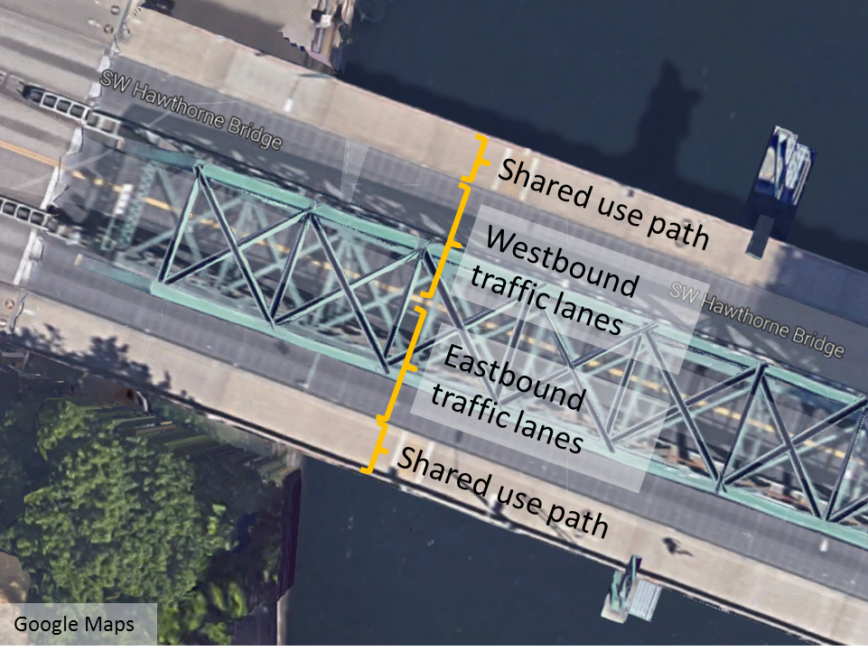
Example Facility

Slide 24
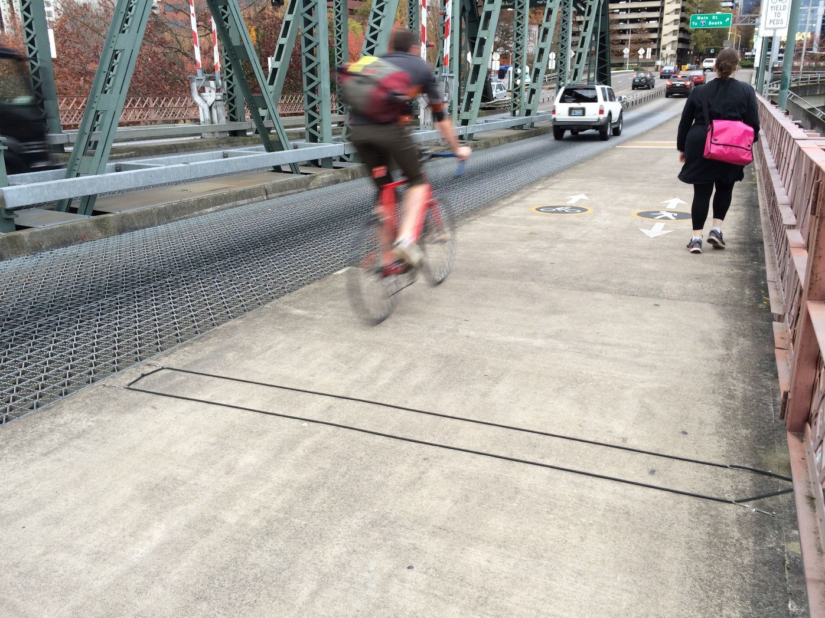
Example Flow
Unmeasured Flow:
East- and westbound Pedestrians
Measured Flow:
Westbound Bicyclists

Slide 25
Example Detector
Detector

Slide 26
Schema
Seg-ment Area
Facilities
Flows
Detectors
Count Descriptor
Count Data
CD Id
Start Time
Measure Period
Volume

Slide 27
Conclusions

Slide 28
Conclusions
Data sharing makes the most of the data we have
Bicycle and pedestrian count data are complex
Designed for compatibility
Connecting a “Detector” with a “Flow” via a table adds versatility to the schema
  Allows archive to handle mobile counters
  Allows multiple counts of the same flow/time (as for validation counts)
Minimizing data in count data table
  Saves memory
  Improves performance/efficiency

Slide 29
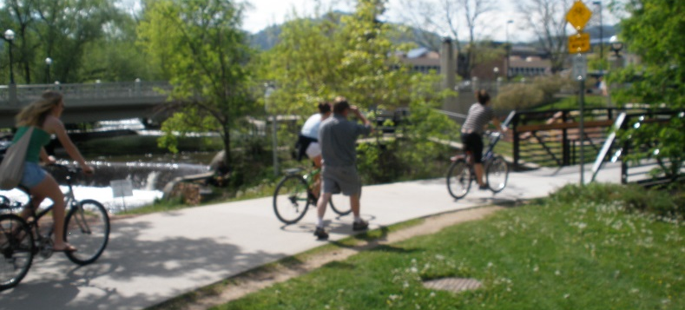
Next Steps in Phase I
User data input interface
Automated upload
User data output interface
Basic QA/QC

Slide 30
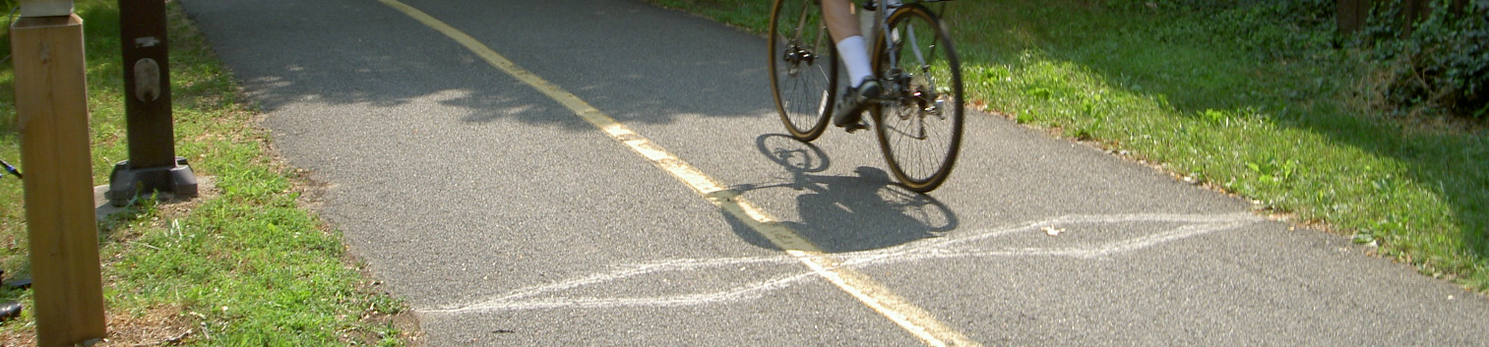
Phase II and beyond
Future Phases (unfunded)
  Enhanced QA/QC
  Analysis tools
    Summary Statistics
    AADT from short duration counts
    Integrating with weather data

Slide 31
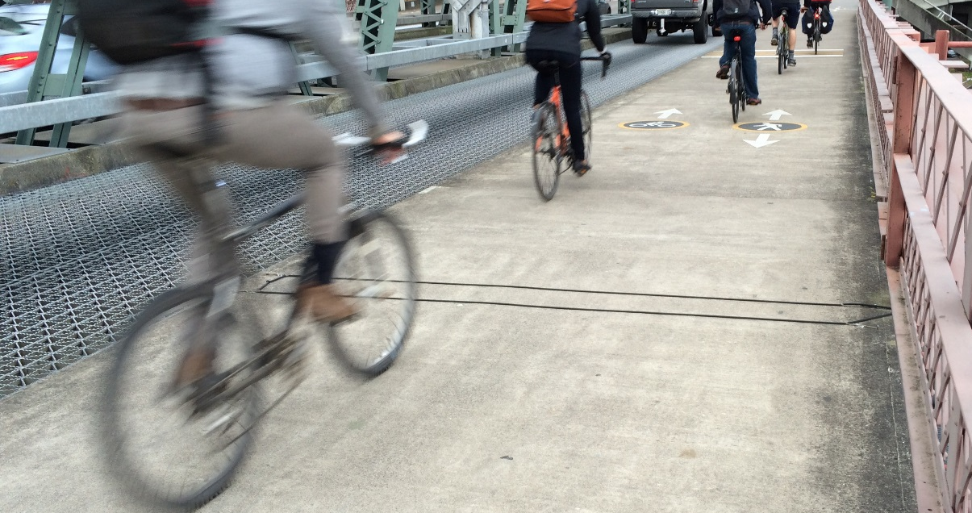
Questions?
Krista Nordback
Nordback@pdx.edu
503-725-2897

Slide 32
EXTRA SLIDES

Slide 33
Schema
Seg-ment Areas Name, State, County, TMG direction, Functional class, Region, Speed limit, National highway?, Route & number, Observed land use, Start/end date
Facilities
Description
Side
Type
Paved?
Width
For bike lanes and cycletracks:
  Color
  Placement of color
  Buffer
Flows
Directions
Mode
Pedestrian
Bicycle
Equestrian
Off-road Vehicles
Motor Vehicle
Other
Detectors
Short Name
Description
Organization
Jurisdiction
Automated?
Make/Model/Serial#
Count Descriptors
Detector ID, Flow ID, Start/end dates, Location (latitude/longitude)
Data
CD Id
Start Time
Measure Period
Volume

Slide 34
Types of Data Warehouses
 | PUBLICLY AVAILABLE | ACCESS RESTRICTED
PUBLIC AGENCY/ Non-profit | > 10 agencies | 2 or more agencies
pRIVATE fIRM | 2 or more | 2 or more companies
Publicly owned
Publicly Available

Slide 35
Public Archive Examples
Agency | Data Types |  | Map? | Graph? | Allows Data Download | Other
 | Duration | Automated?
Delaware Valley Regional Planning Commission | One week |  |  |  |  | Weather
Arlington, Virginia | Permanent |  |  |  |  | Weather
Portal | Permanent
Lane Council of Governments | >24 hr |  |  |  |  | Weather, photos
LA Metro | 2 hour |  |  |  |  | Allows data input
Seattle, WA | Permanent |  |  |  |  | Weather
Only one allows data input.
None facilitate online data input for automated counts.

Slide 36
Detectors
Flows
Facilities
Segment Area

Slide 37

AMI and WWI
AMI = $\frac{\sum_{h=7}^{8}{v_{h}}}{\sum_{h=11}^{12}{v_{h}}}$
where:
AMI = Average Morning/Midday Index
v_{h} = Average weekday hourly count for hour (h) where hours are given as starting time of
the hour
WWI = V_{we}/V_{wd}
where:
WWI = Weekend/Weekday Index
V_{we}=average weekend daily traffic
V_{wd}=average weekday daily traffic
Miranda-Moreno, L. F., Nosal, T., Schneider, R. J., & Proulx, F. (2013). Classification of bicycle traffic patterns in five North American Cities. Paper presented at the Annual Meeting of the Transportation Research Board, Washington, DC.

Slide 38
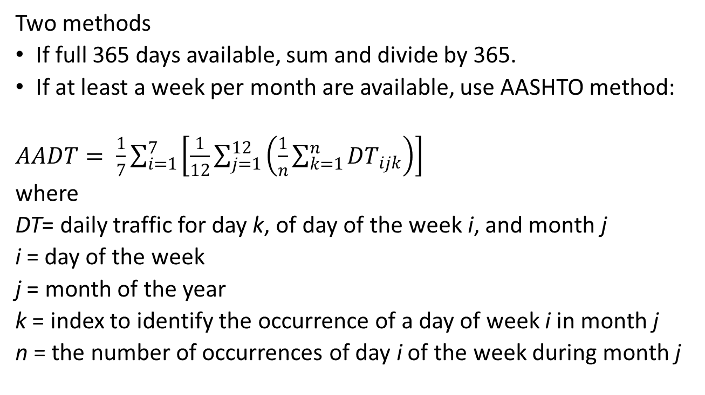
AADT Computation
Two methods
If full 365 days available, sum and divide by 365.
If at least a week per month are available, use AASHTO method:
$AADT= \frac{1}{7}\sum_{i=1}^{7}{\left[\frac{1}{12}\sum_{j=1}^{12}{\left(\frac{1}{n}\sum_{k=1}^{n}{{DT}_{ijk}}\right)}\right]}$
where
DT= daily traffic for day k, of day of the week i, and month j
i = day of the week
j = month of the year
k = index to identify the occurrence of a day of week i in month j
n = the number of occurrences of day i of the week during month j
AASHTO. (1992). Guidelines for Traffic Data Programs (pp. 114). Washington, D.C.: Joint Task Force on Traffic Monitoring Standards of the AASHTO Highway Subcommittee on Traffic Engineering.

