Slide 1
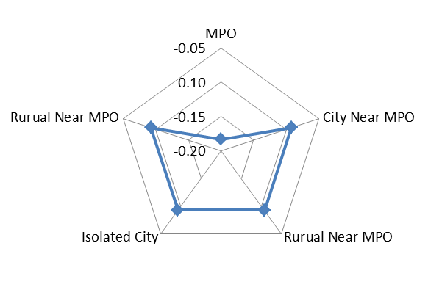
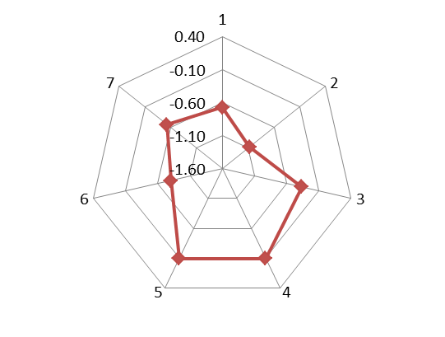
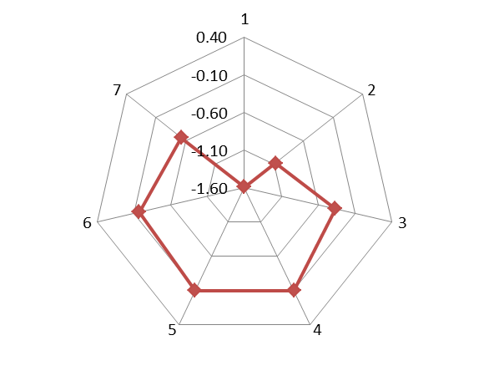
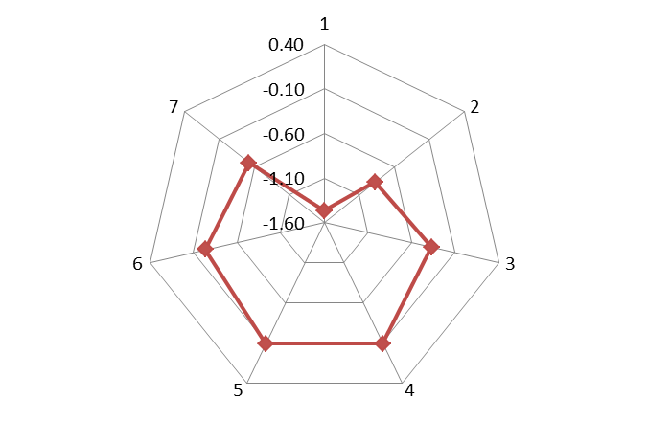
Investigating Household Bicycle Ownership Levels: A Tale of Two Market Segments
Roger B. Chen, PhD, Yunemi Jang
Maseeh College of Engineering &Computer Science:
Civil &Environmental Engineering
Abstract
Bike Ownership Levels
Estimation Results
Life-Cycle Class and Residential Density Interaction
This study investigates two market segments for bicycle ownership, based on household bicycle ownership count observations from the Oregon Household Travel Survey (OHAS). We address the problem of analyzing latent market segments based on bicycle ownership counts and household attributes typically found in conventional surveys. To investigate their relationship, a two-regime or latent class Poisson model was estimated for bicycle ownership levels, using household attributes to explain both the ownership levels and the latent class memberships. The results showed that the two regimes represented two distinct market segments comprised of (i) households that own bicycles and (ii) those that have selected out of bicycle ownership. The second segment was particularly important since they were unlikely influenced by improved bicycle infrastructure investments. The decision on the number of bikes to own, conditional on deciding to own a bicycle, was influenced more by lifecycle characteristics of households relative to the decision to own a bicycle. Interestingly the results showed contrast in the impacts of specific variables on both the decision to adopt bicycles, and the latter decision on number of bicycles to own. Some factors that positively affected the likelihood of owning bicycles had opposite effects on conditional decision of the number of bicycles to own.
Variable | Model
 | Coefficient | z-statistic
Poisson Count Model
Constant | -0.092 | -1.59
Household Size | 0.096 | 9.15
Number of Telecommuters | 0.060 | 3.84
Detached Single-Family Housing | 0.414 | 13.27
Attached Single-Family Home | 0.313 | 5.67
Number of Students per Household | 0.145 | 12.15
Vehicles per Licensed Driver | 0.135 | 8.42
Household Has Zero Vehicles | 0.293 | 4.55
Household participates in Car-Share | 0.260 | 6.03
Number of Retired Vehicles | --- | ---
Lifecycle Class 1, Single Adults <=65 (0/1) | -0.581 | -1.69
Lifecycle Class 2 Single Adult, <65, >=18 (0/1) | -0.980 | -23.55
Lifecycle Class 3 Non-Related (0/1) | -0.276 | -5.03
Lifecycle Class 4 Single Parent w/Child (0/1) | --- | ---
Lifecycle Class 5 Parents w/Child (0/1) | --- | ---
Class 6 Related Adults, no Child >=65 (0/1) | -0.707 | -6.19
Class 7 Related Adults, no Child <65 (0/1) | -0.436 | -8.59
MPO (0/1) | -0.091 | -2.80
Isolated City (0/1) | --- | ---
Lifecycle Class - Residential Density Interaction Terms
Lifecycle Class 1 - MPO (0/1) | -0.916 | -2.63
Lifecycle Class 6 - MPO (0/1) | 0.632 | 5.53
Lifecycle Class 1 - Rural Near MPO (0/1) | -0.794 | -1.93
Lifecycle Class 2 - Rural Near MPO (0/1) | 0.199 | 1.95
Lifecycle Class 6 - Rural Near MPO (0/1) | 0.559 | 3.92
Probit Choice Model (Zero-Inflated Component)
Constant | 0.092 | 1.07
Number of Telecommuters | -0.202 | -5.29
Detached Single-Family Housing | -0.289 | -5.65
Number of Students per Household | -0.159 | -8.49
Household Has Zero Vehicles | 0.620 | 7.00
Household participates in Car-Share | -0.888 | -6.13
Number of Retired Vehicles | -0.229 | -2.94
Lifecycle Class 2 (0/1) | -2.245 | -3.01
Lifecycle Class 7 (0/1) | 0.449 | 7.71
MPO (0/1) | -0.154 | -2.21
Lifecycle Class - Residential Density Interaction Terms
Lifecycle Class 1 - City near MPO (0/1) | 0.837 | 2.43
Lifecycle Class 3 - MPO (0/1) | -0.355 | -3.06
Lifecycle Class 4 - MPO (0/1) | -0.334 | -3.96
Lifecycle Class 5 - MPO (0/1) | -0.308 | -5.91
Lifecycle Class 2 - Rural Near MPO (0/1) | 1.747 | 2.17
Lifecycle Class 5 - Rural Near MPO (0/1) | 0.229 | 2.10
Lifecycle Class 6 - Rural Near MPO (0/1) | 0.707 | 6.83
Lifecycle Class 5 - Isolated City (0/1) | -0.883 | -1.59
Number of Households | 16021
Log-Likelihood at Convergence | -20987.10
Log-Likelihood (0) | -26776.59
Vuong Test | 19.04
<Residential density class>
<Lifecycle for city near MPO
/isolated city/rural>
<Lifecycle for MPO>
<Lifecycle for rural near MPO>
Conclusion
Modeling Framework
The results show that the two regimes represent two distinct market segments comprised of (i) households that are owning bicycles and (ii) those that have selected out of bicycle ownership. Interestingly, two latent household market segments for bicycle ownership were likely opposite to the association of variables with bicycle ownership, however the coefficients for some variables showed same in both distinct market segments. Here are summary of key findings.
Positive association in a count model
: household size, num. of students, num. of telecommuters, detached single-family housing
, attached single-family home, vehicles per licensed driver, household having zero vehicles
, household participates in car-share, related adults (> 64 yrs) with no children & MPO, single adult (<65 years and >17 yrs) & rural near MPO, related adults (>64 yrs) with no children & rural near MPO
Negative association in a count model
: single adults (>66 yrs), single adult (<65 yrs and >17 yrs), non-related households, related adults (>64 yrs) with no children, related adults (<65 years) with no children, MPO, single adults (>64 yrs) &MPO, single adults >64 yrs & rural near MPO
Positive association in both a count model and a choice model
: household has zero vehicles, single adult (<65 yrs and >17 yrs) & rural near MPO, related adults (>64 yrs) with no children & rural near MPO
Negative association in both a count model and a choice model
: single adult (<65 yrs and >17 yrs), MPO
A two-regime or latent class Poisson model is estimated for bicycle ownership levels, using households attributes to explain both the ownership levels and the latent class memberships. The two regime model to account for zero mass observations consists of three parts.
(i) Latent class model choice : The first part describes decisions to participate in the zero regime though a latent construct. A household will likely belong to the bike ownership regime, given that the household’s scaled latent propensity exceeds zero.
where Φ(.) : the standardized cumulative normal distribution.
(ii) Poisson count model: The number of bicycles owned by a household i is assumed to be generated by a Poisson distribution.
(iii) Joint density function
93rd Annual TRB Meeting, January 12-16, 2014

